Slide 1
Member Quick Guide:
How to Create a Customized Survey

Slide 2
Member: Quick Guide, from scratch survey
Quick Steps :
Step 1: Enter login Credentials https://rba.ifuli.cn/login/index.html. Select ‘Get Started’
Step 2: Click ‘Create Survey’ in Customized Survey page
Step 3: Fill in survey title and click ‘OK’
Step 4: Create survey by dragging question type to box.
Step 5: Click ‘Publish’ to deploy to factories
Step 6: Under section “Customized Survey” - double click survey title previously created
Step 7: Click ‘Add factory’
Step 8: Choose time period you wish to deploy survey and click ‘Next’
Step 9: Select the factories will deployed and click ‘Next’
Step 10: Confirm the information and then select ‘Complete’
Step 11: Reports and Progress: To view the data select ”Overview” for aggregated view; or “Results” to view an individual factory. Export Data to excel.

Slide 3
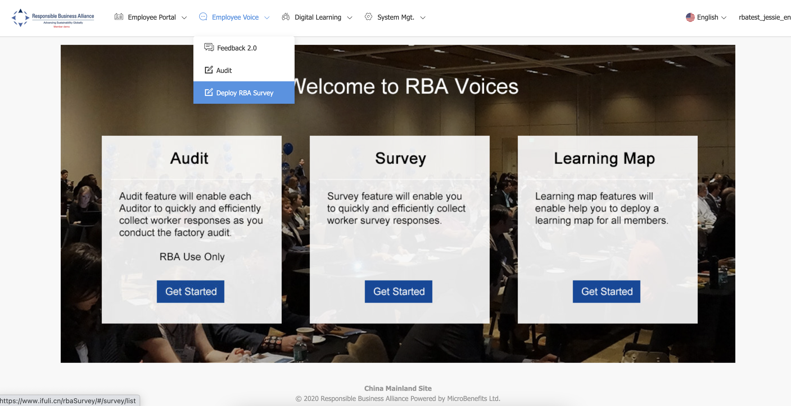
Step 1: Enter login credentials; select ‘Get Started’ to deploy custom and RBA designed surveys.

Slide 4
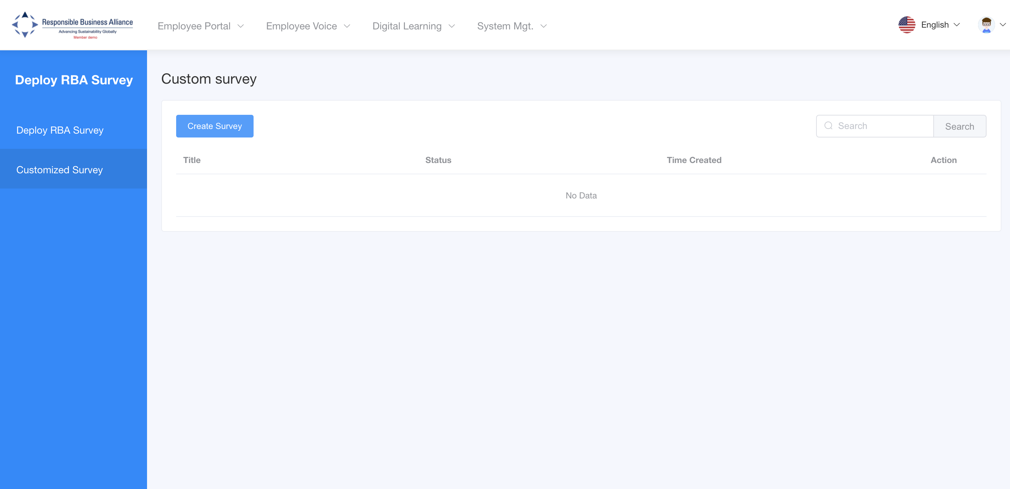
Step 2: Click ‘Create Survey’ in customized survey
(Note: Section “Deploy RBA Survey” is to deploy RBA developed surveys)

Slide 5
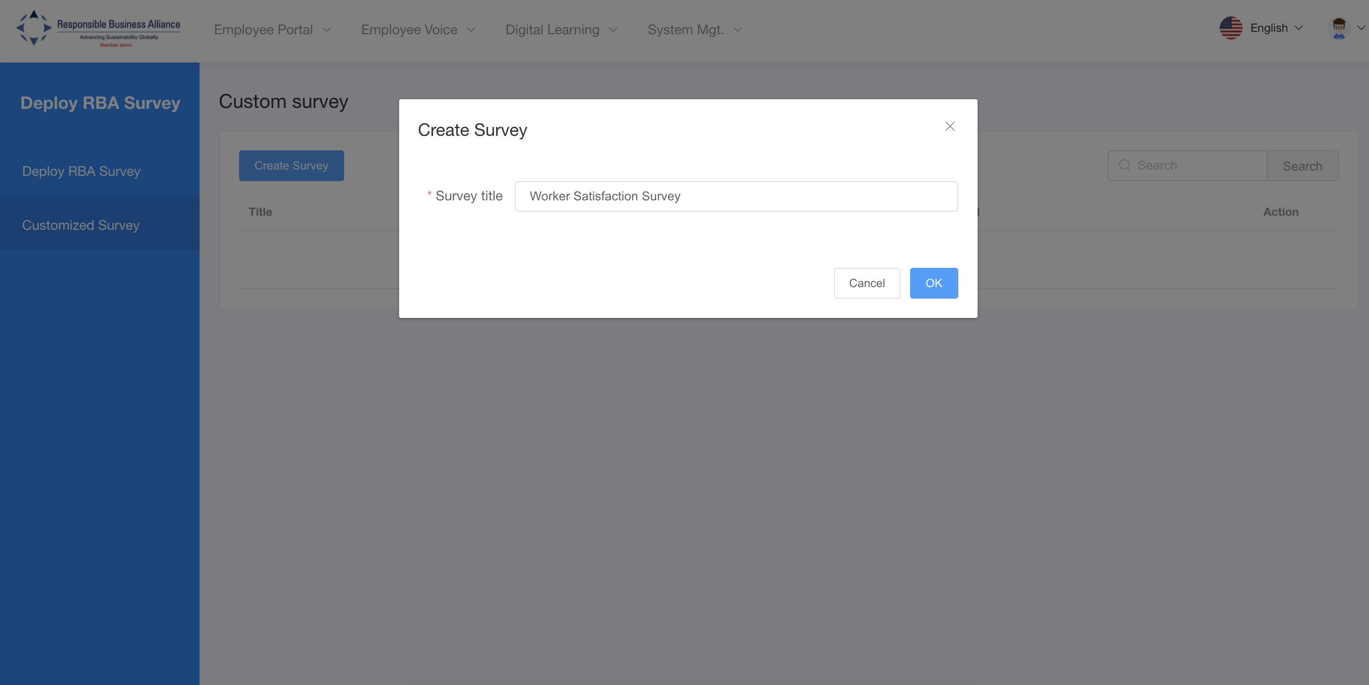
Step 3: Fill in survey title and click ‘OK’

Slide 6
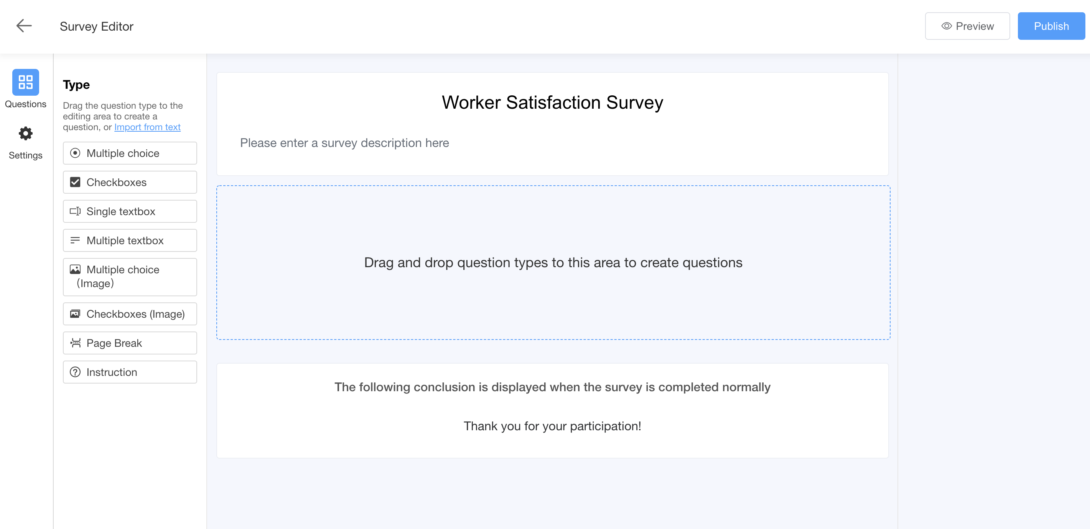
Step 4: Create survey by dragging question type.

Slide 7
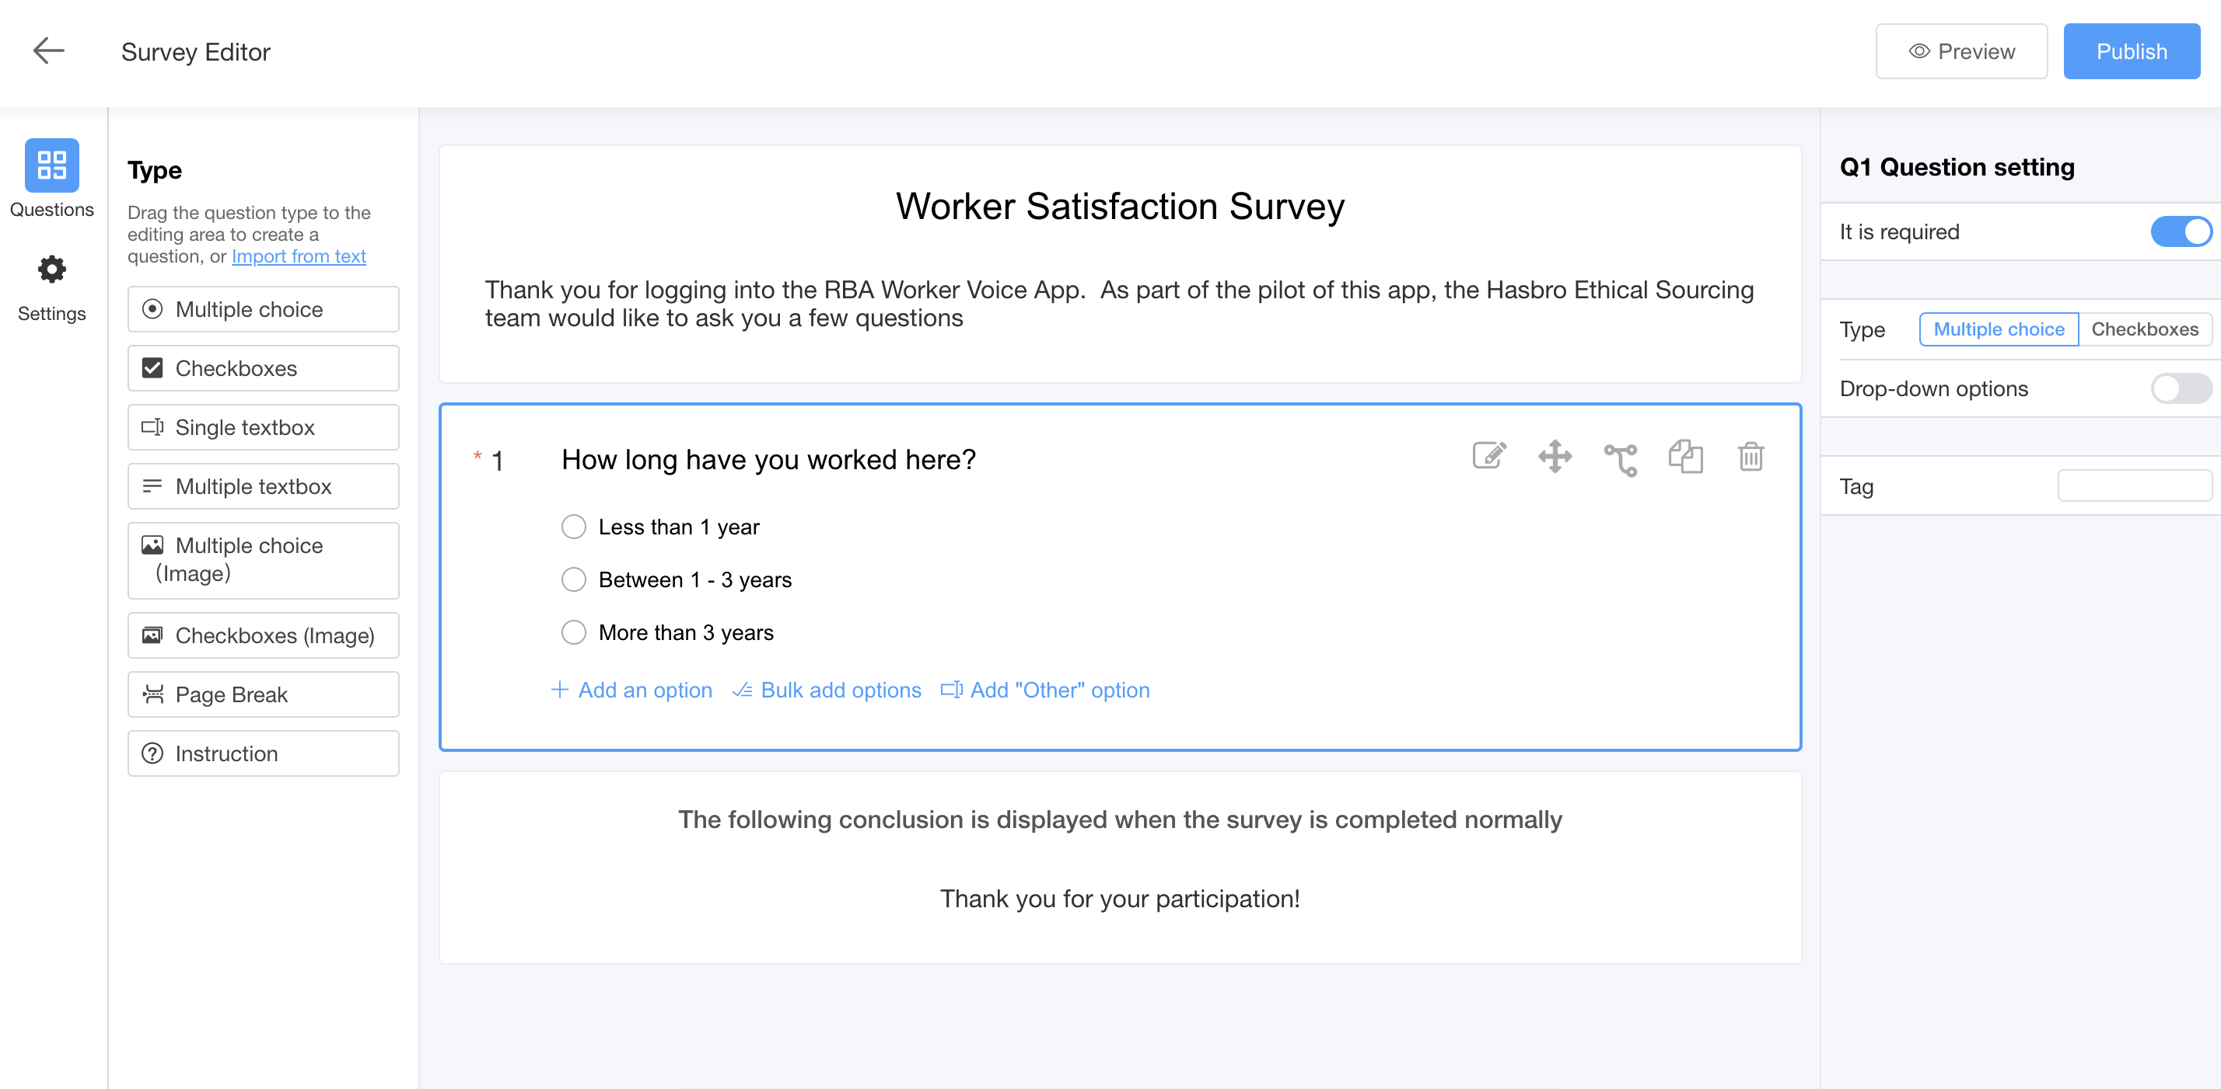
Step 5: When finished creating survey, select ‘Publish’
Note: Once you select publish, you are now ready to deploy the survey.

Slide 8
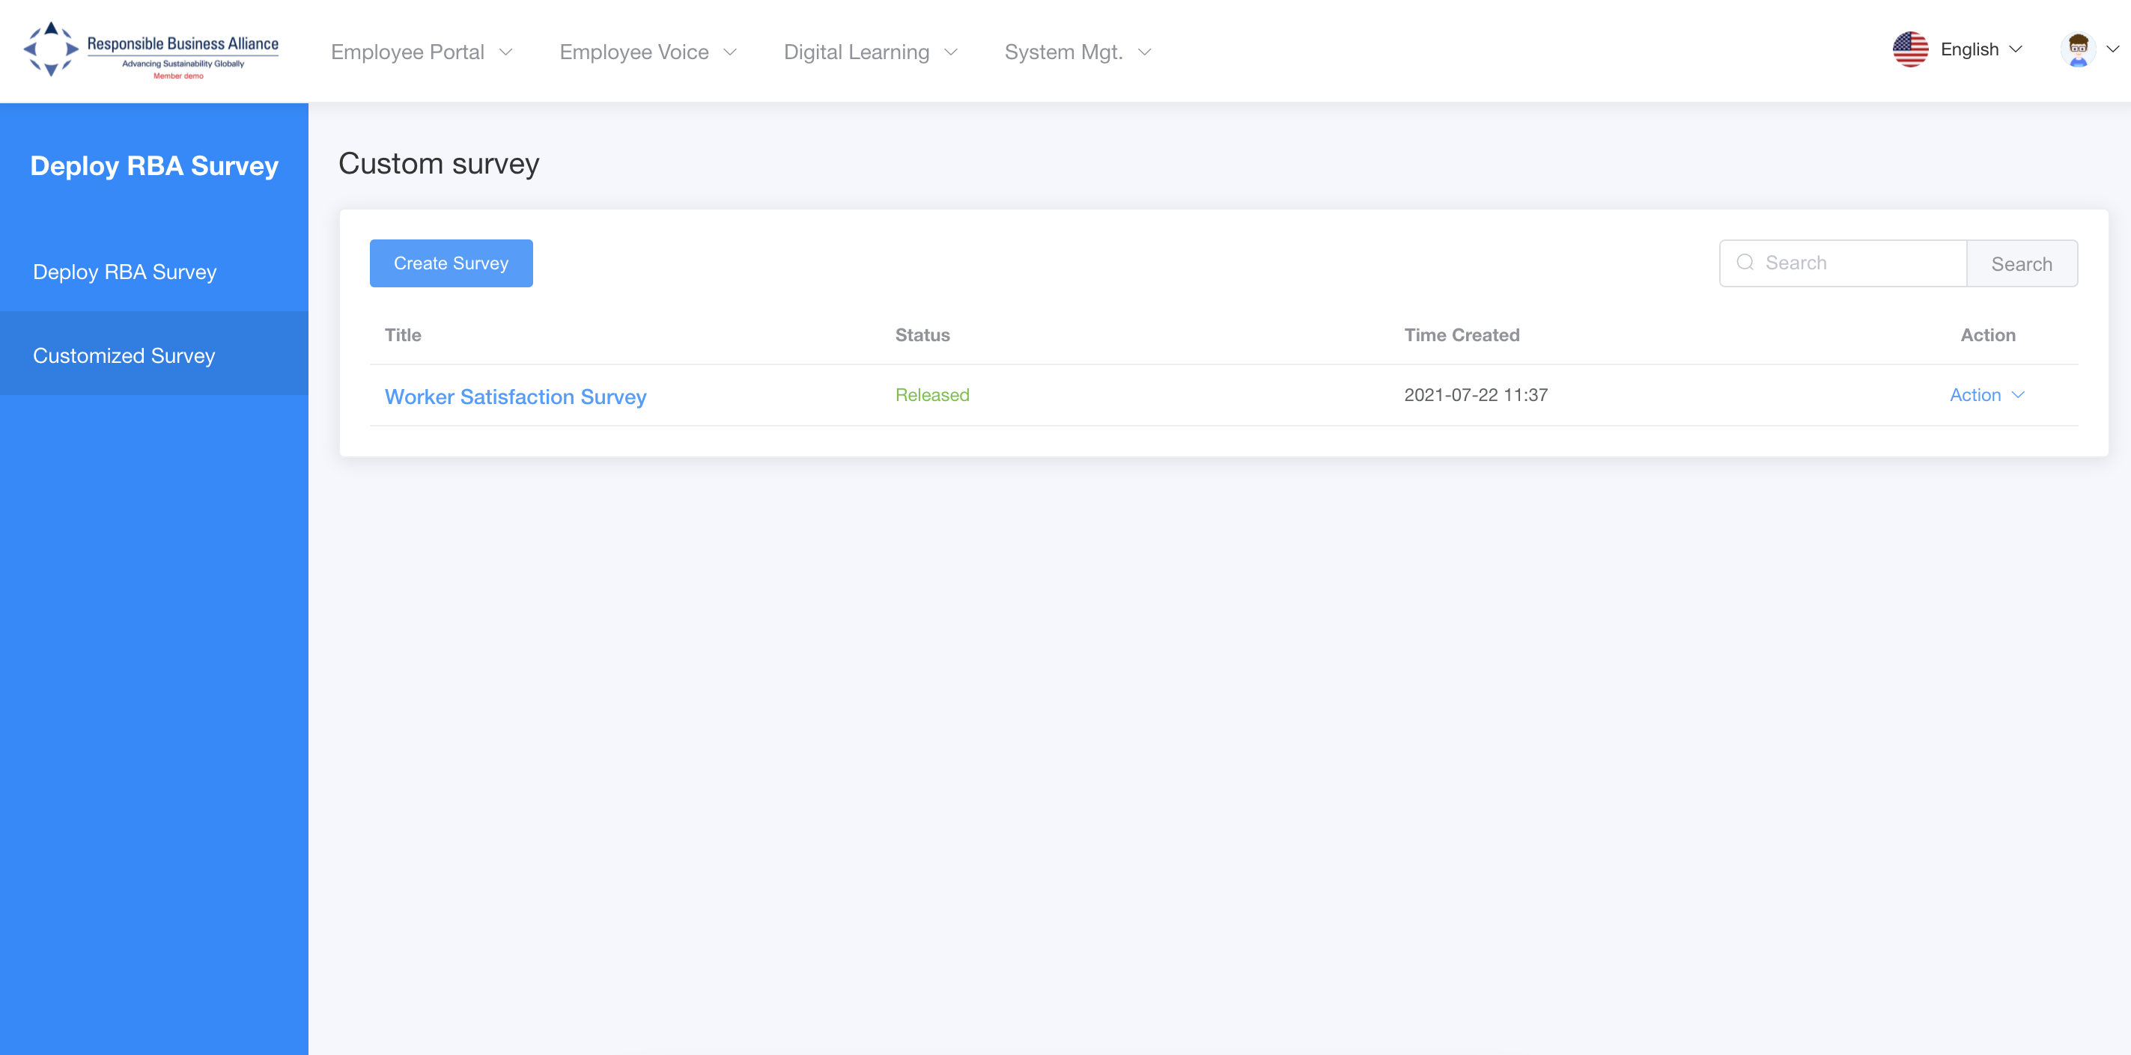
Step 6: Under section ‘Customized Survey’ –
Double click survey title previously created

Slide 9
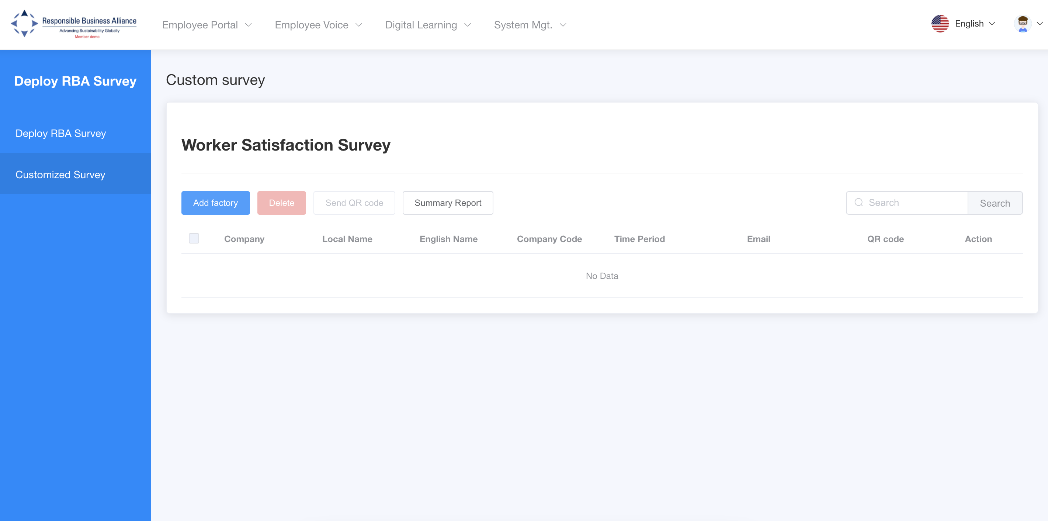
Step 7: Click ‘Add factory’

Slide 10
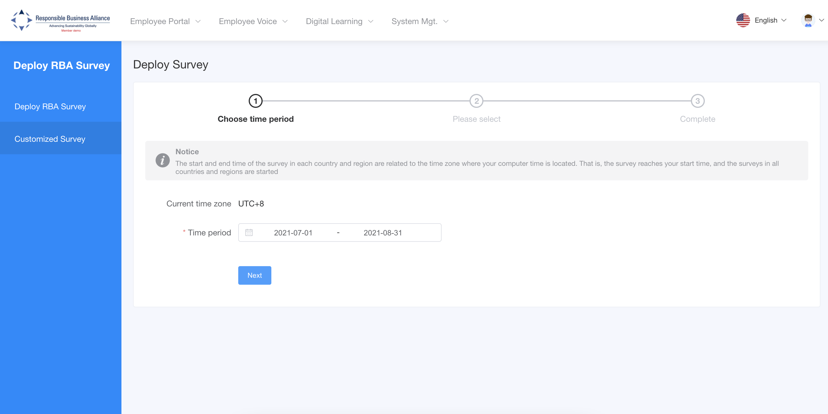
Step 8: Choose time period to deploy and click ‘Next’

Slide 11
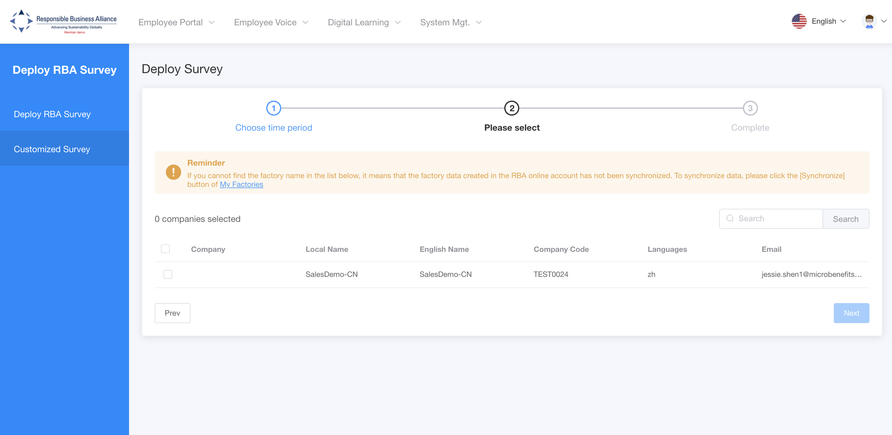
Step 9: Select the factories to be deployed and click ‘Next’

Slide 12
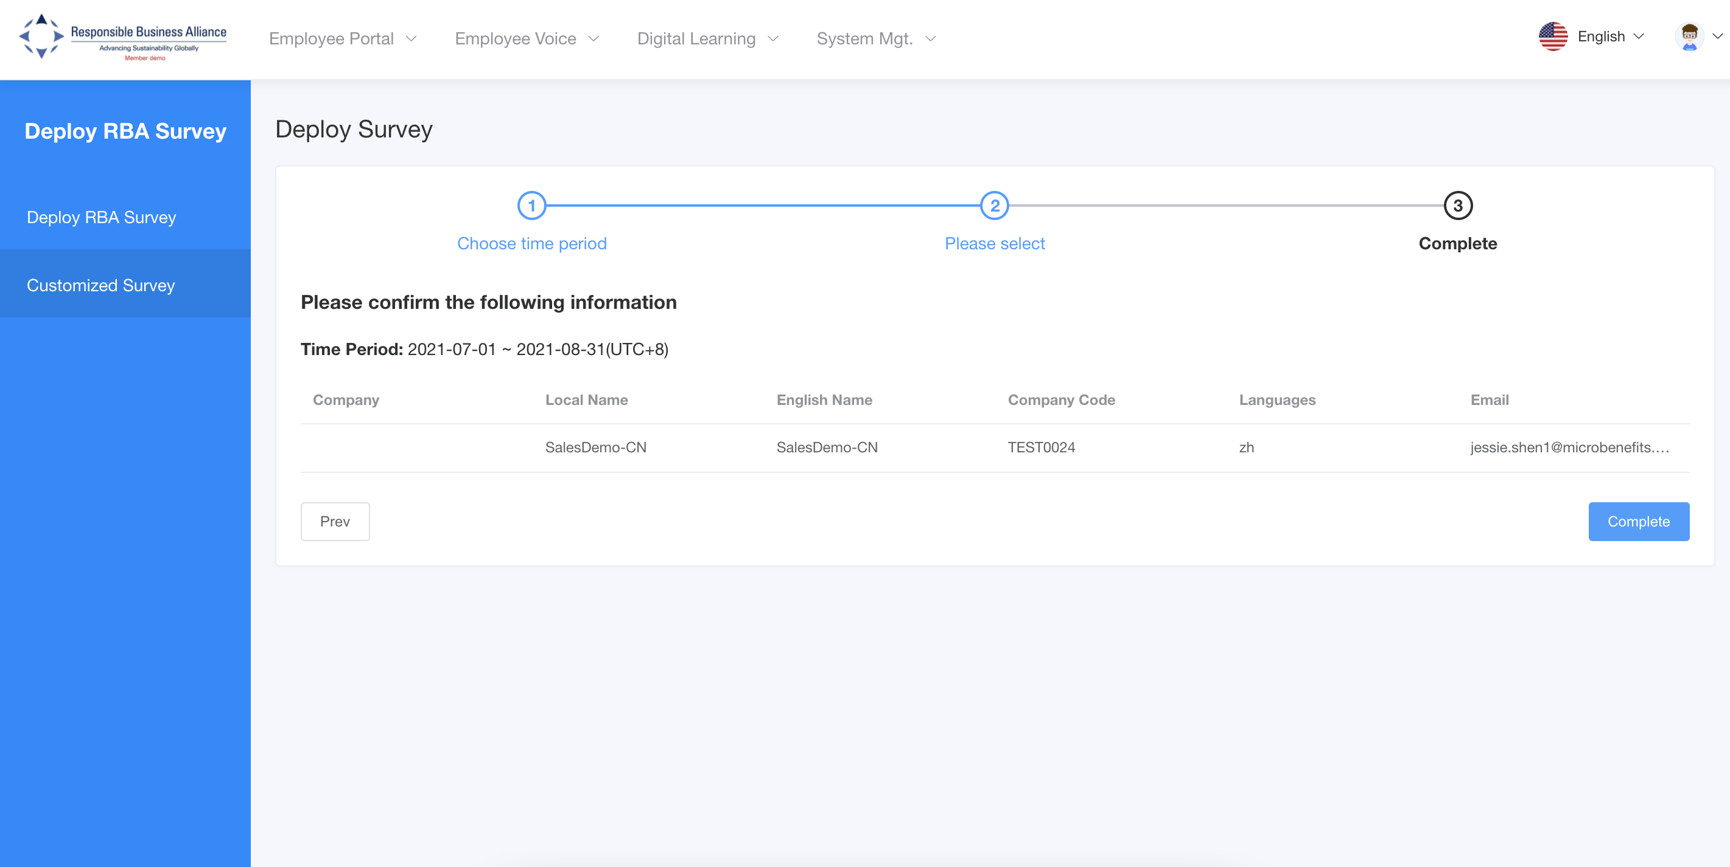
Step 10: Confirm the factory information, and then select ‘Complete’.

Slide 13
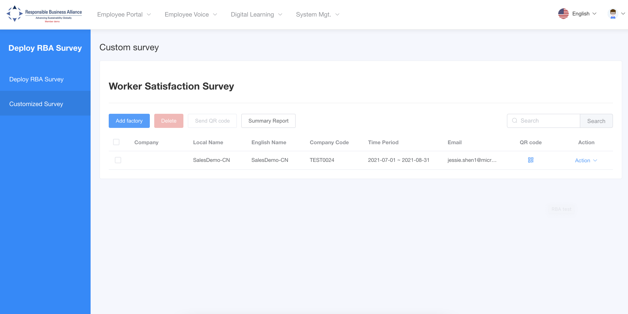
Note: Once deployed, you can find the factory QR and status of those you have deployed.

Slide 14
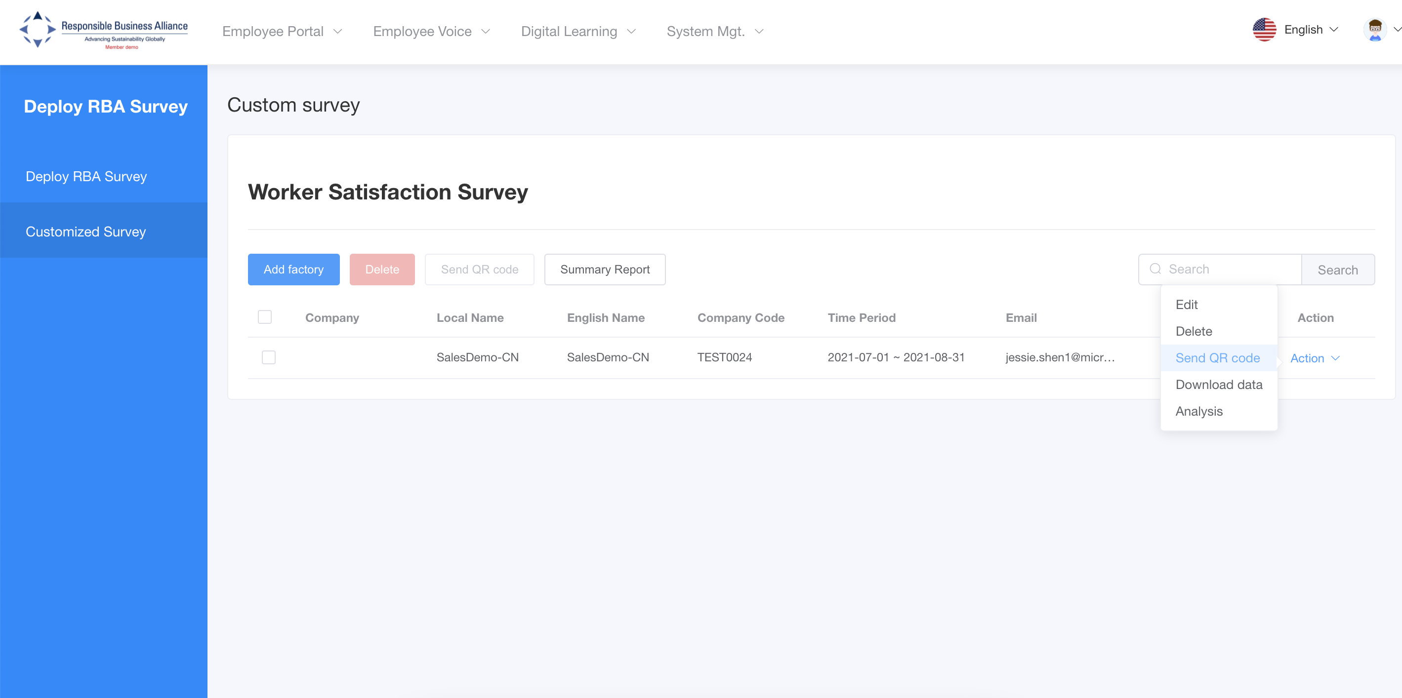
Step 11: Reports and Progress: Check data report for this survey by selecting ”Summary Report”

Slide 15
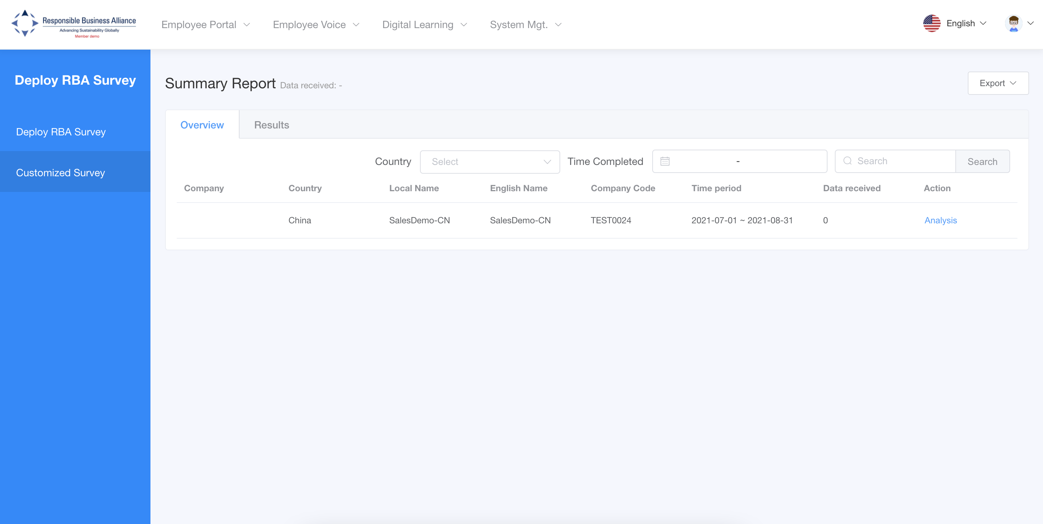
Overview - provides member aggregated view
Results - provides an individual factory view
Filters – segment results into via country and time.

Slide 16
Member: Quick Guide, from copied survey
Quick Steps :
Step 1: Enter login Credentials https://rba.ifuli.cn/login/index.html. Select ‘Get Started’
Step 2: Click ‘Create Survey’ in Customized Survey page
Step 3: Find the survey you want to copy or modify and click “Action” on the right, then “Copy”
Step 4: Once the newly copied Survey is onscreen, modify the title.
Step 5: Make all the modifications for the new survey. The system automatically saves changes
Step 6: Click the Survey Editor option at the top left-hand side to get out of editing mode
Step 7: Under section “Customized Survey” - double click survey title newly created
Step 8: Click ‘Add factory’
Step 9: Choose time period you wish to deploy survey and click ‘Next’
Step 10: Select the factories will deployed and click ‘Next’
Step 11: Confirm the information and then select ‘Complete’
Step 12: Reports and Progress: To view the data select ”Overview” for aggregated view; or “Results” to view an individual factory. Export Data to excel.

Slide 17
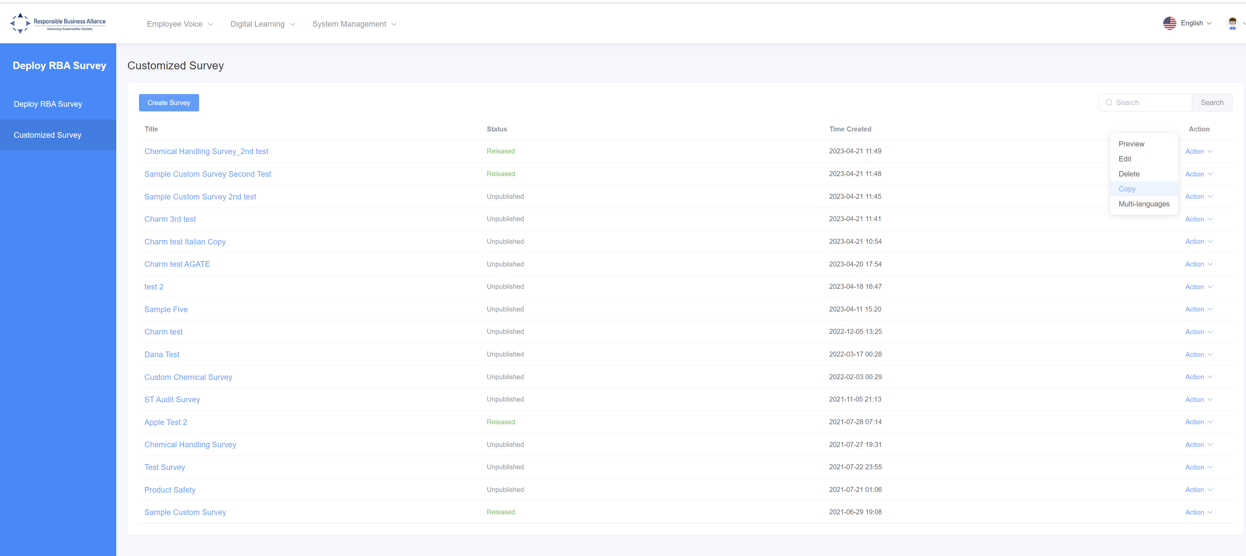
Steps for modifying copied surveys
Step 1: click Action, then copy the chosen survey

Slide 18
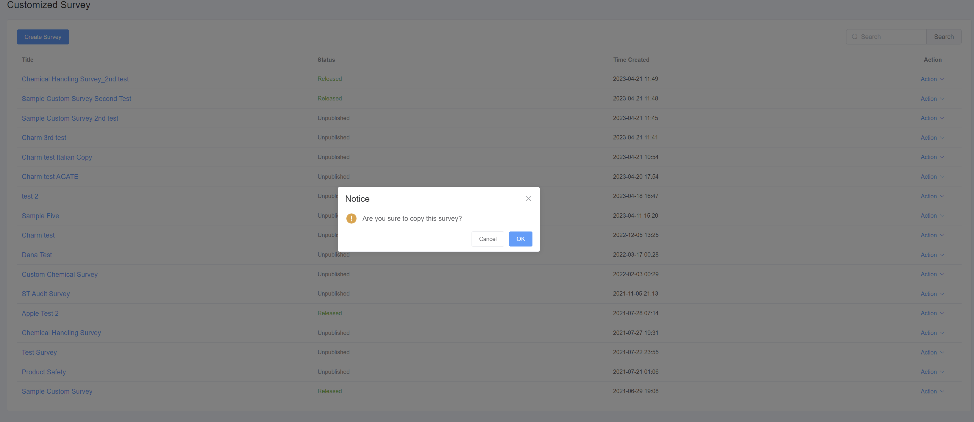
Steps for modifying copied surveys
Step 2: click Ok to confirm copying of survey

Slide 19
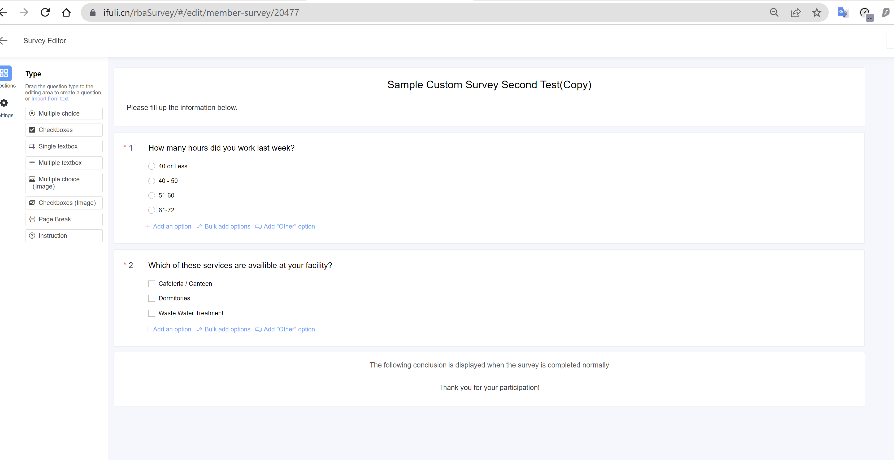
Steps for modifying copied surveys
Step 3: Modify the title and content. Then publish and deploy as normal

