Slide 1
Member Quick Guide:
Backend Navigation
& How to Deploy Feedback Tool to Factory
Notes:
Welcome to Member Quick Guide Video
In this video, we will teach you how to Navigate the Backend of Feedback Tool & How to Deploy Feedback Tool to Factory

Slide 2

Necessary Preparations
List the Factories where you would like to deploy RBA Voices.
Send email to the factories. Ask them to confirm participation in the program by assigning a Factory Point of Contact (POC) to manage the rollout of the program.
This POC will receive the Feedback Onboarding Information. If email listed in RBA Online is incorrect, you will need to change it in the Backend system. To change the FTY POC, please continue reading this instruction
View Video: How to deploy tool to target factory
on the Quick Onboarding Guide (Step 3)
Review 2 product options
& decide which one you would like deploy in the factory.
2
Notes:
Before you start deploy, here are the few necessary preparations:
First, you will need a list of specific factory which you desire to deploy the Feedback Tool to
Second, Please go to RBA Online and check if the factory Point of Contact & their email address is correct. When you deploy tool to the factory, the system will send the Tool Onboarding Email to this address
(show onboarding email to factory)
Third, review deployment video at _____
Forth, review 2 Product Options & make a decision on which one you would like to deploy to factory

Slide 3
Review 2 Product Options
Depending on Member’s decision to either deploy Product 1 or 2,
the Factory will receive a QR Code with the corresponding product option
Product 1: Full App
Product 2: Single Feedback Tool
After scanning the QR Code, worker will be prompted to install the RBA Voices app
which includes multiple features:
Feedback Tool
Surveys
Worker Learning Academy
Recommended for locations with larger worker
populations and suppliers that have mature and
digitized HR departments.
After scanning the QR Code, worker will be directed to a web browser which only includes:
Feedback Tool Only
This single function QR code provides a
scalable option to RBA members.
Recommended for locations that do not have the capacity to add learning or survey content.
Notes:
Depending on Member’s decision to either deploy Product 1 or 2,
the Factory will receive a QR Code with the corresponding product option

Slide 4
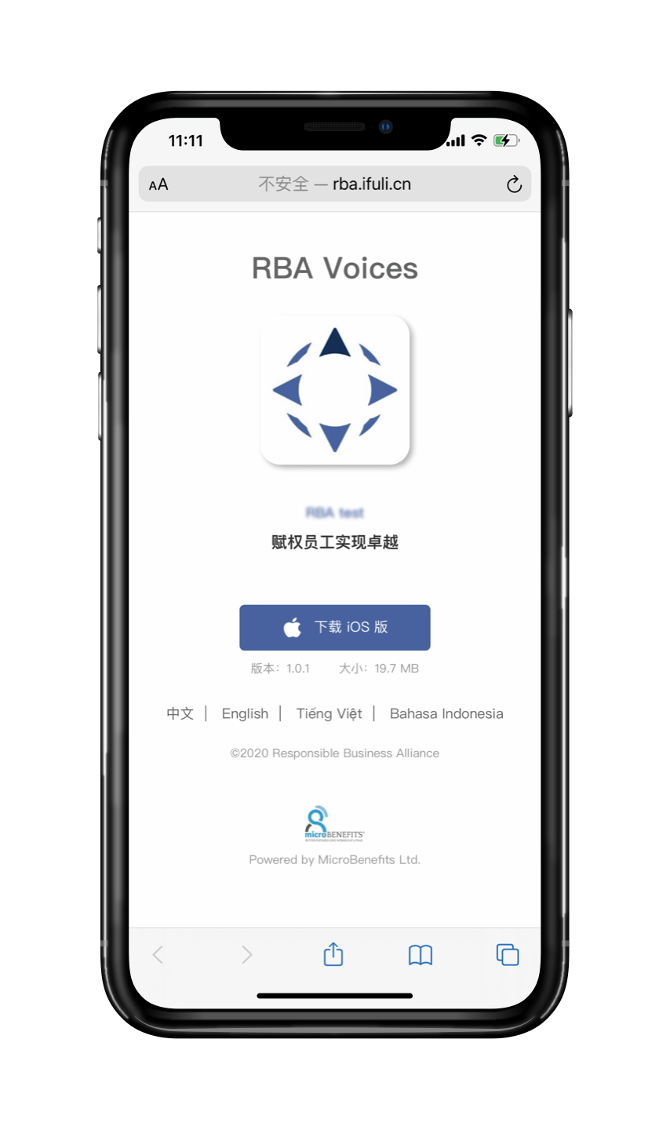
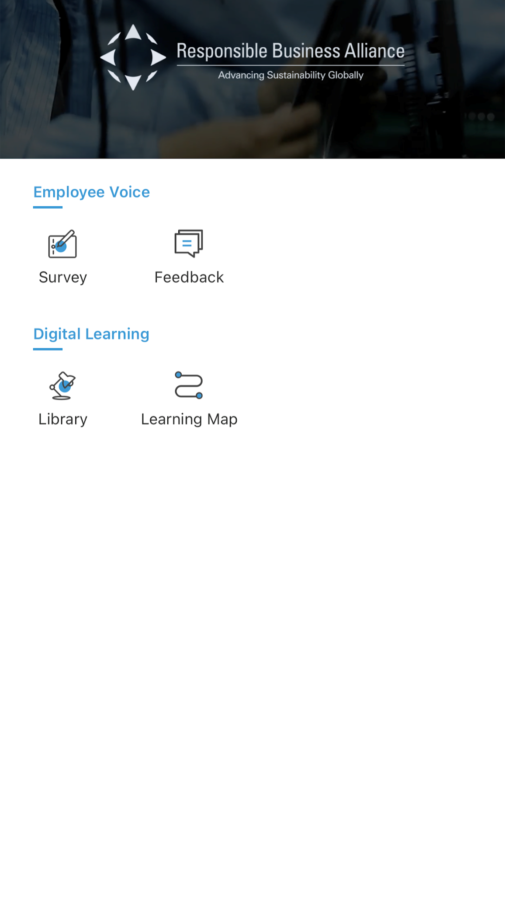
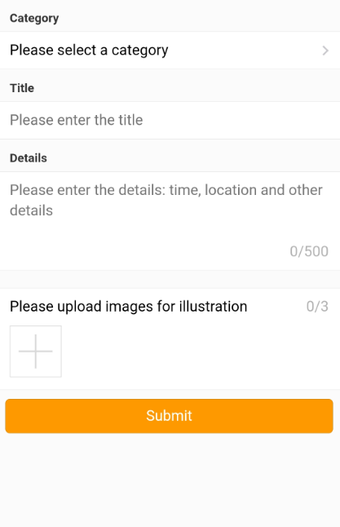

Product Option 1: Full App (highly recommended)
After scanning the QR Code, worker will be prompted to install the RBA App
Allows worker to install the RBA Voices App and enjoy the fully integrated: Feedback Tool, Survey Tool, and Worker Learning Academy.
Key Values:
Multiple features
Easy sign in / sign up using
employee ID or mobile number
Quick and easy checking of feedback status and viewing of factory response
Notes:
Product 1: Full App
Allows worker to install the RBA Voices App and enjoy the fully integrated:
Feedback Tool
Survey Tool,
and
Worker Learning Academy
This option is highly recommended for locations with larger worker populations and suppliers that have mature, digitized HR departments
Its Key Value are
Multiple features
Easy sign in / sign up using employeeID or cellphone number
Quick & easy checking of Feedback status & viewing of factory response

Slide 5
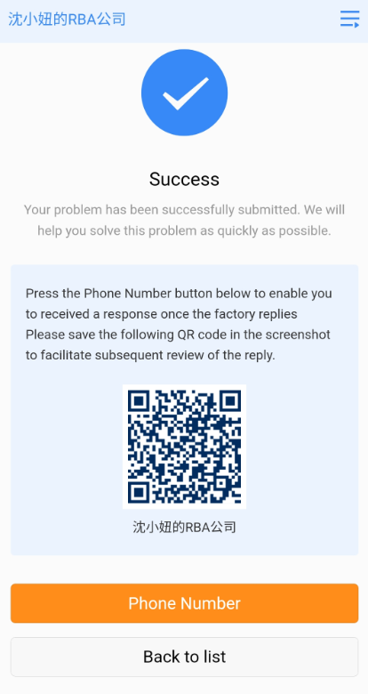
Product Option 2: Single Feedback Tool (optional)
After scanning the QR Code, worker will be directed to the Feedback Tool Webpage
Allows worker to have quick access to the Feedback Tool
Requires worker to provide phone number to receive SMS notification whenever the factory replies
Requires worker to scan a new QR Code to check / view the reply of factory
Key Values:
No app installation required
Quick & easy Feedback submission
Notes:
Product 1: Single Feedback Tool
Allow worker to have quick access to a webpage, which only include the Feedback Tool
This single function QR code is recommended for use in locations that do not have the capacity to add learning or survey content
Its Key Values are:
No app installation is required
Quick & easy Feedback submission
However, it will require worker to provide phone number in order for worker to receive SMS notification whenever the factory response

Slide 6
Backend Navigation
Notes:
As you have completed the necessary preparation, let’s access to the Feedback Tool Backend

Slide 7
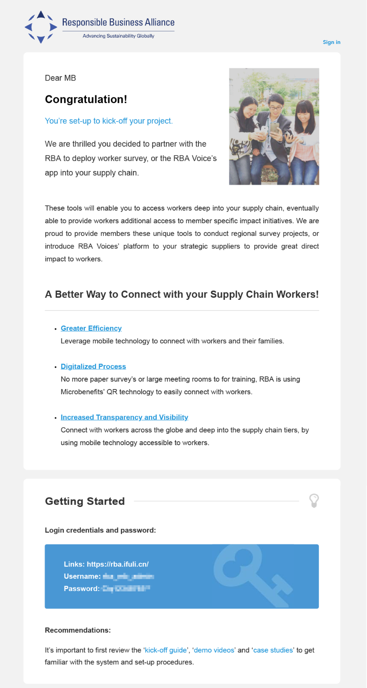
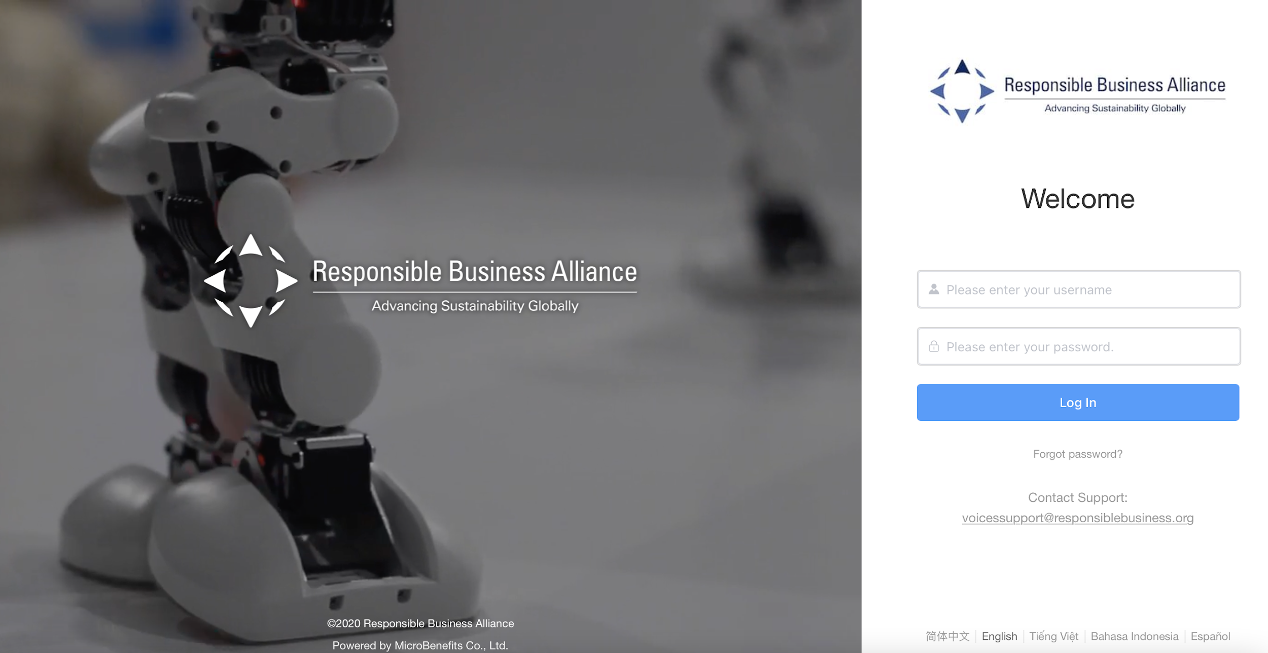

Backend Login
Step 1: Access the Feedback Backend & login with your Login Credentials
Login Credentials
are emailed to you
Notes:
Login to the Backend.
On the Onboarding Email, you will receive the Login Credentials. This is the login account to the Backend - a website which allows you to manage this tool.
(show a sample of Onboarding email for Member, point to the Login credentials)
The URL Link to access this Backend can be found at the last step on the Onboarding Quick Guide.
(show the last step of Onboarding Quick Guide, point to the Backend URL link)
What you’ll need to do is click on the Backend URL link, then enter your Username & Password.
Click on [Log in]
(show login page of Backend)

Slide 8
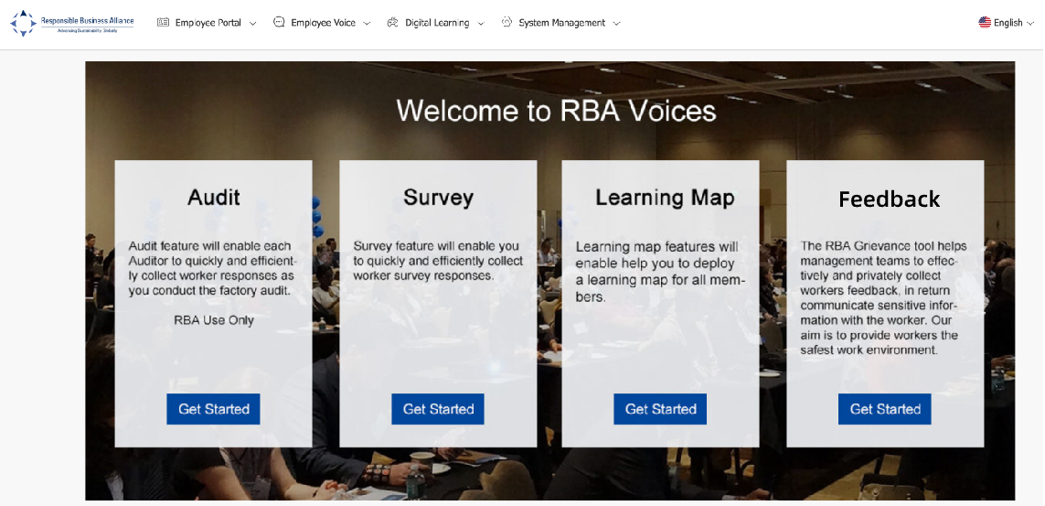
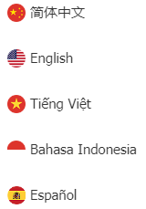
Backend Login
Step 2: At [Feedback] section –> Click [Get Started]
Click on this if you wish to view Backend in a different language
Languages Available
Notes:
Here on this page, if you wish to view the backend in another language, please click on this icon on the top right of the screen.
Current available languages are Simplified Chinese, English, Vietnamese, Bahasa Indonesia, Spanish
(point to the icon & language choices)
Next, at the [Feedback] section, click [Get Started]

Slide 9
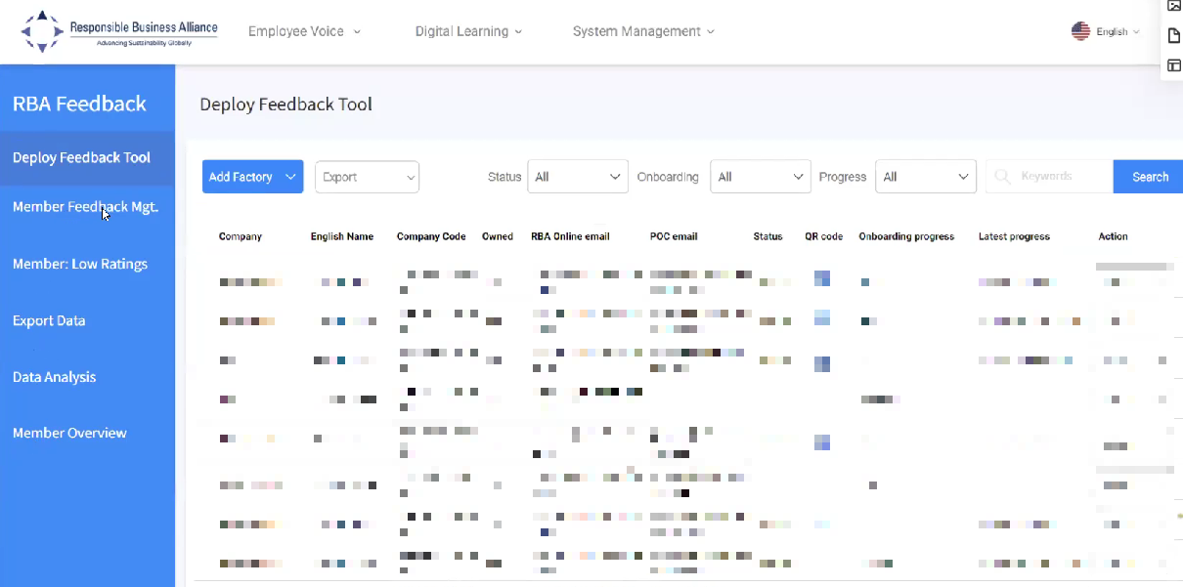
Backend Features
The left column you will find multiple features related to the Feedback Tool usage:
Terms Description:
Deploy Feedback Tool: Where you can deploy the Feedback tool to specific factories.
Member Feedback Mgt: Details of the Feedback submitted by workers in your factory.
Member: Low Ratings: Details of low-rated Feedback. This measures worker satisfaction after receiving Feedback from the factory.
Export Data: Where you download the details of feedback
Escalation: Details of the Feedback escalated by the workers.
Member Overview: Analysis report of Feedbacks by factory or country.
Notes:
Start from 3:10’ of the video
On the left column, you will find multiple features related to the Feedback Tool
(click on each tab)
Deploy Feedback Tool: Where you can deploy the Feedback tool to specific factories.
Member Feedback Mgt: Details of the Feedback submitted by workers in your factory.
Member: Low Ratings: Details of low-rated Feedback. This measures worker satisfaction after receiving Feedback from the factory.
Export Data: Where you download the details of feedback
Escalation: Details of the Feedback escalated by the workers.
Member Overview: Analysis report of Feedbacks by factory or country.

Slide 10
How to Deploy Feedback Tool to the Factory
Notes:
Next, we will learn how to deploy the feedback tool to the factory

Slide 11
Quick High-level Process Flow
Access RBA feedback tool
Select ”Deploy Feedback tool”
Select “Add Factory” note: upload company logo
Select preferred product: “Full App” or “Single Feedback” function
Select “Send email”
Factory will complete questionnaire and assign Feedback manager POC
System will send Onboarding email to Feedback manager POC
Feedback manager will access the backend to receive and respond to worker inquiries
Ongoing questions or comments VoicesSupport@responsiblebusiness.org

Slide 12
Two methods to deploy the Feedback tool:
Method A: is designed for Member who have NOT yet pre-communicated with factory teams about the RBA feedback tool. Or don’t have the factory Feedback manager POC contact information. (preferred)
Method B: is designed for Member who HAVE already communicated with factory leadership teams about the RBA feedback tool and have the Feedback manager contact information.
Notes:
There are 2 methods for member to deploy the feedback tool
Method A: is designed for Member who have NOT yet pre-communicated with factory teams about the RBA feedback tool. Or don’t have the factory Feedback manager POC contact information. (preferred)
Method B: is designed for Member who HAVE already communicated with factory leadership teams about the RBA feedback tool and have the Feedback manager contact information.

Slide 13
Deployment method A:
Method A is designed for Member who have NOT yet pre-communicated with factory teams about the RBA feedback tool. This deployment method will assist you to send a formal invitation to your factories that will include with information and background.
Allows for Factory to Agree or Disagree to introduce the Feedback tool, and will provide case studies to the benefits.
Factory team will assign Feedback manager Point of Contact for onboarding and program management
Notes:
First, let’s look at the Deployment method A: This is designed for Member who have NOT yet pre-communicated with factory teams about the RBA feedback tool. This deployment method will assist you to send a formal invitation to your factories that will include with information and background.
Allows for Factory to Agree or Disagree to introduce the Feedback tool, and will provide case studies to the benefits.
Factory team will assign Feedback manager Point of Contact for onboarding and program management

Slide 14
Step 1. Click [Deploy Feedback Tool]
The page is blank during the first log-in. As you [add factory] the list will populate with FTY names and their status.
Company Code: Code of the factory according to RBA Online
Owned: If the Factory is owned by the Member or not
RBA Online Email: Email of factory’s contact person. This may or may not be the email of the factory’s feedback manager.
POC Email: Email of factory’s feedback manager. When the Feedback Tool is deployed to the factory, the system will send an Onboarding Email to this account
Notes:
(Step 1)
On the left column, click on [Deploy Feedback Tool]
This page is blank during the first log-in. As you “add factory” the list will populate with FTY names and their status.
Company Code: Code of the factory according to RBA Online
Owned: If the Factory is owned by the Member or not
RBA Online Email: Email of factory’s contact person. This may or may not be the email of the factory’s feedback manager.
POC Email: Email of factory’s feedback manager. When the Feedback Tool is deployed to the factory, the system will send an Onboarding Email to this account

Slide 15
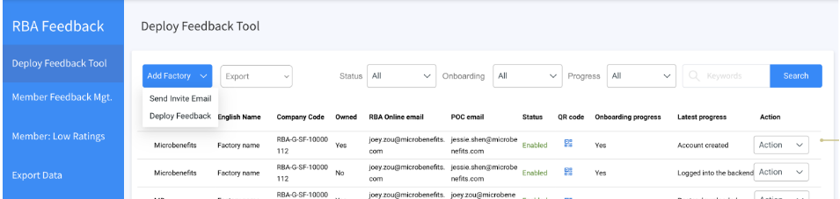
Step 2. Prepare invitation email
1st Click on [Add Factory]
2nd Select [Send Invite Email]
Notes:
(Step 2)
Click on [Add Factory] , then Select [Send Invite Email]

Slide 16
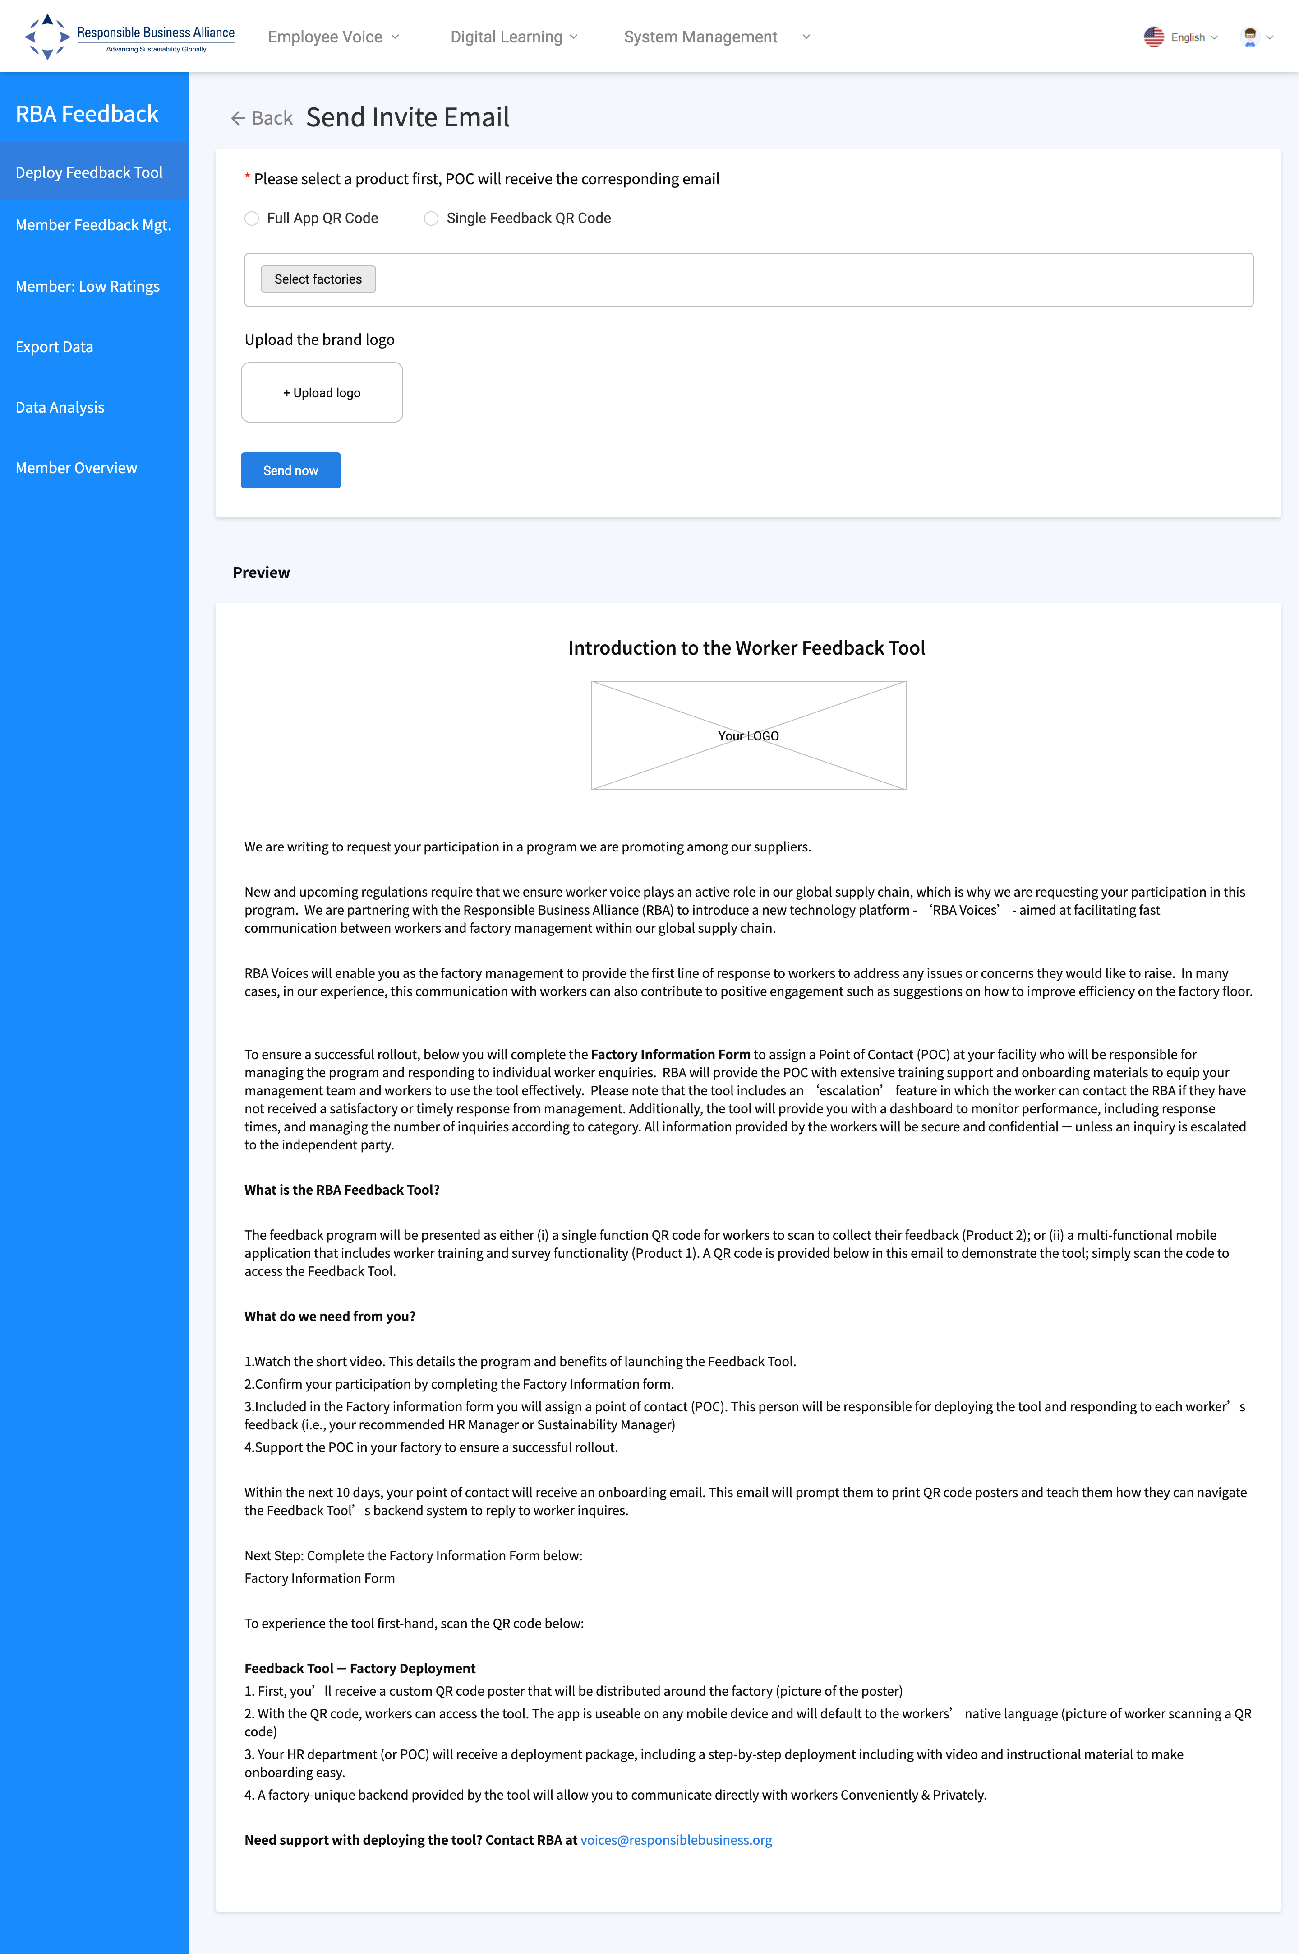

Invitation Letter
The Invitation email will include:
Add your company logo
Brief introduction to the RBA Feedback Tool and the benefits
Questionnaire for factory to provide more details and to assign a Feedback Manager POC
Upon receiving this email,
the factory will need to click on the given link
& complete an Assign Feedback Manager POC form.
Please note that this URL only valid for 20 days. If later than 20 days, Member can send another invite to the factory again.
Notes:
The Invite Email will include:
Add your company logo
Brief introduction to the RBA Feedback Tool and the benefits
Questionnaire for factory to provide more details and to assign a Feedback Manager POC
Upon receiving this email, the factory will need to click on the given link & complete an Assign Feedback Manager POC form.
Please note that this URL only valid for 20 days. If later than 20 days, Member can send another invite to the factory again.

Slide 17
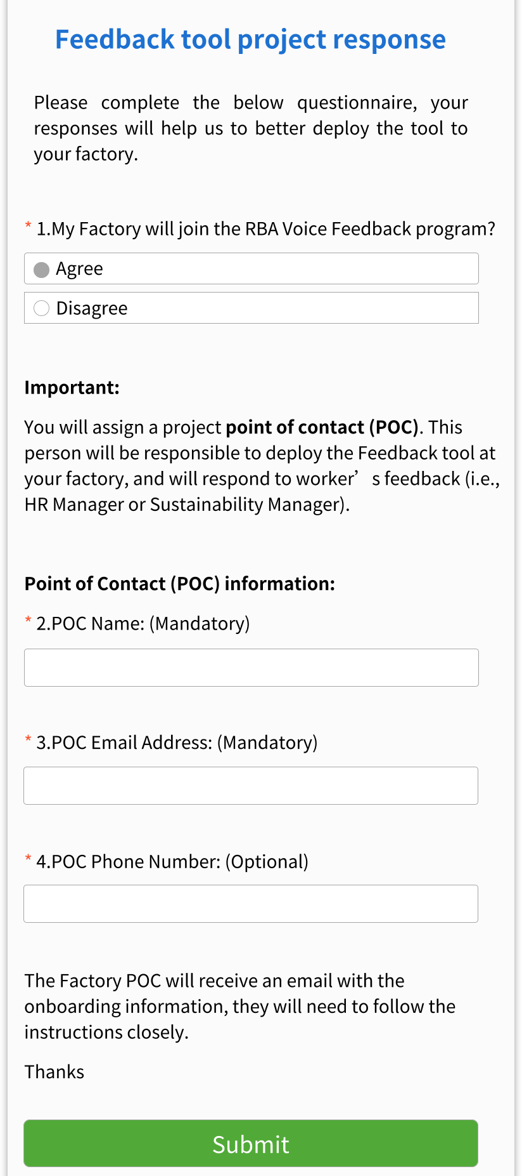
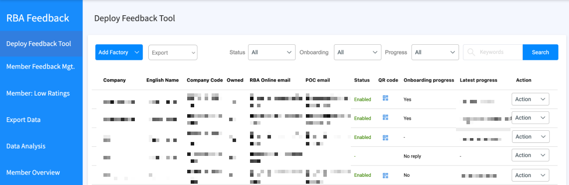
Invitation Letter Questionnaire
Question 1. My factory will join the RBA Voice Feedback program?
‘AGREE’, the system will automatically send the Onboarding Email with the account credentials to the POC email address (see Q#3).
‘DISAGREE’, the system will continue to ask additional question of factory already has a tool, they type, or other reasons for not joining the program.
Note: Progress and response tracking can be found at “Deploy Feedback tool”
Notes:
Base on the answer of the Factory on this form, the system will send out the Feedback Tool Onboarding Email
Question 1. My factory will join the RBA Voice Feedback program?
If the factory choose ‘AGREE’, the system will automatically send the Onboarding Email with the account credentials to the POC email address (see Q#3).
In case factory choose ‘DISAGREE’, the system will continue to ask additional question of factory already has a tool, they type, or other reasons for not joining the program.
Progress and response tracking can be found at “Deploy Feedback tool”.

Slide 18
Step 3. Select product type
Select Product 1 – Full App QR Code or Product 2 – Single Feedback QR Code
Notes:
(Step 3)
Select Product 1 – Full App QR Code or Product 2 – Single Feedback QR Code

Slide 19
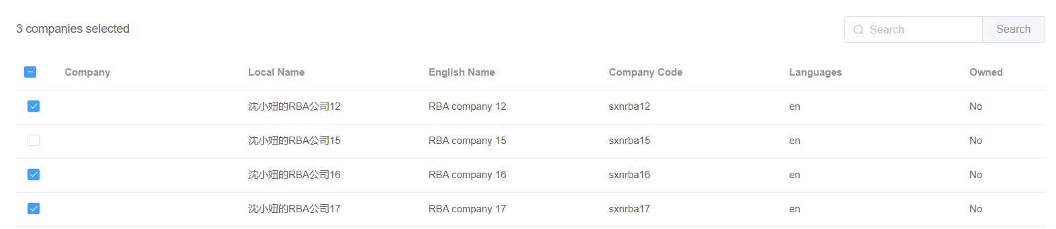
Step 4. Select Factory
Click [Select Factories]
B. Select the factories which you would like to send invitation email to by clicking on the checkbox beside the names of the factories
Notes:
(Step 4)
Click [Select Factories] & select the factories which you would like to send invite email to by clicking on the checkbox beside the names of the factories

Slide 20
Step 5. Upload Logo & Send Invitation
A. Click on [Upload Logo] & select your company’s logo in PNG or JPG format from your computer
B. Click on [Send now] to send out invitation email to factories & deploy the tool
After this step, please wait for the factory to complete the Assign Feedback Manager POC form.
The system will automatically send Onboarding Email to the factory who ‘agreed’ in the form.
Notes:
(Step 5)
Click on [Upload Logo] & select your company’s logo in PNG format
Then click on [Send now] to send out invitation email to factories & deploy the tool
After this step, please wait for the factory to complete the Assign Feedback Manager POC form.
The system will automatically send Onboarding Email to the factory who ‘agreed’ in the form.

Slide 21
Deployment method B:
Method B is designed for Member who have already communicated with factory leadership teams about the RBA feedback tool.
Important Preparations Prior to Deployment:
List of factories that will join the program
The Email address to each factory’s Feedback Manager POC. This will be important for the onboarding and ongoing feedback program formalities.
Notes:
Next, let’s look at the Deployment method B:
, which is for Member who have already communicated with factory leadership teams about the RBA feedback tool.
Important Preparations Prior to Deployment:
List of factories that will join the program
The Email address to each factory’s Feedback Manager POC. This will be important for the onboarding and ongoing feedback program formalities.

Slide 22
Step 1. Add Factory
Click [Add Factory] & Choose [Deploy Feedback]
Notes:
(Step 1)
Click [Add Factory] and [Deploy Feedback]
then Select the factories where you would like to deploy the tool by clicking on the checkbox beside the names of the factories.

Slide 23
Step 2. Select Factory to Deploy
A. Select the factories which you would like to deploy the tool to by clicking on the checkbox beside the names of the factories.
B. Confirm by clicking [Next]
Notes:
(Step 2)
Select the factories where you would like to deploy the tool by clicking on the checkbox beside the names of the factories.
Then confirm by clicking [Next]

Slide 24
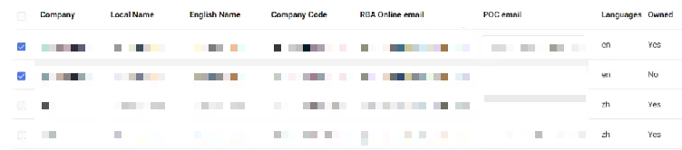

Step 3. Review Factory’s Feedback Manager Email (POC)
Please review if the RBA Online Email is the email address of the Factory’s Feedback Manager
(POC)
In case this is not the email address of the factory’s feedback manager, please type in the correct email address as the POC Email to make sure the factory’s feedback manager can receive the feedback tool onboarding email.
Notes:
(Step 3)
Review if the RBA Online Email is the correct email address of the Factory’s Feedback Manager
In case this is not the email address of the factory’s feedback manager, please type in the correct email address as the POC Email so that the factory’s feedback manager can receive the feedback tool onboarding email.

Slide 25
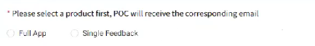
Step 4. Select product type & confirm to send
A. Select Product 1 – Full App or Product 2 – Single Feedback Tool
After completing this step, the system will automatically send out the Onboarding Email to Factory Feedback mgr. POC
(Important: Feedback Tool have been deployed to factories)
Notes:
(Step 4)
Select Product 1 – Full App or Product 2 – Single Feedback Tool
Then confirm to send.
After completing this step, the system will send out the Onboarding Email to the factories.

Slide 26
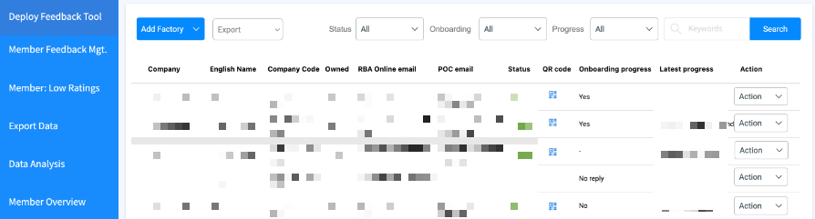
Tracking Onboarding Progress
You can track FTY ‘s progress by re-visiting the [Deploy Feedback Tool] page
from time to time & view [Onboarding progress]
Descriptions of Terms:
Agree: Factory agrees to deploy Feedback tool & the Onboarding Email has been sent to factory’s designated feedback manager’s email.
Disagree: Factory declines to use the Feedback Tool
In Progress: Factory has not accessed the link to assign the feedback manager
Expired: Factory has not accessed the link to assign the feedback manager. And It have been more 20 days since the Invite Email was sent. Therefore, the link has been expired.
Notes:
You can track FTY ‘s progress by re-visiting the [Deploy Feedback Tool] page
from time to time & view [Onboarding progress]
Agree: Factory agrees to deploy Feedback tool & the Onboarding Email has been sent to factory’s designated feedback manager’s email.
Disagree: Factory declines to use the Feedback Tool
In Progress: Factory has not accessed the link to assign the feedback manager
Expired: Factory has not accessed the link to assign the feedback manager. And It have been more 20 days since the Invite Email was sent. Therefore, the link has been expired.

Slide 27
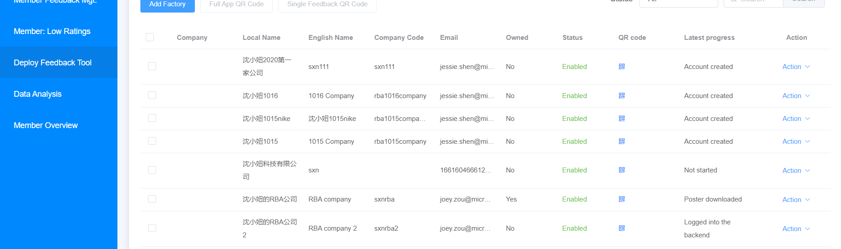
Tracking Deployment Progress
Please click [Deploy Feedback Tool] page from time to time & view [Deployment progress]
Descriptions of Terms
Not started: Member has NOT deployed feedback QR Code to the Factory
Account created: The Onboarding Email has been sent to factory’s designated email address.
Poster downloaded: Factory has received the onboarding email & downloaded the feedback poster for printing
Logged into the backend: Factory has completed reading the onboarding quick guide, logged into the backend & start managing the feedback tool
Notes:
You can also track Factory‘s progress by re-visiting this same page of [Deploy Feedback Tool] from time to time.
Here at the [Latest progress] column, there’re 4 types of status:
Not started: Member has NOT deploy feedback tool to Factory
Account created: The Onboarding Email has been sent to factory’s designated email address.
Poster downloaded: Factory has received the onboarding email & downloaded the feedback poster for printing
Logged into the backend: Factory has completed reading the onboarding quick guide, logged into the backend & start managing the feedback tool

Slide 28

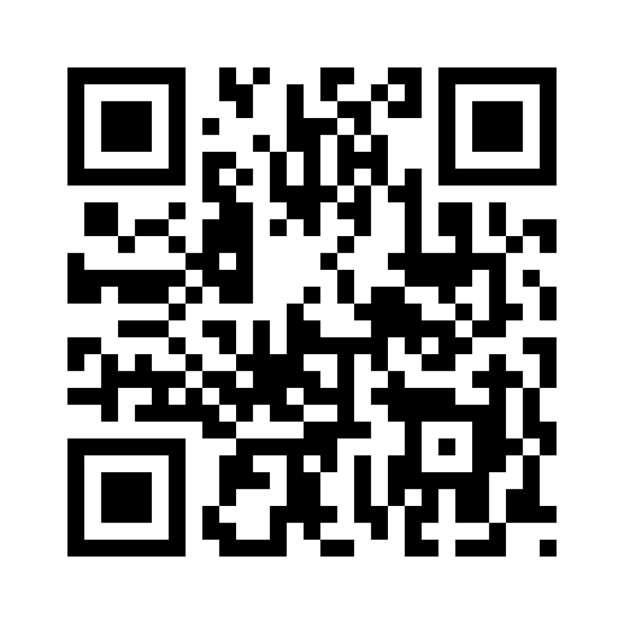
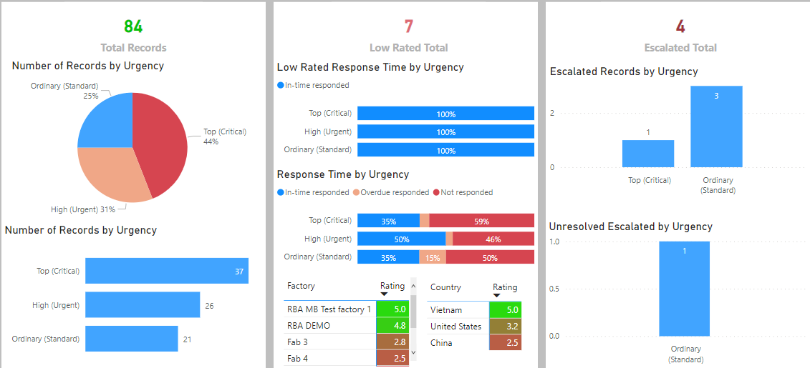
Report
Once the Factory deploys the Feedback Tool to the Employees
and the Employees scan the QR Code on the Poster to use the Feedback tool,
the Backend system will analyze the total No. of feedback received and generate the Analysis Report for Member
Factory deploy tool to Employee
Employee submit Feedback
Factory response to Feedback
System record all Feedback Dialogue
Member view Analysis Record
Notes:
End at 7.23’ in video
Once the Factory deploys the Feedback Tool to the Employees
and the Employees scan the QR Code on the Poster to use the Feedback tool, the Backend system will analyze the total number of feedback received and generate the Analysis Report for the Member.

Slide 29
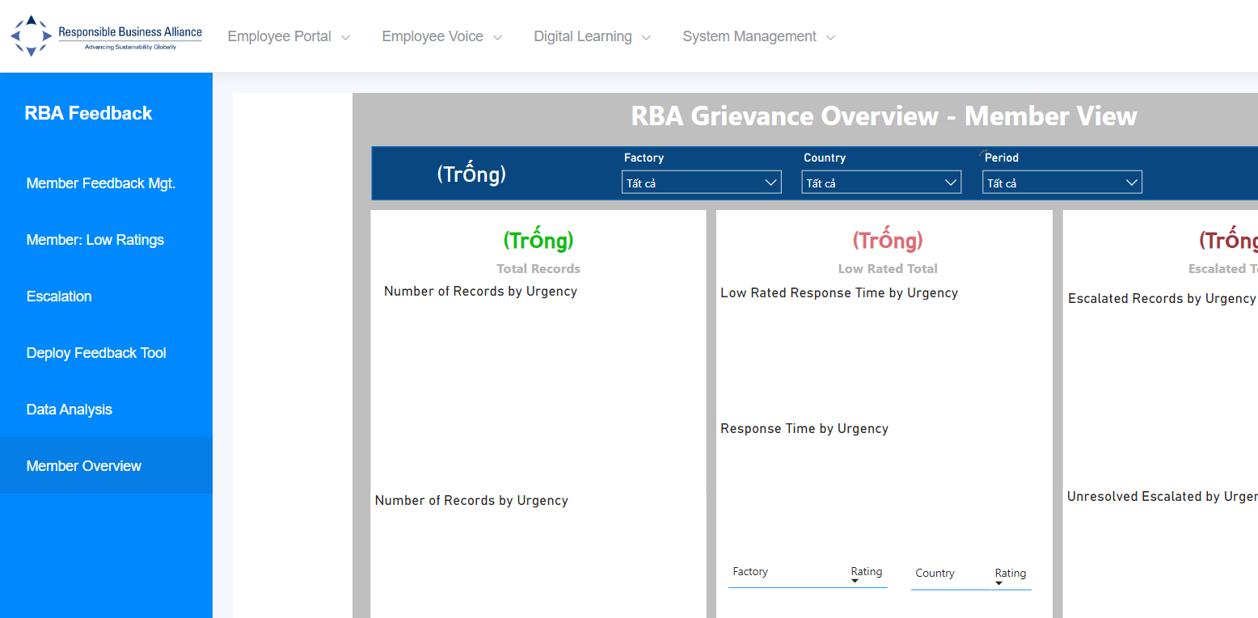
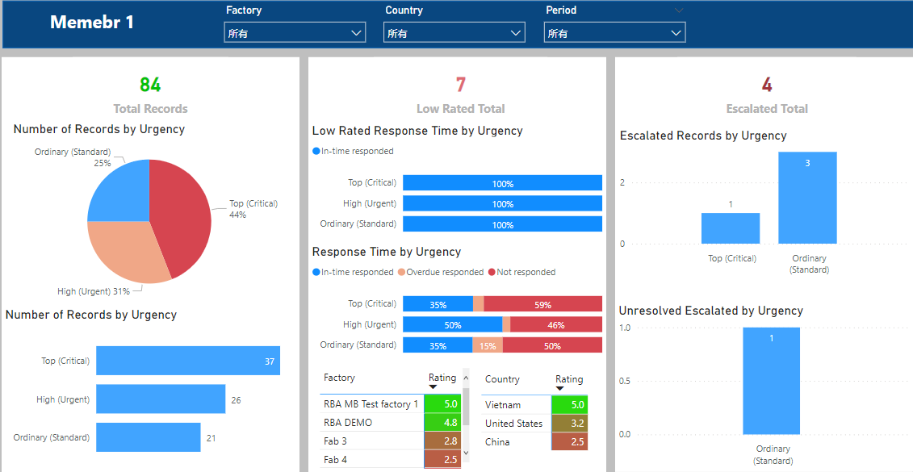
How to view Report: On the left panel, click on [Member Overview]
Here, Member can view the total number of feedbacks submitted by the employees from the Member’s Chain Supply Factories
Notes:
Here’s how Member can view Report:
Please login to the Member Backend, go to the Feedback Tool management page, on the left panel, click on [Member Overview]
On the left panel, click on [Member Overview].
Here, Member can view the total number of feedbacks submitted by the employees from the Member’s Chain Supply Factories

Slide 30
Choose to view a specific report by selecting Name of factory, Country and Period of time
Notes:
You can choose to view a specific report by selecting Name of factory, Country and Period of time.
This report can be viewed as many times as you want and anytime

Slide 31
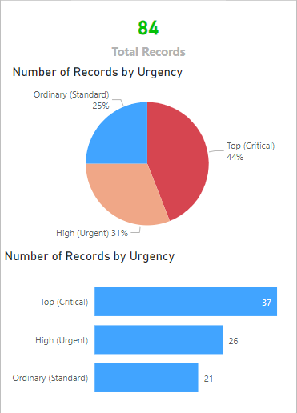
Description of Terms 1.1
Total Records: Total amount of feedback that was submitted within a period of time
What is Level of Urgency?
                Ordinary (Standard): Low urgency feedbacks that require a response within 72 hours
                High (Urgent): High urgency feedbacks that require a response within 48 hours
                Top (Critical): Very high urgency feedbacks that require a response within 24 hours
Notes:
If this is the first time you have seen this report, here are some description of terms to help you understand how to read this report. You can pause this video here to take a closer look.

Slide 32
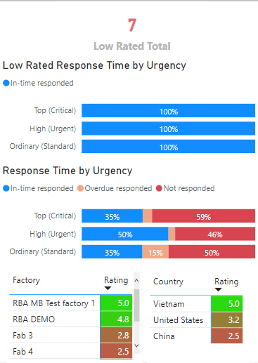
Description of Terms 1.2
Rating: Employees can show their satisfaction with the Admin’s reply by providing scores (rating data is only available if factories enabled the rating function and users chose to give ratings)
Low Rated Total: Total number of feedback questions with Employee Satisfaction Ratings lower than 2.5
Low Rated Response Time by Urgency: Low-rated questions divided according to Response Status and Feedback Urgency
Response Time by Urgency: All feedbacks divided according to Response Status and Question Urgency
In-time responded: Factory has replied to feedback within the response time limit
Overdue responded: Factory has replied to feedback outside the response time limit
Not responded: Factory has NOT replied to feedback

Slide 33
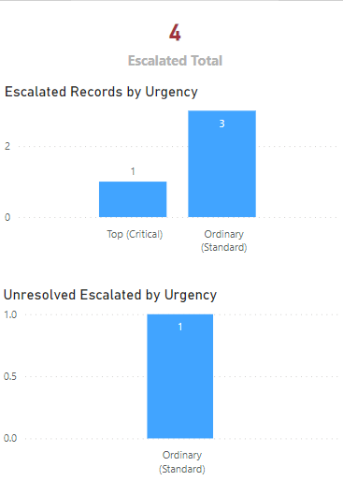
Description of Terms 1.3
Escalated Total: Total feedback questions that were escalated and require the attention of higher-level management
Escalated Records by Urgency: Total number of Escalated questions broken down according to Question Urgency
                Unresolved Escalated by Urgency: The number of Escalated questions that are still open, broken down according to Question Urgency
Notes:
And that is all for this video. Thank you for watching.

