Slide 1
How to Respond to Workers
Notes:
Welcome to Feedback Tool Quick Guide video

Slide 2
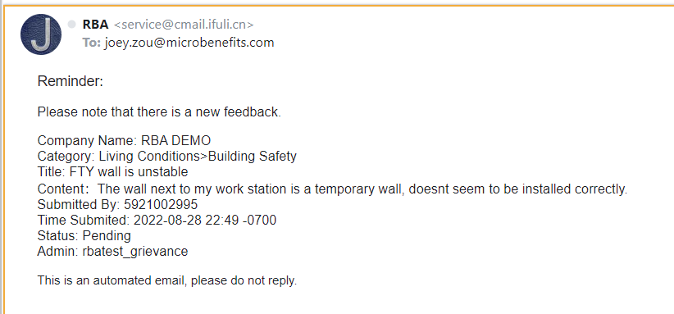
Email Notification for the Factory
When an employee submits feedback, the system will send an email notification to the factory POC.
Notes:
When the employee submits a new feedback, the system will send a notification email to factory Point of Contact
After that, the Factory Point of Contact, also known as the Factory Admin will have the responsibility to Login Backend to view the feedback & respond to the feedback within certain time limit.
In this video, we will teach you How to Response to Workers

Slide 3
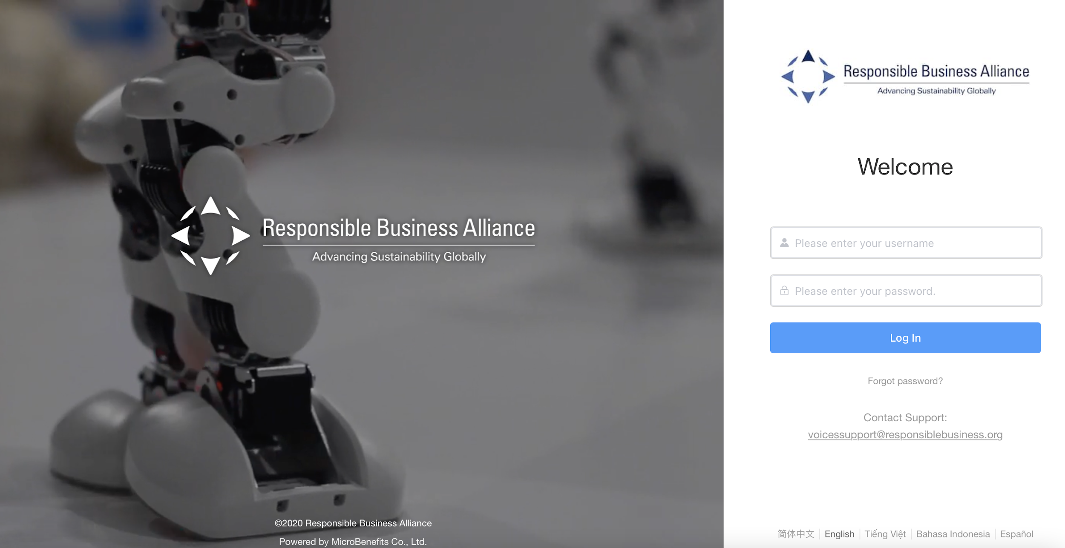
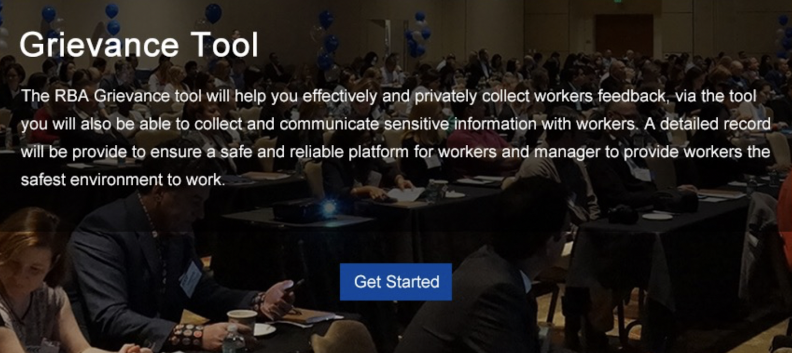
Step 1. Log-in to Feedback Backend
Use your Login Credentials to log-in the Backend
At [Feedback] Tool > Click [Get Started]
Notes:
(step 1)
Use your Login Credentials to log-in the Backend
At [Feedback] Tool > Click [Get Started]

Slide 4
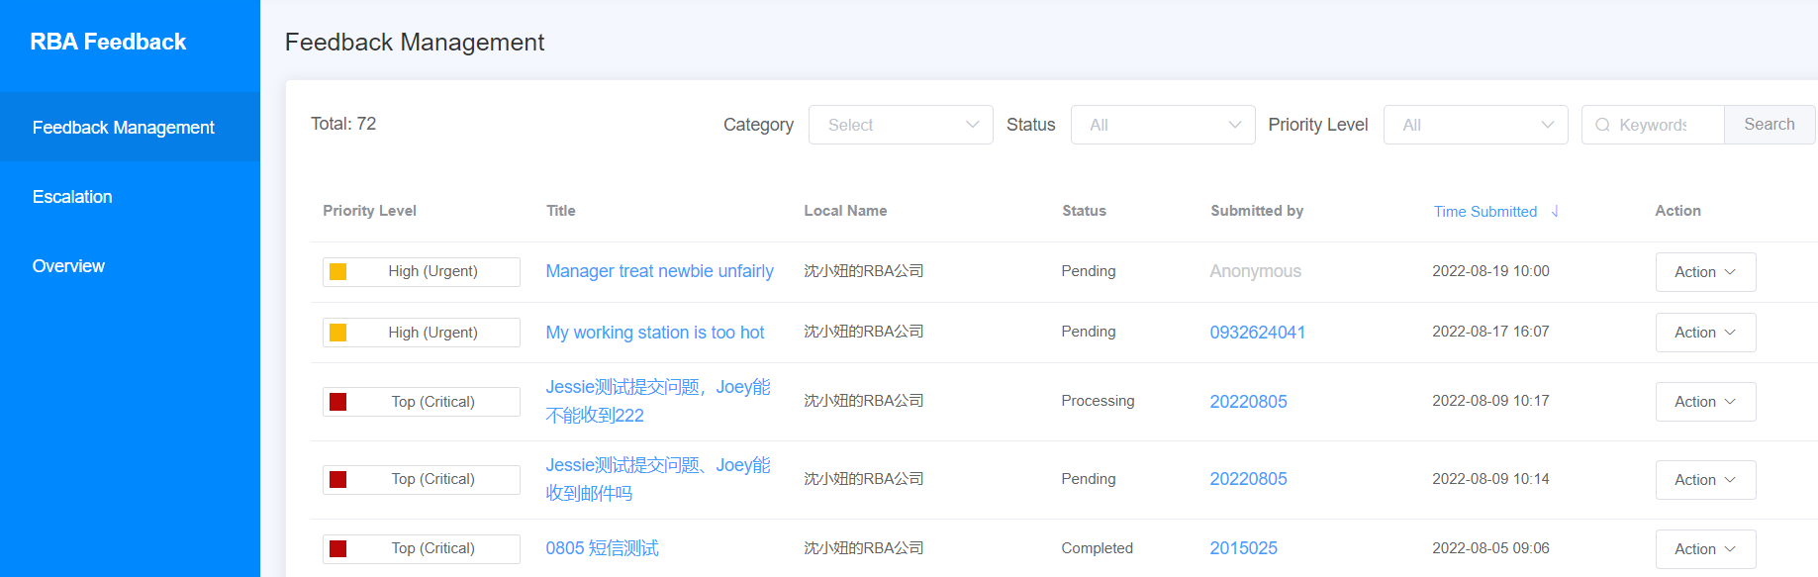

Step 2. View list of feedback
If employees have NOT submitted any feedback,
this page will be empty.
Notes:
(step 2)
On the Feedback Management page, you can view the list of all feedback submitted by your workers.
(If employees have NOT submitted any feedback, this page will be empty)

Slide 5
3 Priority Levels of Feedback Category
Notes:
According to the Worker Feedback Project Guideline, there are 3 Priority Levels of feedback category.
Depending on the category of feedback submitted by the workers, the feedback will have different recommended timeframe for factory admin to response.

Slide 6
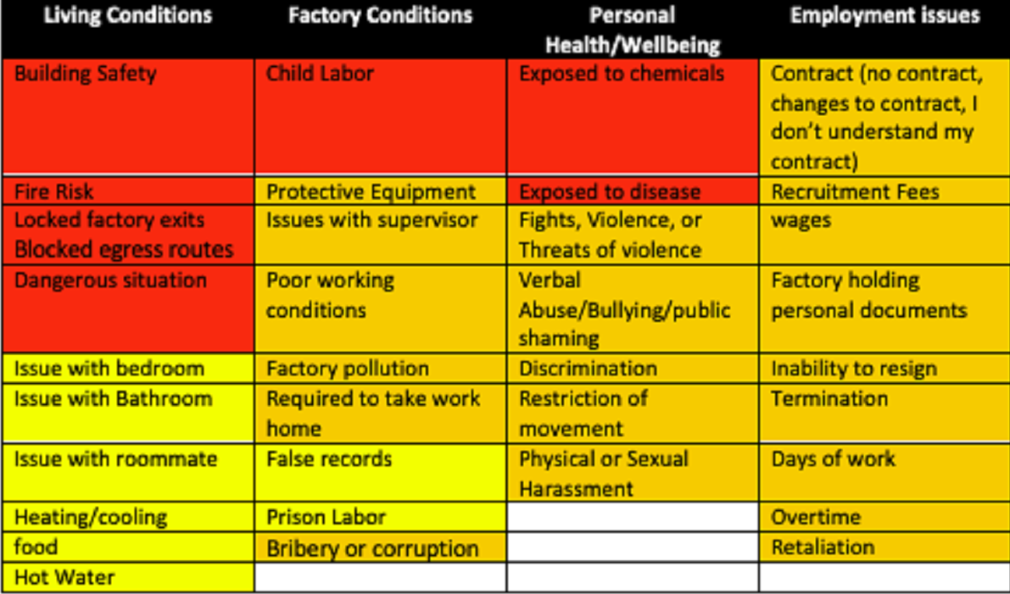
3 Priority Levels of Feedback
                Ordinary (Standard): Low urgency feedback category that requires response within 72 hours
                High (Urgent): High urgency feedback category that requires response within 48 hours
                Top (Critical): Very high urgency feedback category that requires response within 24 hours
Feedback Priority Level
Notes:
Ordinary (Standard): Low urgency feedback category that require a 72 hrs response, mark in red color
High (Urgent): High urgency feedback category that require a 48 hrs response, mark in orange color
Top (Critical): Very high urgency feedback category that require a 24 hrs response, mark in yellow color

Slide 7
5 Types of Feedback Status
                Pending: Factory has not responded to the feedback yet
                Processing: Factory has not closed the feedback yet
                Completed: Factory has closed the feedback
                Revoked: Employee has submitted the feedback but changed his mind & recalled the feedback
                Response rated: Factory has closed the feedback & employee has given satisfaction rating score for the feedback
Notes:
Next, let’s look at the 5 type of feedback status
Pending: Factory has not responded to this feedback yet
Processing: Factory has not closed this feedback yet
Completed: Factory has closed this feedback
Revoked: Employee submitted this feedback but changed his mind & recalled the feedback
Response rated: Factory has closed this feedback & employee have given satisfaction rating score for the feedback

Slide 8
Who submitted the feedback?
Submitted by: Employee ID or Mobile Number of the employee who submitted the feedback
                Anonymous: Employee chose the anonymous setting when submitting the feedback
Notes:
Next, on this page, you can also view the employeeID or the Mobile Number of the employee who submitted the feedback & the time they submitted
‘Anonymous’ means that this employee chose the anonymous setting when submitting the feedback

Slide 9
Feedback Management
Admin can search for a specific feedback by [Category], [Status], [Priority Level] or [Keywords]
Notes:
The factory admin can also search for a specific feedback by [Category],[Status],[Priority Level] or by [Keywords]

Slide 10
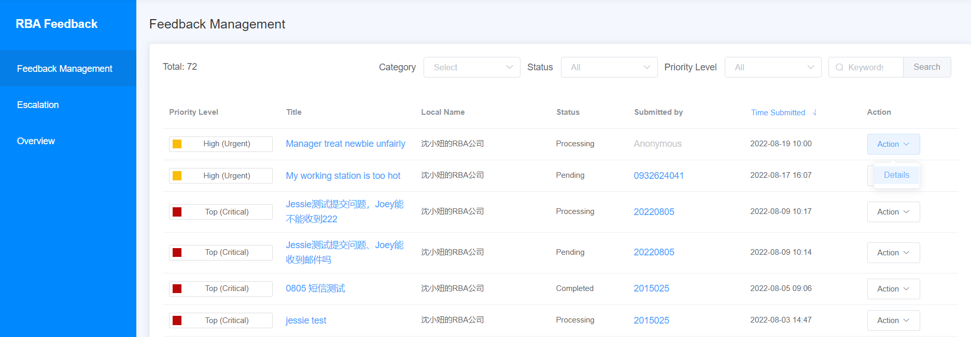
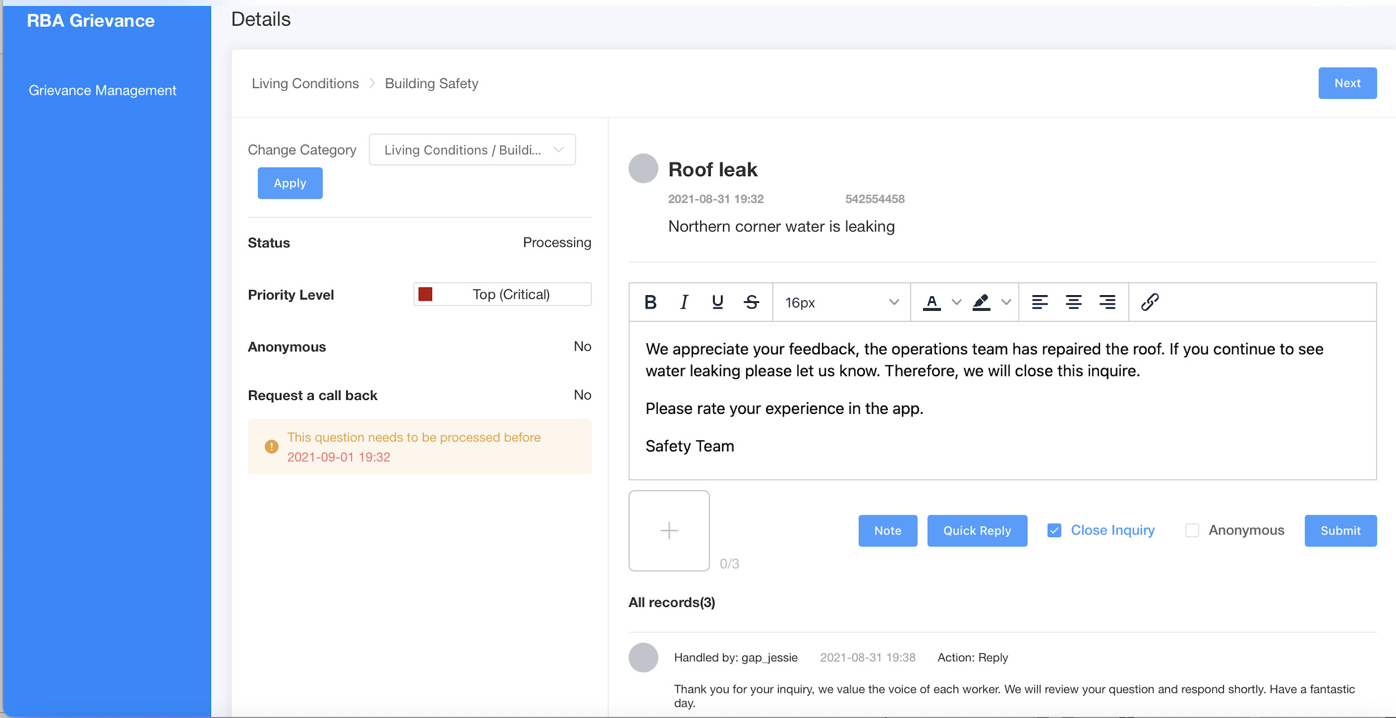
Step 3. View feedback details
To view the details of the Feedback content, Admin can click on [Action] > [Details]
Notes:
(Step 3)
To view the details of the Feedback content, Admin can click on [Action]
Select [Details]

Slide 11

Feedback Detail 1
Feedback category
The feedback content sent by the employee
Anonymous (YES / NO):
If the employee sent the
feedback anonymously or not
Request a call back (YES / NO): If the employee requested
the factory to call their mobile number for a quick response
Notes:
Here you can find:
-Feedback category
-The feedback content that was sent by the employee
-Whether this employee has sent the feedback anonymously or not
-Whether this employee requested the factory to call back his/her mobile number for a quick response or not

Slide 12
Feedback Detail 2
Factory can click here to view Employee ID or Mobile Number of the employee
Factory can type the response here
Factory can insert images here (optional)
Notes:
-Click here to view the EmployeeID or Mobile Number of employee
-This is where factory admin can type in the response
-and insert image if needed

Slide 13
Feedback Detail 3
If factory responds to the feedback within this time period, the feedback will be classified as In-time response in the report.
If not, it will be classified as Overdue response in the report.
Notes:
According to the project guideline, this is the recommended time limit for admin to give response to this feedback.
If the factory responds to the feedback within this time period, the feedback will be classified as In-time response in the report.
If not, it will be classified as Overdue response in the report.

Slide 14
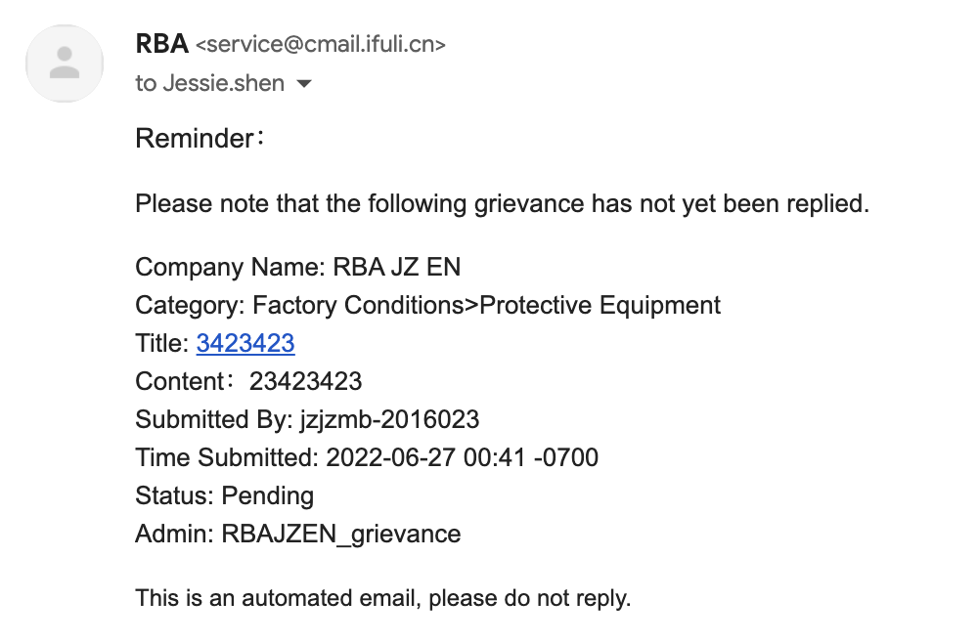
Overdue Response
If the factory did NOT RESPOND to the feedback on time, the system will send a notification email to factory POC → Click on the Title in the email and you will be redirected to view the feedback.
Notes:
If the factory did NOT RESPOND to the feedback on time, the system will send a notification email to factory Point of Contact
Click on the Title in the email and you’ll be redirected to view the feedback.

Slide 15
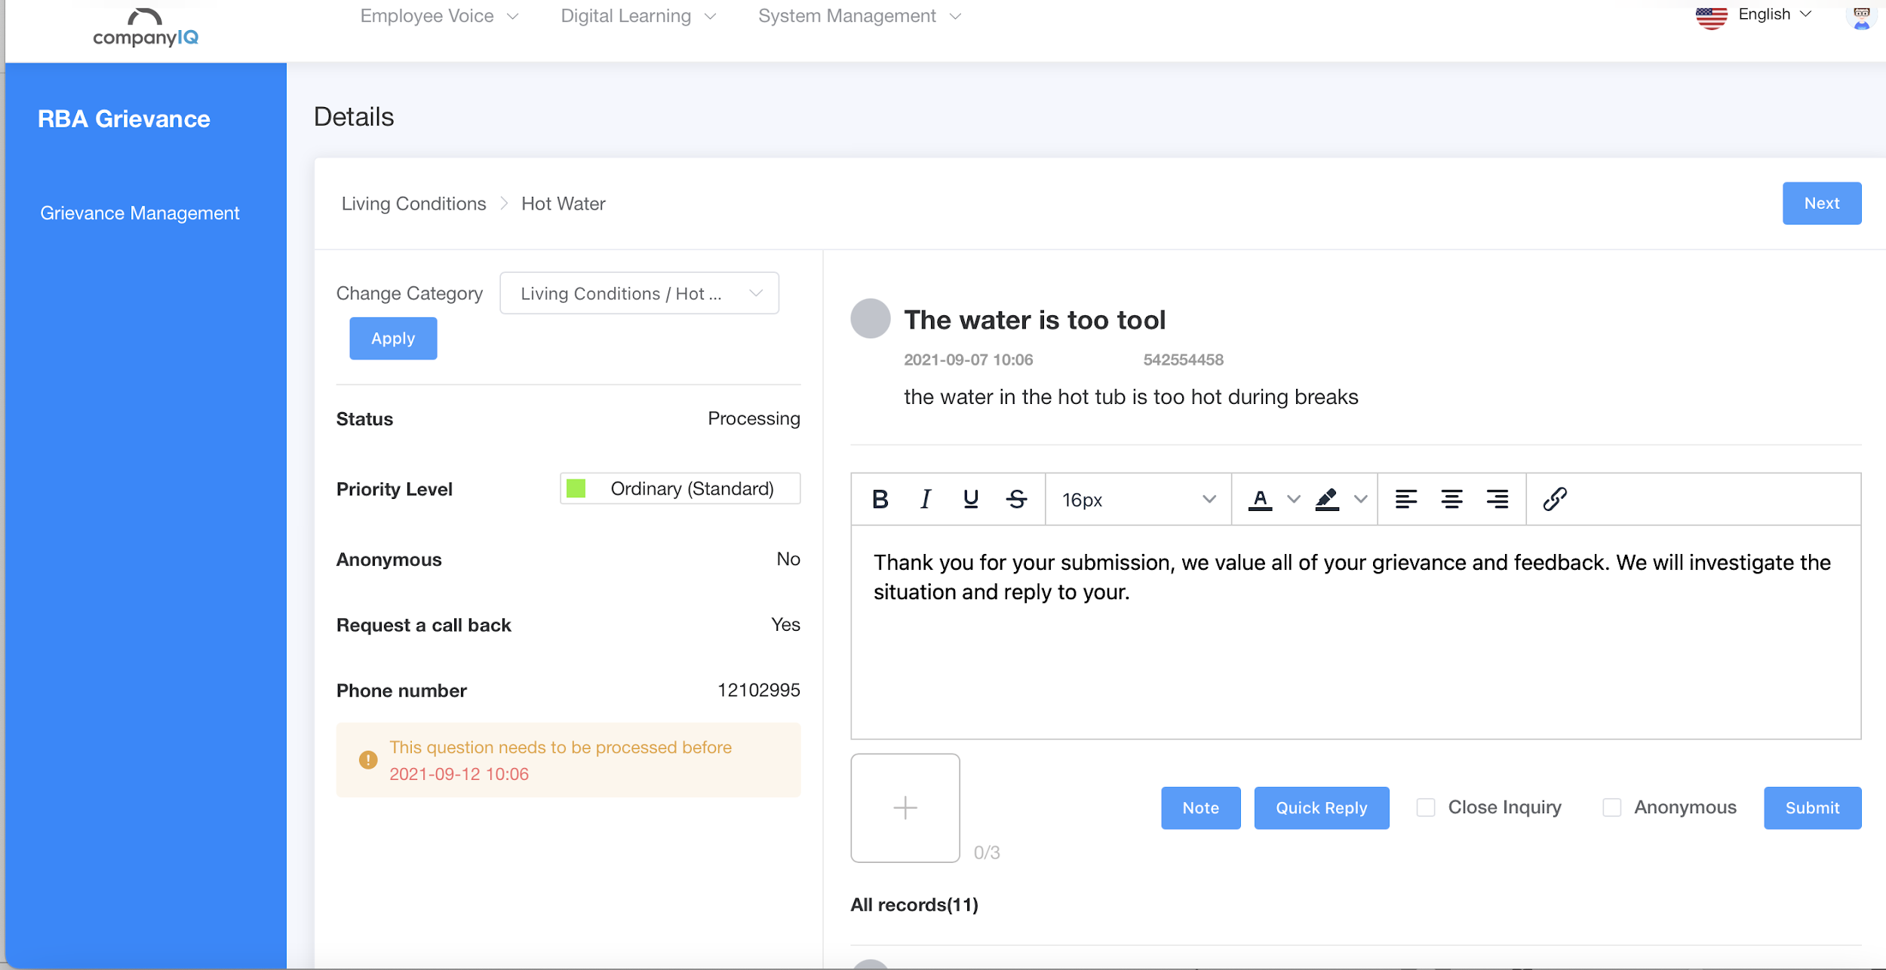
Step 4. Type the response to worker & click [Submit] to send
15
Notes:
(Step 4)
Type the response to worker & click [Submit] to send

Slide 16
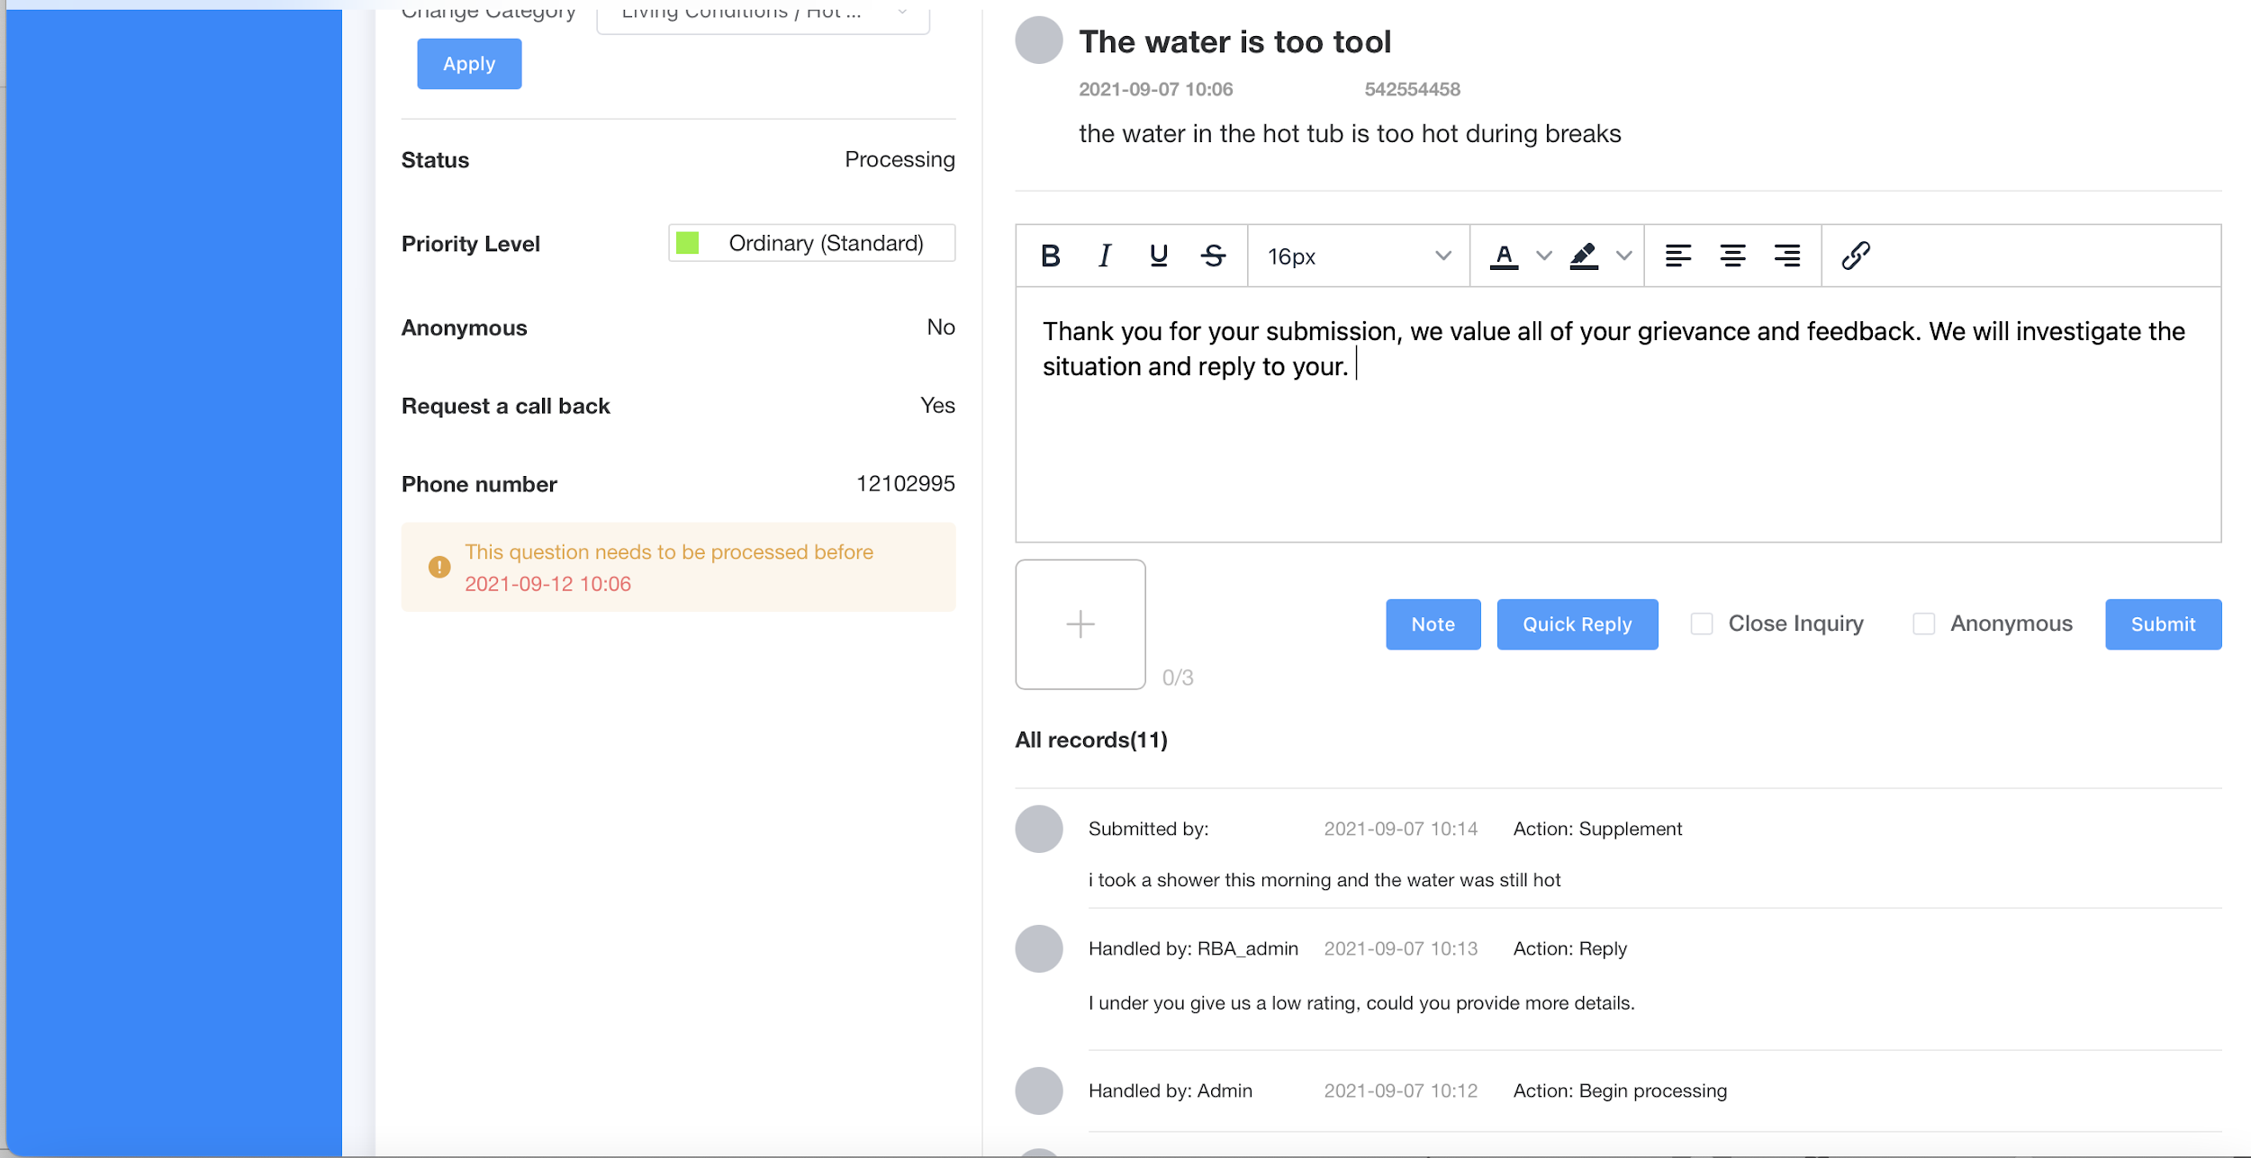
Step 5. Follow up by viewing Dialogue Record &
submit further response (Optional)
Notes:
(Step 5)
Follow up by viewing Dialogue Record & submit further response if needed

Slide 17
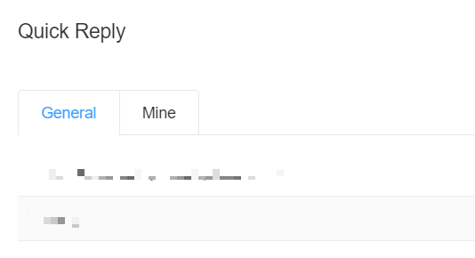
Quick Reply (Optional)
Click on [Quick Reply] to generate a new default response or to apply a default response to a feedback. This will help admin respond quicker to similar feedbacks.
Only the Factory Admin can view this note, employees CANNOT see the note.
Notes:
Click on [Quick Reply] to generate a new default response or to apply the default response to this feedback. This will help admin to respond quicker to similar type of feedbacks.

Slide 18
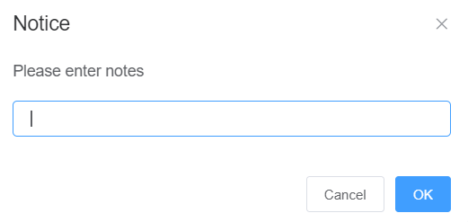
Note (Optional)
Factory admin can also click on [Note] to insert additional comments for internal reference.
Only the Factory Admin can view this note, employees CANNOT see the note.
Notes:
Furthermore, Factory admin can also click on [Note] to insert additional comments for internal reference.
This note can only be viewed by the factory admin. Employee cannot view this note.

Slide 19
Step 6. Click on [Close Inquiry]
to mark the feedback as “Completed”
19
Notes:
(Step 5)
Click on [Close Inquiry] to mark the feedback as “Completed”.
This step is very important. Because it indicate that the factory has solved this inquiry for the worker.

Slide 20
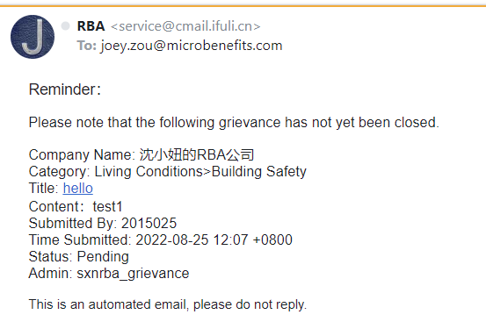
Overdue Close
If the factory did NOT CLOSE the feedback on time, the system will send a notification email to factory POC → Click on the Title in the email and you’ll be redirected to view the feedback detail
Notes:
If the factory did NOT CLOSE the feedback on time, the system will send a notification email to factory Point of Contact.
And that is all for this video. Thank you for watching.

