Slide 1
How To Deploy Tool To Workers
Notes:
Welcome to Factory Quick Guide Video
In this video, we will teach you How To Deploy the Feedback Tool To Your Workers

Slide 2
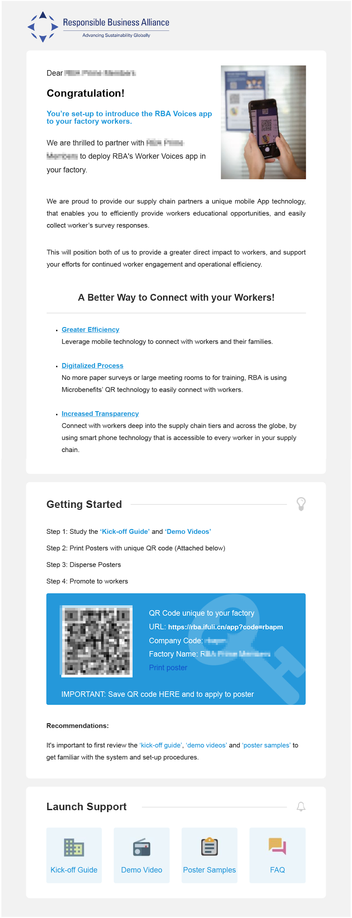
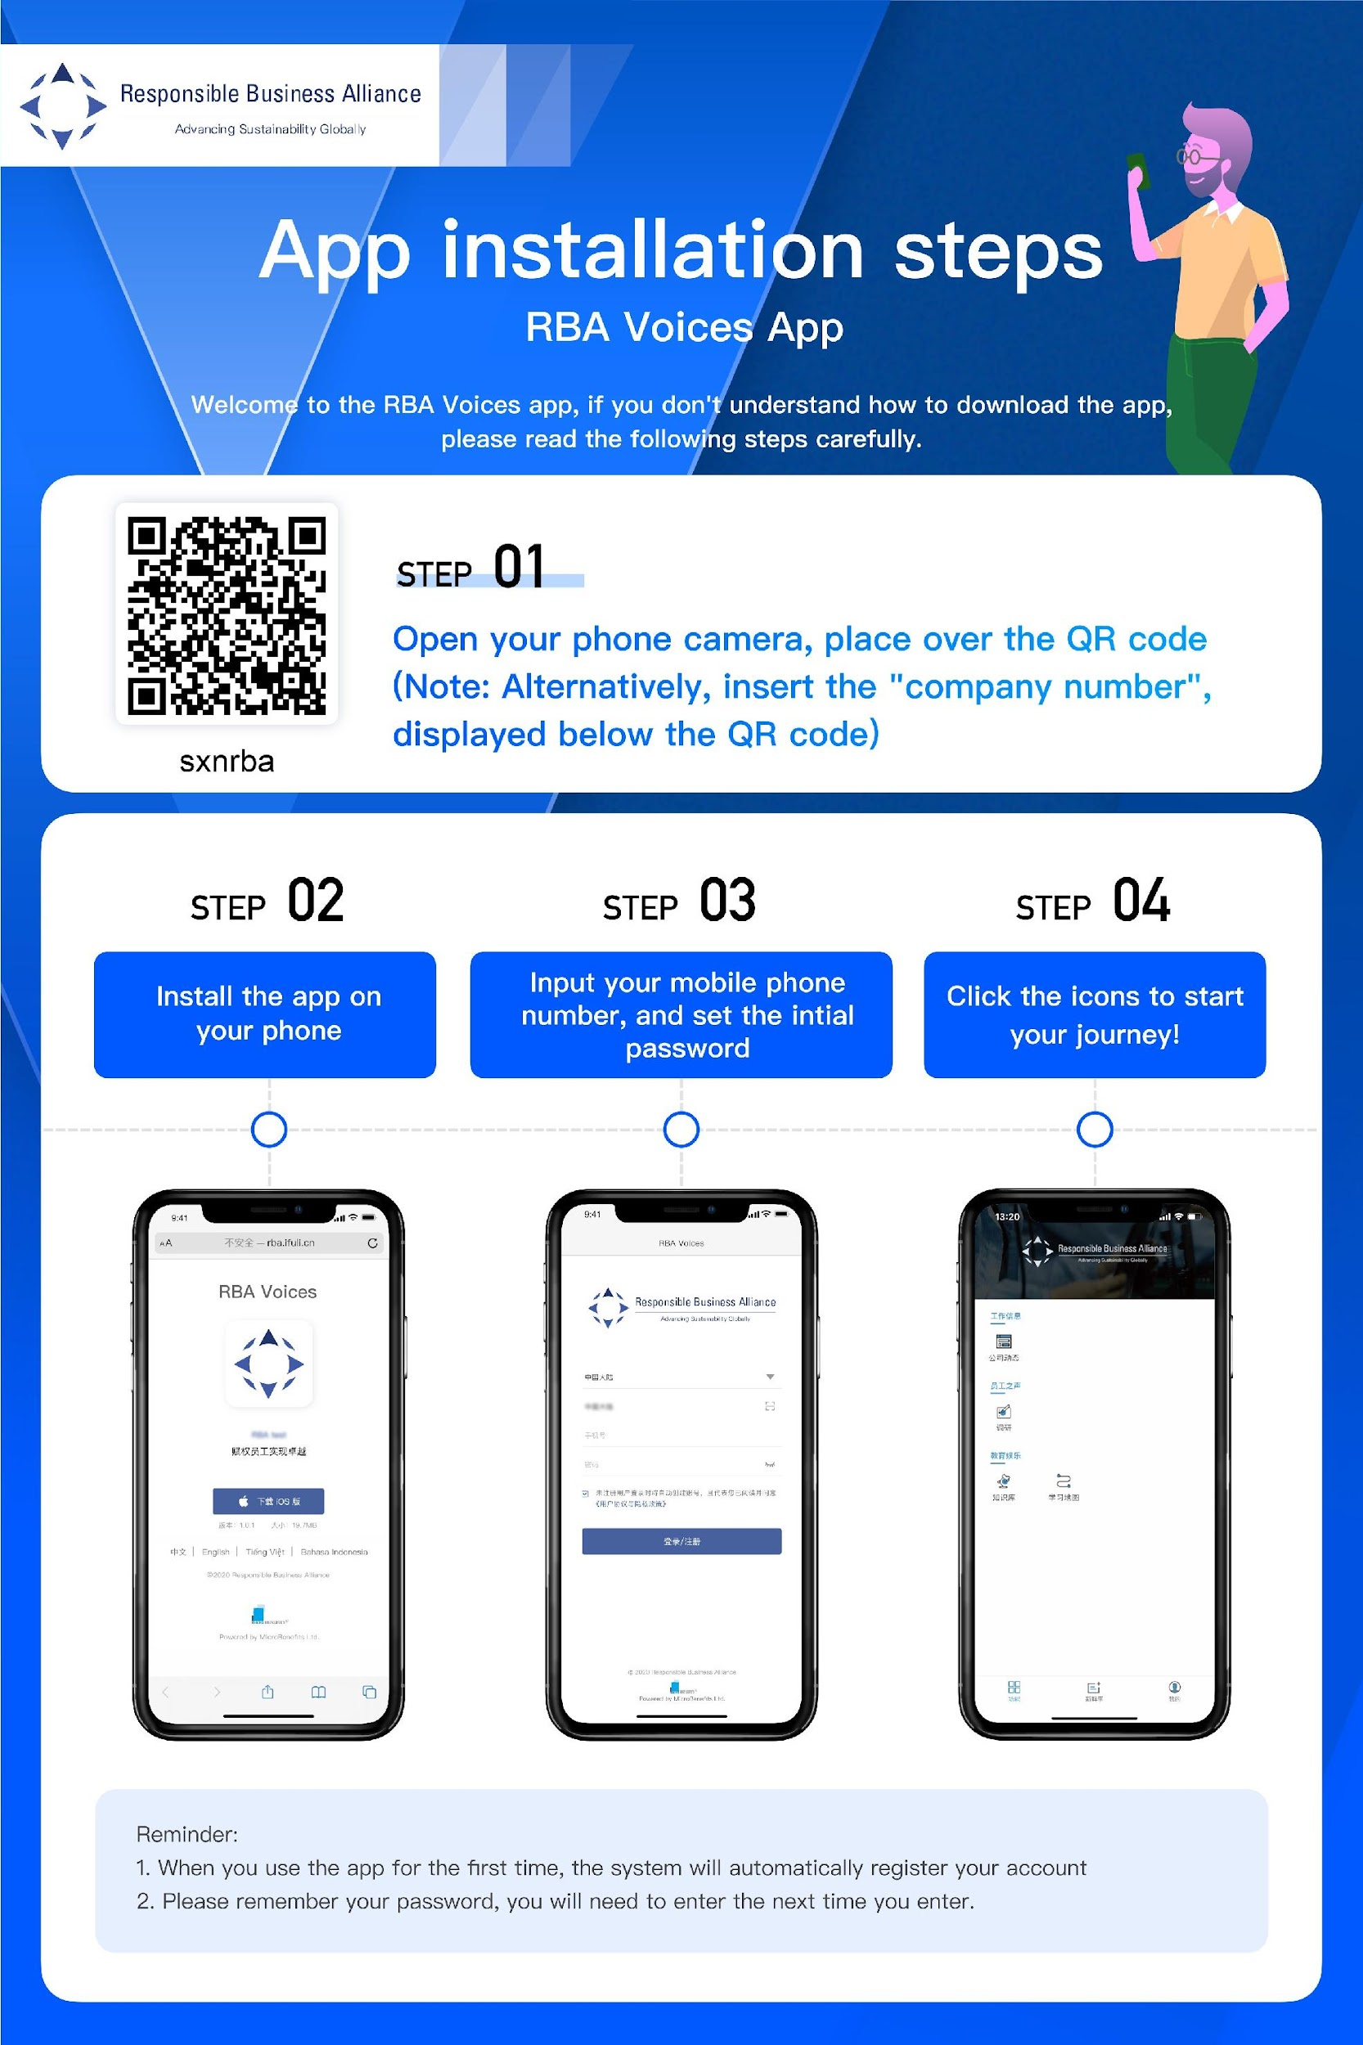

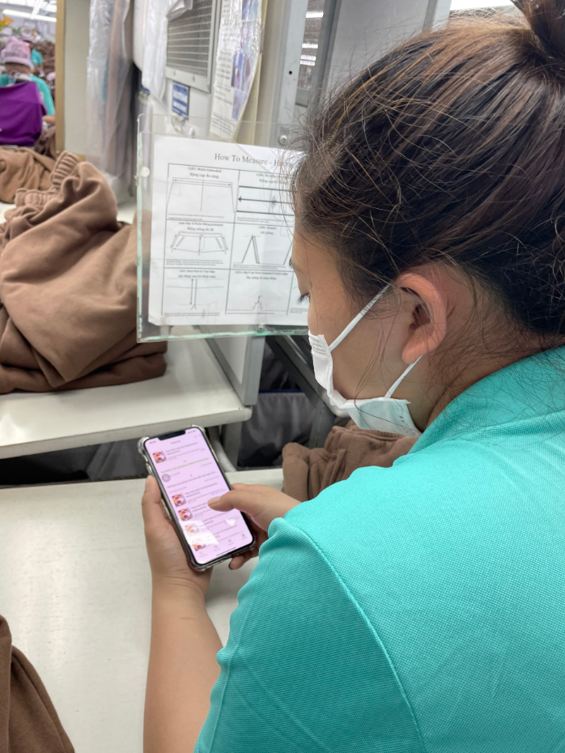
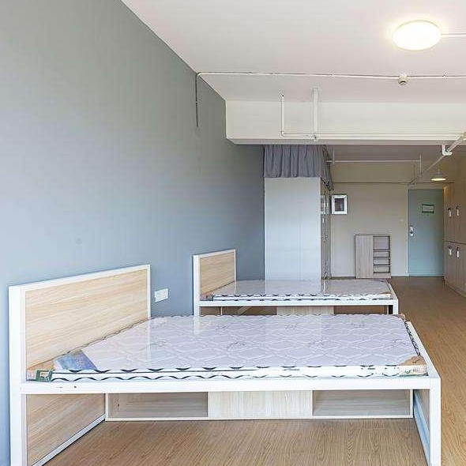

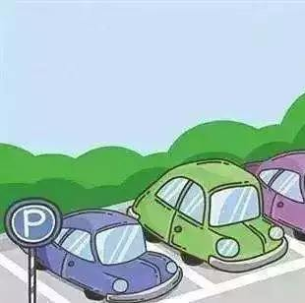


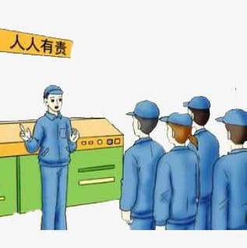
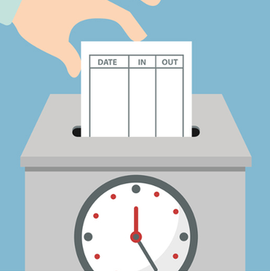
Tool Deployment Process
Factory receives
Onboarding Email
Factory prints out QR Code Poster
Factory positions Poster in common areas
Factory promotes tool to the Workers
Workers scan the QR Code to access Tool & Submit Feedback
Dormitory
Canteen
Parking Lot
Rest Room
Production
Floor
Clock-in Area
Notes:
First, let’s take a look at the overall Tool Deployment Process
By now you have already received the Onboarding Email
In this video, we will guide you through the key contents which are included in that email
Next, We will also teach you how to print out the Feedback Tool Promotion Poster, where to position it within your factory
And what are the most efficient practices to promote the tools to your worker
Lastly, the final goal in this process is successfully invite workers to scan the QR Code on the Poster, access the Tool and Submit feedback whenever they have any inquiries.
It’s a simple process, but it will require the initiative of factory management in order to invite & win the trust of workers, get them to be willing to communicate with the factory. By the end of this deployment process, we hope that your workers will feel encouraged to raise questions, voice up grievance, give innovated suggestions or comments through the Feedback Tool to contribute for the constant improvement of your company.

Slide 3
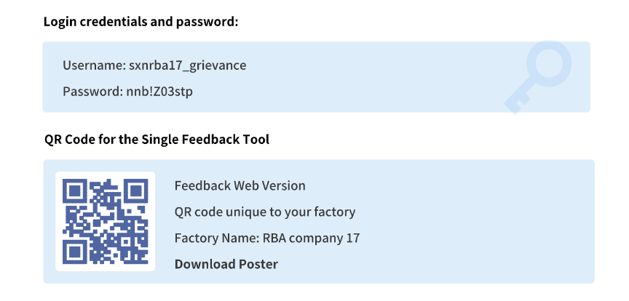

Step 1. Receive Onboarding Email
The Factory Point of Contact (POC) will receive an onboarding email that includes:
Factory’s Backend login credentials
QR Code for workers to scan & access the tool
Pre-made poster for factory to print out
Notes:
Let’s start with step 1. Receive Onboarding Email.
The Onboarding Email that has been sent to your Factory POC will include:
Factory’s Backend Login Credentials
QR Code for workers to scan & access the tool
Pre-made Poster for Factory to print out

Slide 4
Step 2. Download Poster
Click on [Download Poster] in the onboarding
email & download the poster design
Notes:
Step 2. Click on the [Download Poster] button in the Onboarding Email & download the Poster design

Slide 5
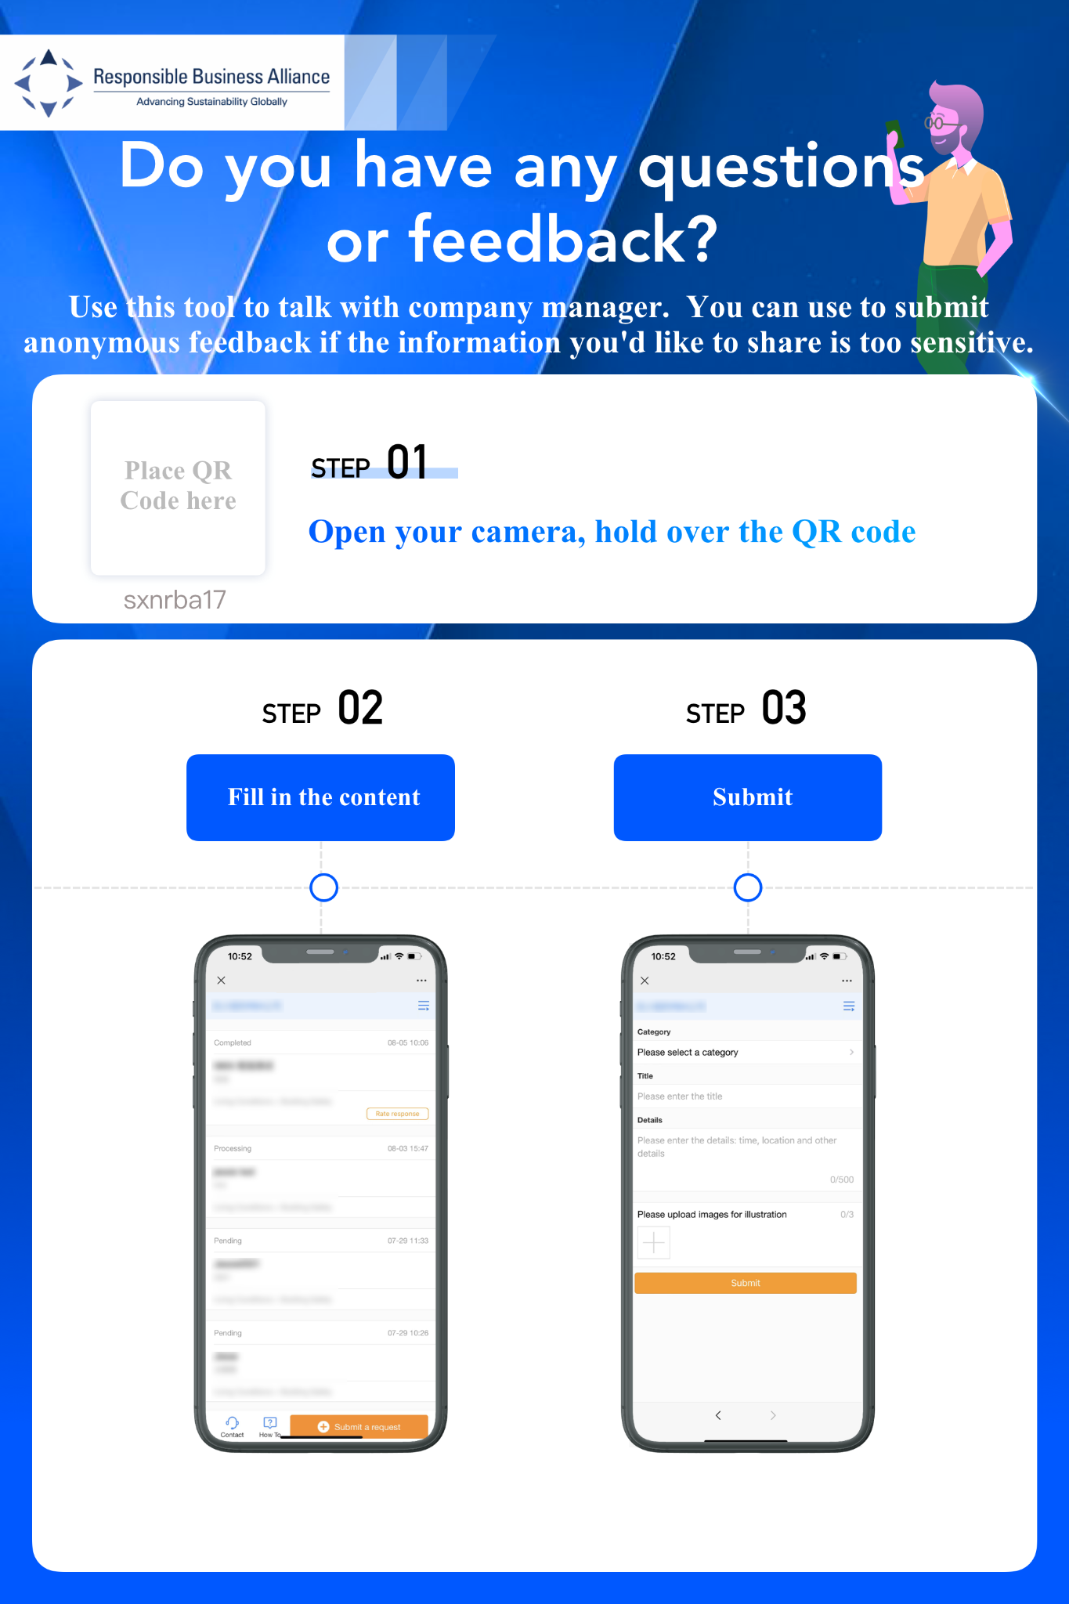
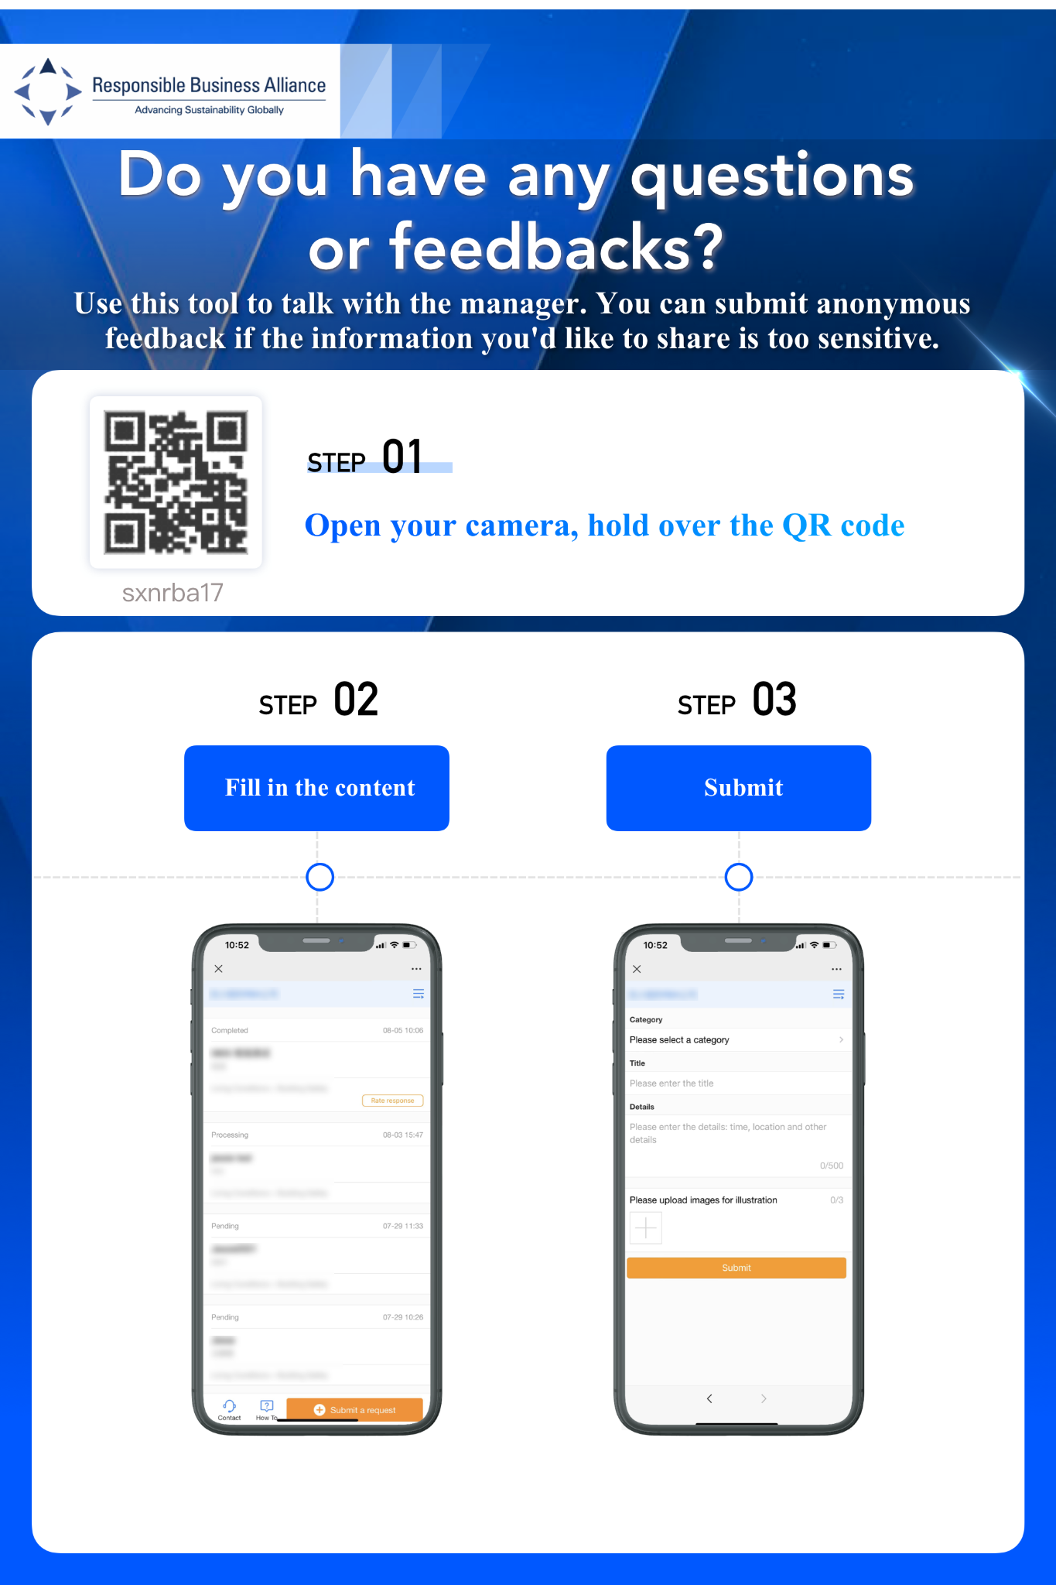
Step 3. Print out the Poster
Print out multiple copies of the poster (with the QR Code already inserted)
Notes:
Step 3. Please print out multiple copies of the Feedback Tool Promotion Poster.
In that poster, there should be: (1) a QR Code which provides a unique access for your factory, (2) an invitation for workers to use this Tool if they want to raise their voices; and (3)
Instructions on how to submit feedback after scanning the QR Code
This poster will help the workers to easily understand how to use this tool & feel more confident in submitting feedback by themselves without asking for assistance from someone, especially if they wish to remain anonymous.

Slide 6



Step 4. Position Posters in Common Areas
Put up posters in areas that are familiar to the workers
So workers can scan the
QR Code & submit feedback according their needs
Dormitory
Canteen
Parking Lot
Placement of posters in high-traffic areas within the factory will give workers easy access to the tool & workers are more likely to submit online Feedback whenever they have any queries.
Lounge Room
Rest Room
Clock-in Area
Production Floor
Printing Area
Notes:
Next, for step 4. Please position these promotion posters in common or high-traffic areas within your factory.
Such as Dormitory, Canteen, Parking Lot, Lounge Room, Rest Room, Clock-In Area, Production Floor, and Printing Area
Having posters around these strategic areas where workers congregate will help the tool to be more accessible for workers to quickly submit feedback in case of need. It will also allow the factory to connect in a timely way with workers for insights & risk-identifications

Slide 7
Step 5. Promote Tool to Workers
2 Weeks of Top-Down, High-Coverage promotion can help workers develop the habit of using
the Feedback Tool, helping the Factory achieve higher value from the Tool.
Communicate with senior management to get support
Senior management send emails to the whole factory
Group leader meeting
Supervisor, team leader held 5-minutes morning meeting to promote to worker
Posting posters
Speaker announcement everyday during the promotion period & repeat at least once a week after that
Held fun lucky draw event at canteen during lunch break. For example: Install RBA Voices App & have a chance of joining lucky lottery
Top-Down Support
Supervisor/team leader communication
Promotional materials
Incentive
(Optional)
01
02
03
04
Notes:
Next, step 5. Please create a marketing plan to promote the tool to your workers.
We highly suggest for a factory to create a 2-week top-down, high coverage promotion plan, to help workers develop the habit of using the Feedback Tool, which in turn will help the factory achieve greater value from the Tool
You can incorporate these strategies into your promotion plan:
Top Down Support: This will require you to communicate with your senior management to get more support from other departments or senior management can send emails to the whole factory announcing the new available communication feedback tool at the factory. This will make sure the news about Tool Launching will be spread to all factory units
During the promotion period, Supervisor or Team Leader could also help by communicating with their team members: This can be done by each team leader during the usual morning meetings by dedicating 5-minutes each time to guide the worker on how to use the Tool.
Besides having posters as promotion material, the factory can also give short public announcement every day during the promotion period to raise worker’s awareness & curiosity about the Tool. The factory make a record of this announcement and we suggest that after the promotion week, play repeatedly this audio message at least once a week.
Last but not least, factory can also give out incentives as an encouragement to workers who have installed the RBA Voices App. This is optional, depending on the resources of the factory. From our experience, workers will likely adapt & use the new tool quicker if they already have it pre-installed on their mobile phone.

Slide 8
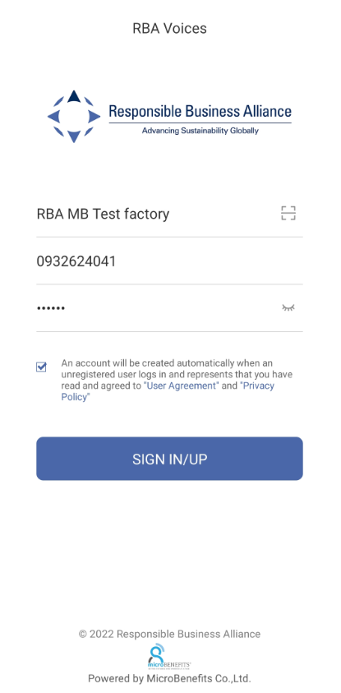
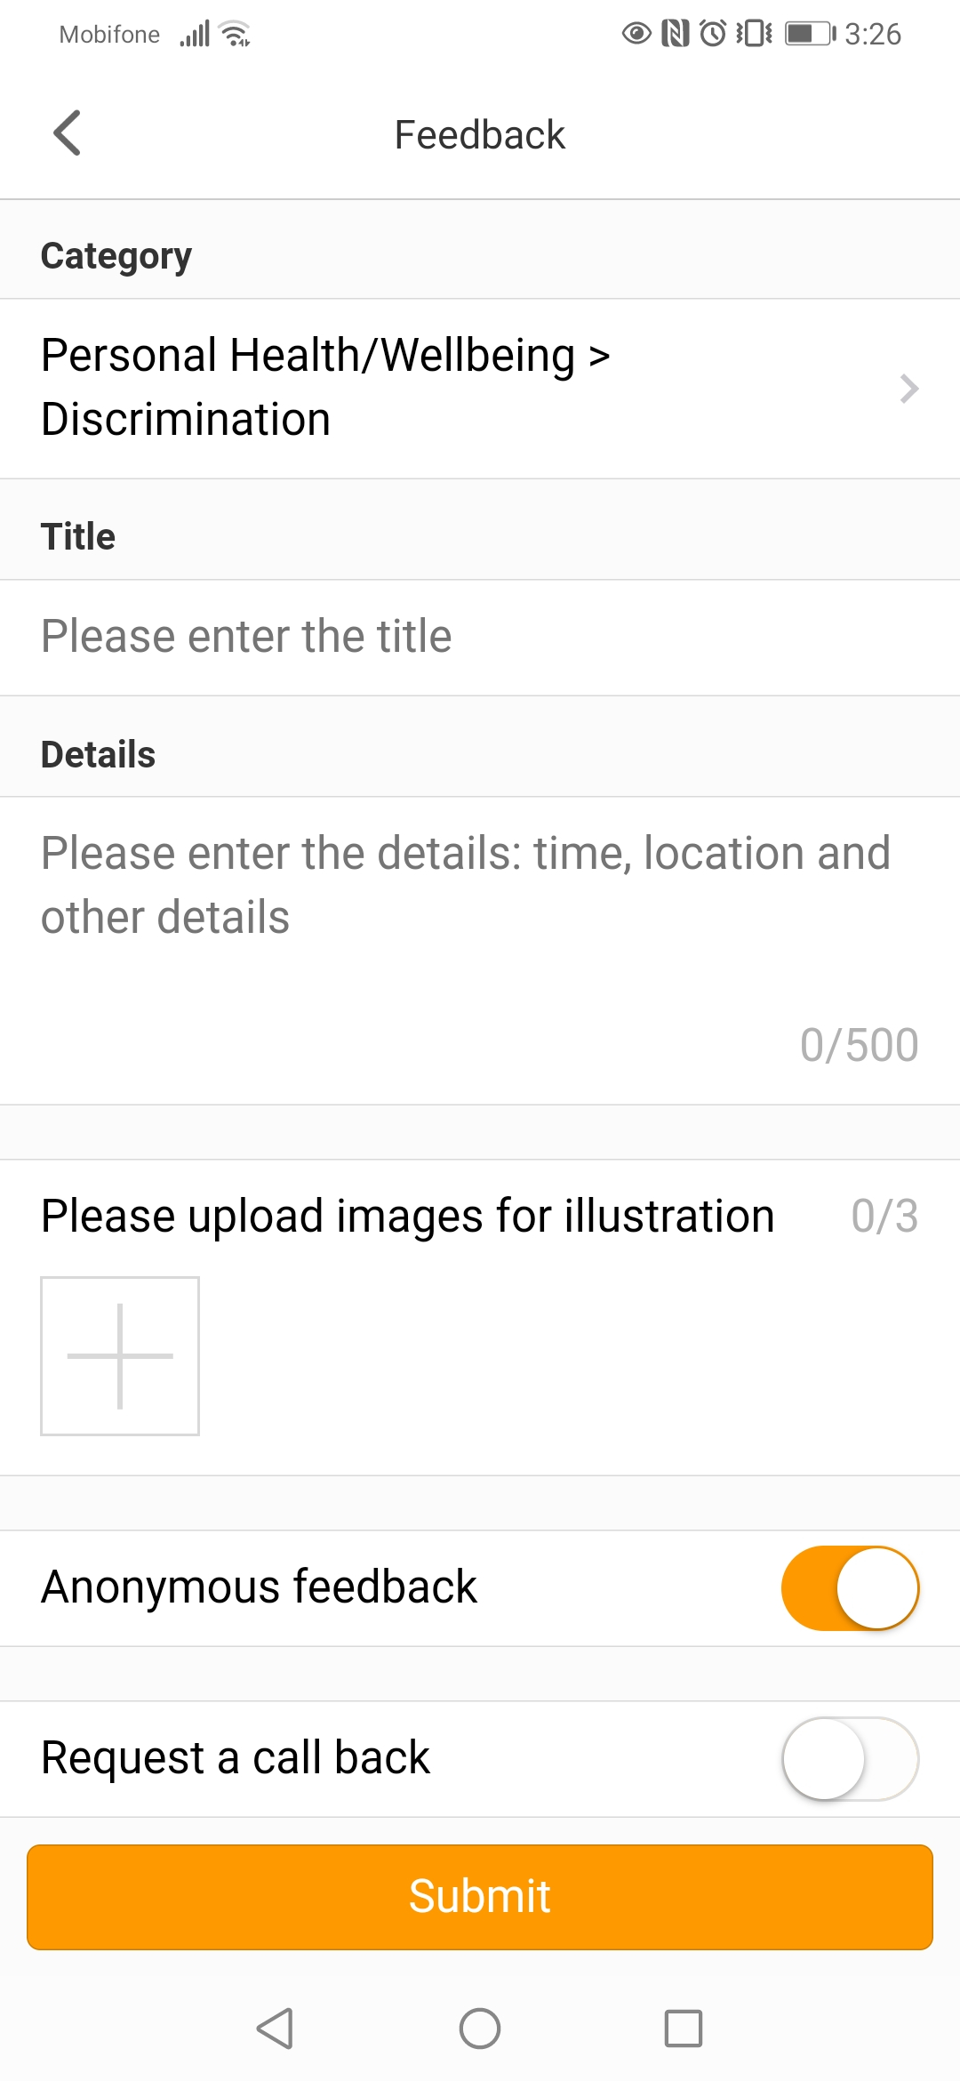
Key Points in Tool Promotion
1. Tool Introduction
2. How to Access Tool
3. How to Sign-up and Log-In
4. How to Submit Feedback & Receive Response
-Feedback Tool: A mobile platform communication channel which allows workers to have a 1-on-1 private dialogue with the manager.
- Workers can help factory identify risks at production floor & improve working experience by submitting a feedback.
-Workers can conveniently submit inquiries from anywhere, anytime.
-Workers can submit inquiries anonymously for sensitive information.
-Workers can escalate grievances to 3rd party organizations for further oversight.
Factory Name
Employee ID or Mobile #
Password
Notes:
As you communicate with the workers about the tool, here’re 4 key points that you should include:
Point No 1: Tool Introduction
-Feedback Tool: A mobile platform communication channel which allows worker to have 1-on-1 private dialogue with the manager
-Workers can help factory to identify risk at production floor & improve working experience by submitting feedback
-Workers can conveniently submit inquiries from anywhere, anytime
-Workers can submit inquiries anonymously for sensitive information
-Workers can escalate grievances to 3rd party organizations for further oversight.
Point No 2: How to Access the Tool. This instruction can be found directly on the poster.
Point No. 3: How to Sign up/ Log in. It would be best if group & team leader can provide hands-on assistance to the worker on how to type in EmployeeID or Mobile Number & Password
Point No. 4: How to submit Feedback & receive response. Also, Please don’t forget to tell workers about the anonymous feature & escalation feature of the Tool.
It’s very important that during the promotion period, all workers should be aware of these 4 key points.
And that is all for this video. We wish you a very successful deployment.
Thank you for watching

