Slide 1
Factory Quick Guide:
Backend Login
& Key Features Introduction
Notes:
Welcome to Factory Quick Guide Video

Slide 2

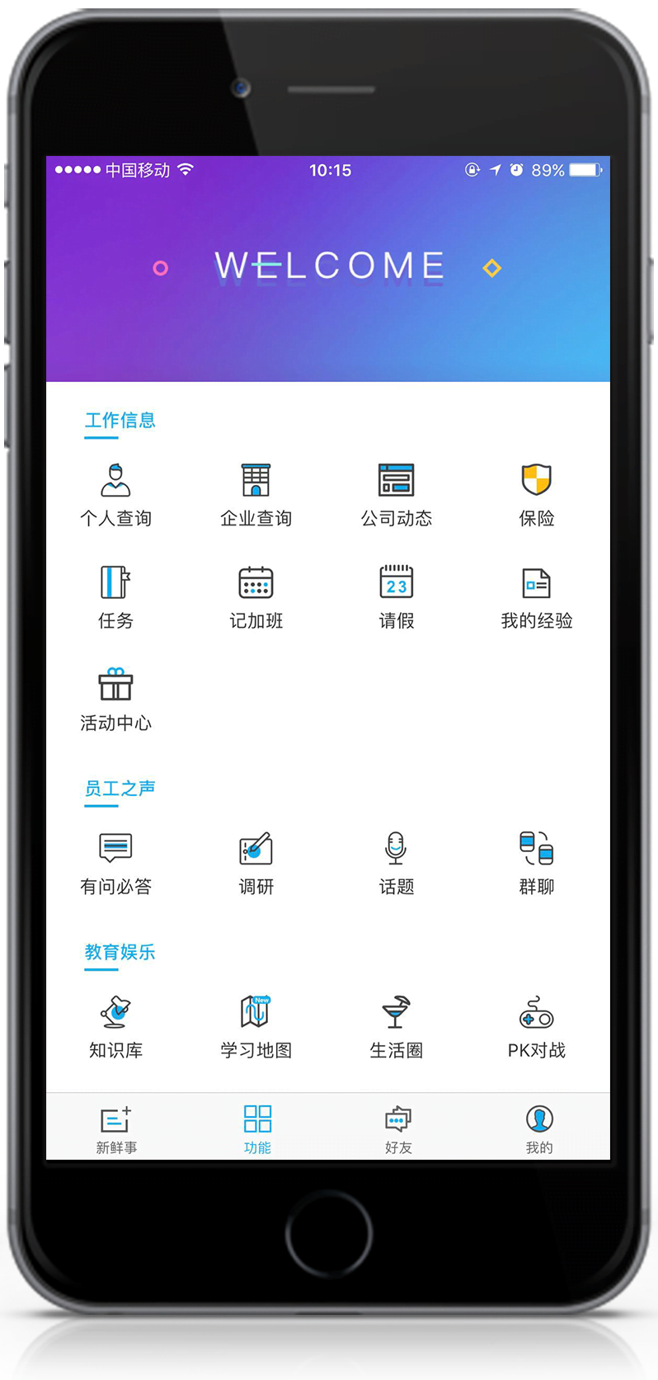

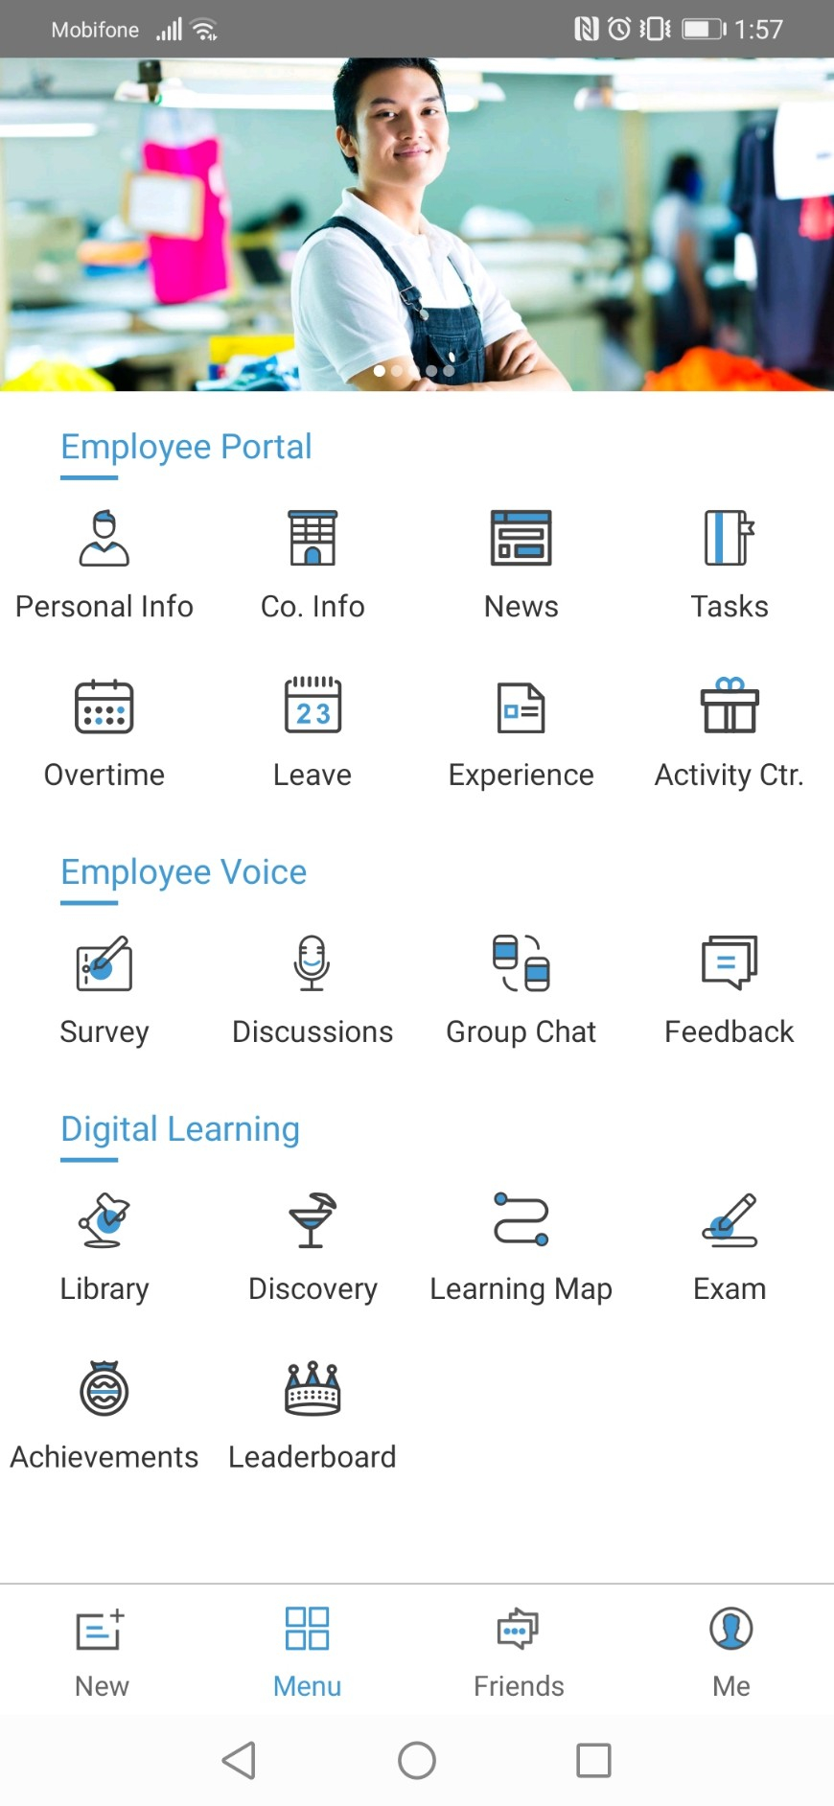
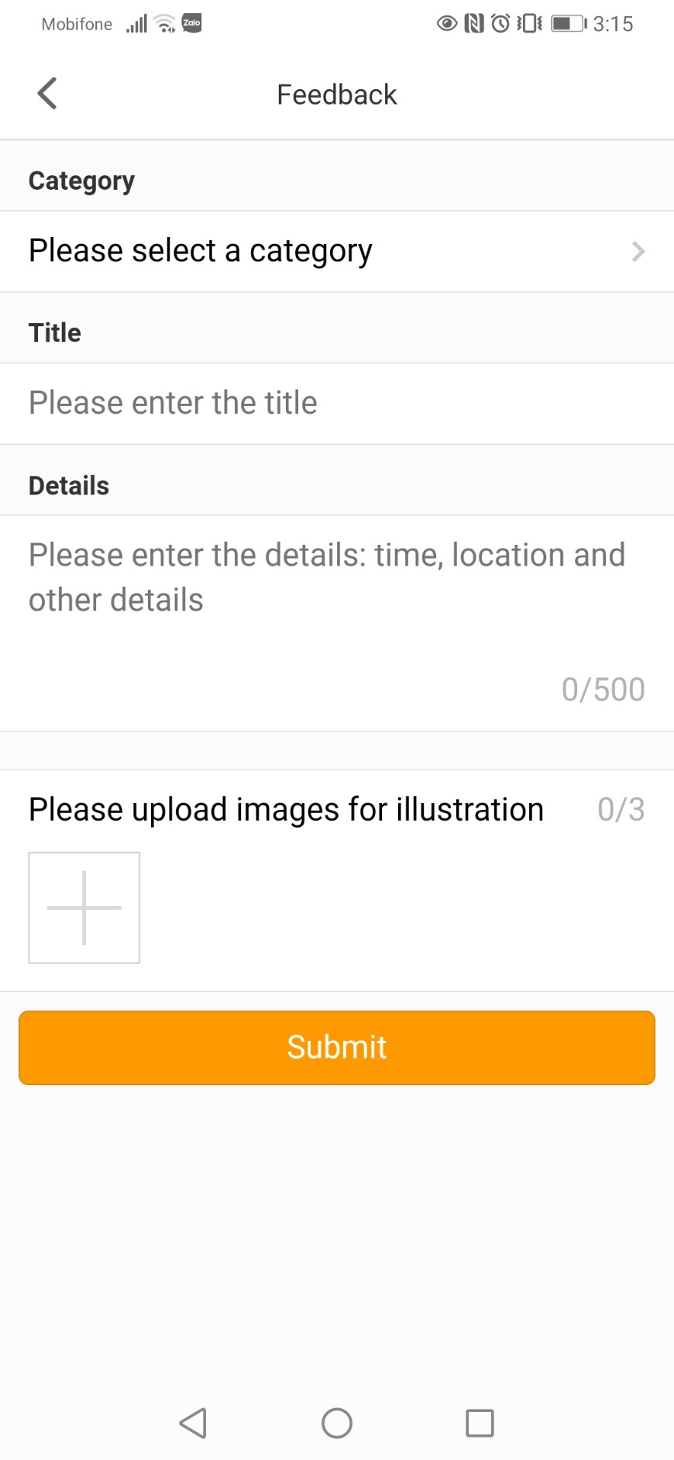

RBA Feedback Tool
Use Smartphone
To Scan QR Code
& Submit Feedback
Use PC / Laptop to Manage & Respond to Feedback via Backend Website
Employees
Factory Admin
MicroBenefits
Notes:
Within the RBA Feedback Tool, there are 2 different portals: The 1st one is for the employee & the 2nd one is for the factory admin.
Employee can submit feedback by using their smartphone to scan the QR Code
Factory admin can manage & give response to employee’s feedback through the Backend Website
In this video, we will teach you How To Login the Backend & What are the key features of the Backend?

Slide 3
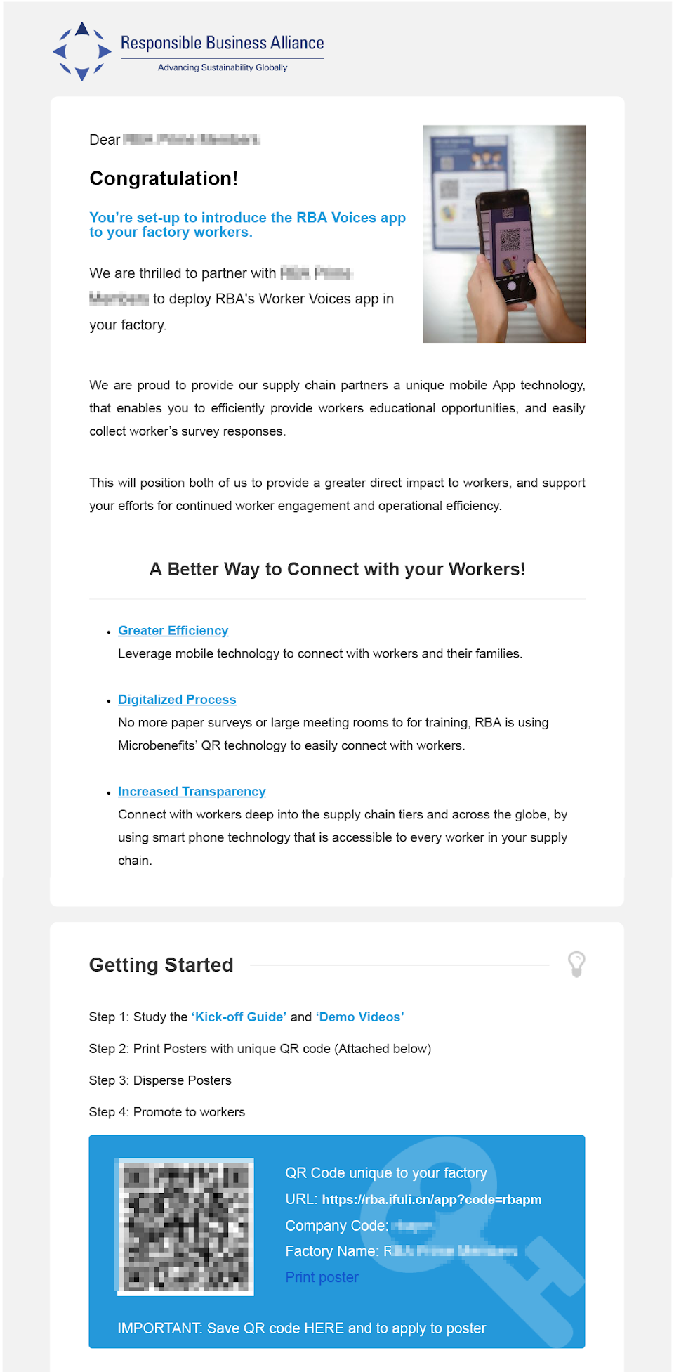

Backend Login
Step 1. Access Feedback Backend & login with your Login Credentials
Login Credentials
are emailed to you
Notes:
At the final page of the onboarding training course, you will be given an URL which direct to the Backend.
Please click on that link & login with your Login Credentials.
(show on screen the credentials in the email, enter username+password, click login)

Slide 4
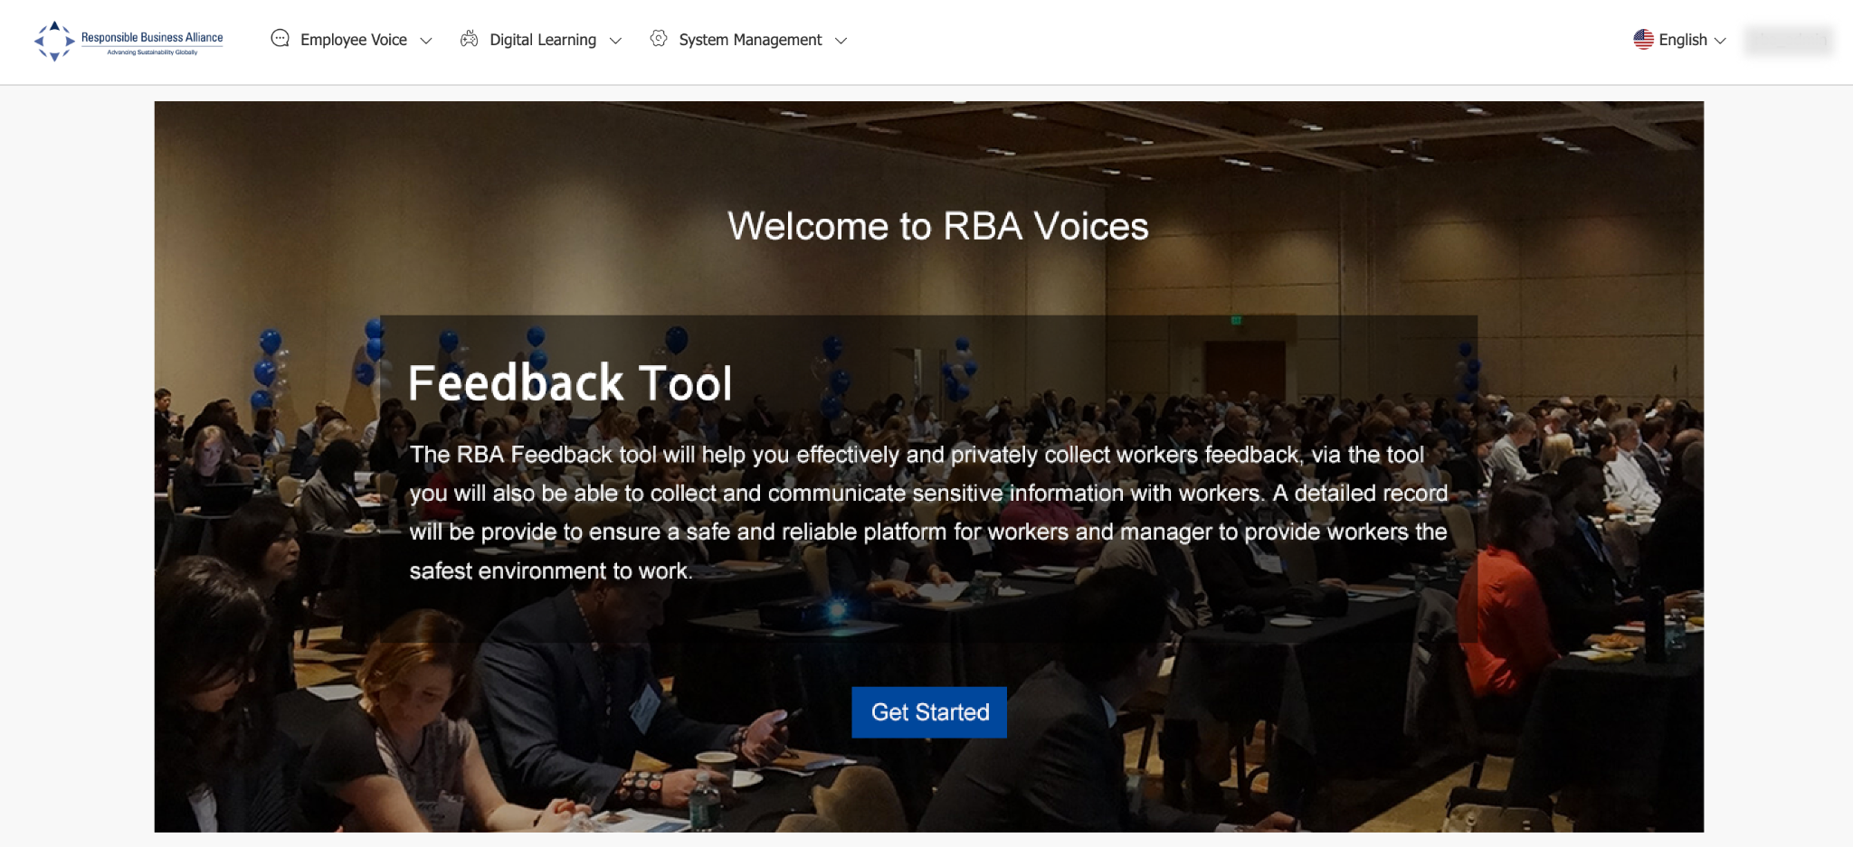
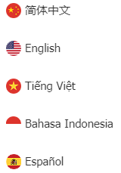
Backend Login
Step 2. At [Feedback Tool] section > Click on [Get Started]
Click on this if you wish to view Backend in a different language
Languages available
Notes:
If you wish to view Backend in different language, please click on this icon
Then, At the [Feedback Tool] section > Click on [Get Started]

Slide 5
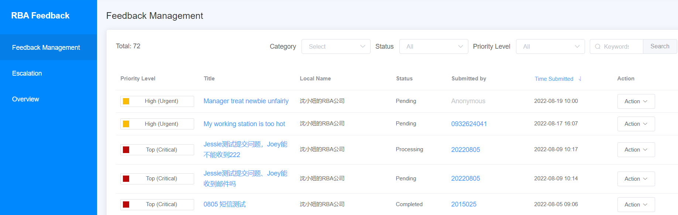
Feedback Management
Next, on this page you will find a list of all Feedback submitted by the workers.
Notes:
First, on the Feedback Management page you will find a list of all Feedback submitted by the workers. This is where the factory admin can manage & respond to the employee’s feedback. We will give you further details and instruction on how to respond to feedback in another video.

Slide 6
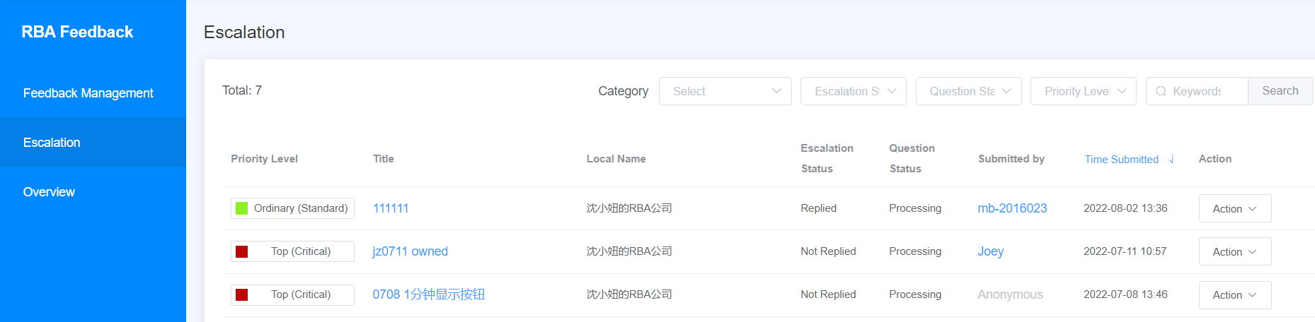
Escalation
What is the Escalation feature?
Who can view & reply to the Escalated Feedback?
Notes:
Next, on this page, you will find escalation feedbacks

Slide 7


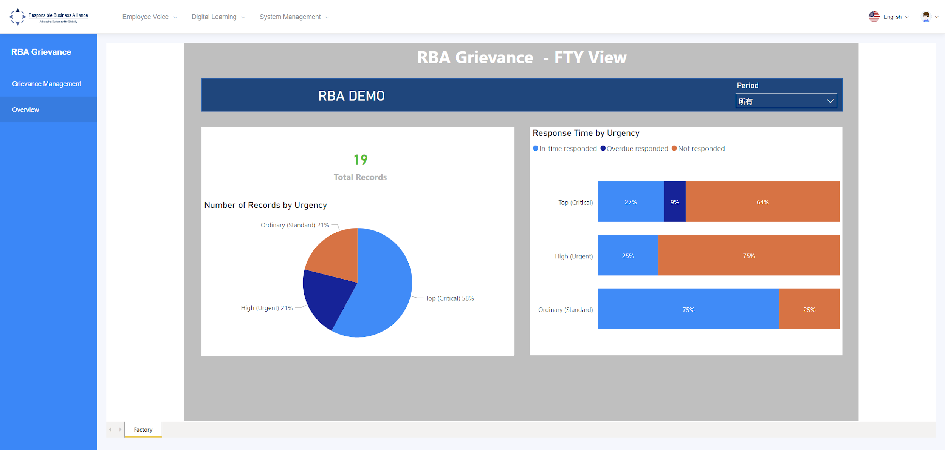
Report
Once the Factory deploys the feedback tool to the employees, the system will calculate the number of feedback submitted and generate an analysis report for the Factory.
Factory deploys tool to Employees
Employees submit Feedback
Factory responds to Feedback
System records all Feedback Dialogue
Factory views Analysis Record
Notes:
Lastly, you can also find the feedback report on this website.
As the employees use the tool to submit feedback to the factory, the Backend system will not only record the details of the feedback, but also analyze the total number of feedback submitted by the employees and generate an Analysis Report for the Factory

Slide 8
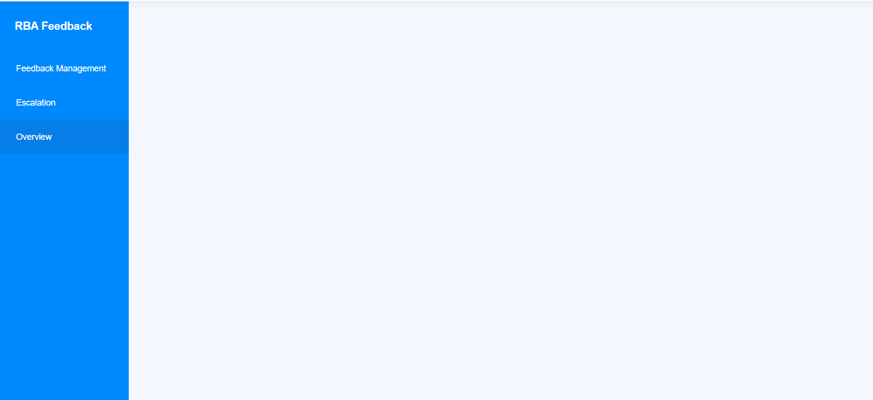
On the left panel, click on [Overview].
Here, the Factory can view the analysis report on the feedback submitted by the employees.
Notes:
All you need to do is go to Backend and on the left panel, click on [Overview]

Slide 9
You can view a specific report by selecting [Period of time]
Notes:
and choose the Period of time you would like the system to show you.
You can check back on this report as many times as you want and anytime

Slide 10
Description of Terms
Total Records: Total amount of feedback that was submitted within a period of time
                Ordinary (Standard): Low urgency feedback that require response within 72 hours
                High (Urgent): High urgency feedback that require response within 48 hours
                Top (Critical): Very high urgency feedback that require response within 24 hours
In-time responded: Factory has replied to feedback within the response time limit
Overdue responded: Factory has replied to feedback outside the response time limit
Not responded: Factory has NOT replied to feedback
Notes:
If this is your first time seeing this report, here is a description of terms to help you understand how to read this report. You can pause this video here to take a closer look.
And that is all for this video. Thank you for watching.

