Slide 1




RBA Grievance Mechanism
RBA Worker Voice Program
June 2021
MicroBenefits
www.microbenefits.com

Slide 2


03
Member View
02
Supplier View
03
RBA and NGO View
04
Frontend view (worker view)

Slide 3
Material:
“How to” PPT’s to show flow (presentation uses)
Short instruction Video
Q&A Documents
Website -
Topics:
Member: How to deploy Grievance Tool
    Existing app
    New member launch
    Grievance app introduction
Member: Backend Management
  How to response to grievance messages
  Company FTY vs. Non-company FTY’s
Factory:
  How to onboard workers
  How to navigate and respond to workers
  Response time requirements
  NGO oversite/ customer oversite
D. How to get started
a. document
b. video
E. Data visual
Notes:
UN GP – state in materials

Slide 4

01.
Member View

Slide 5
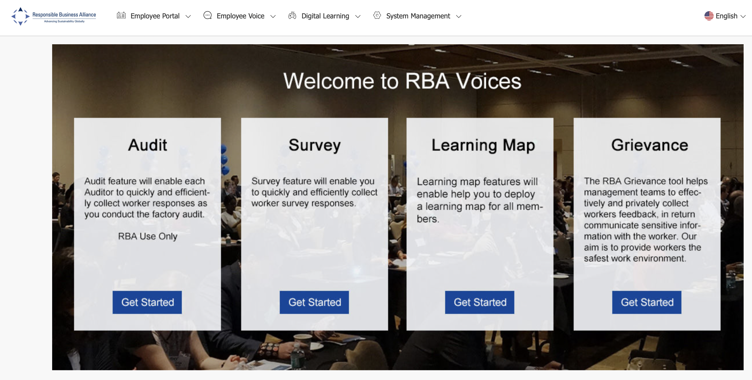
Member login to the RBA backend account to deploy the grievance feature, members FTY’s are integrated from RBA Online. Will add a data share authorization link.

Slide 6
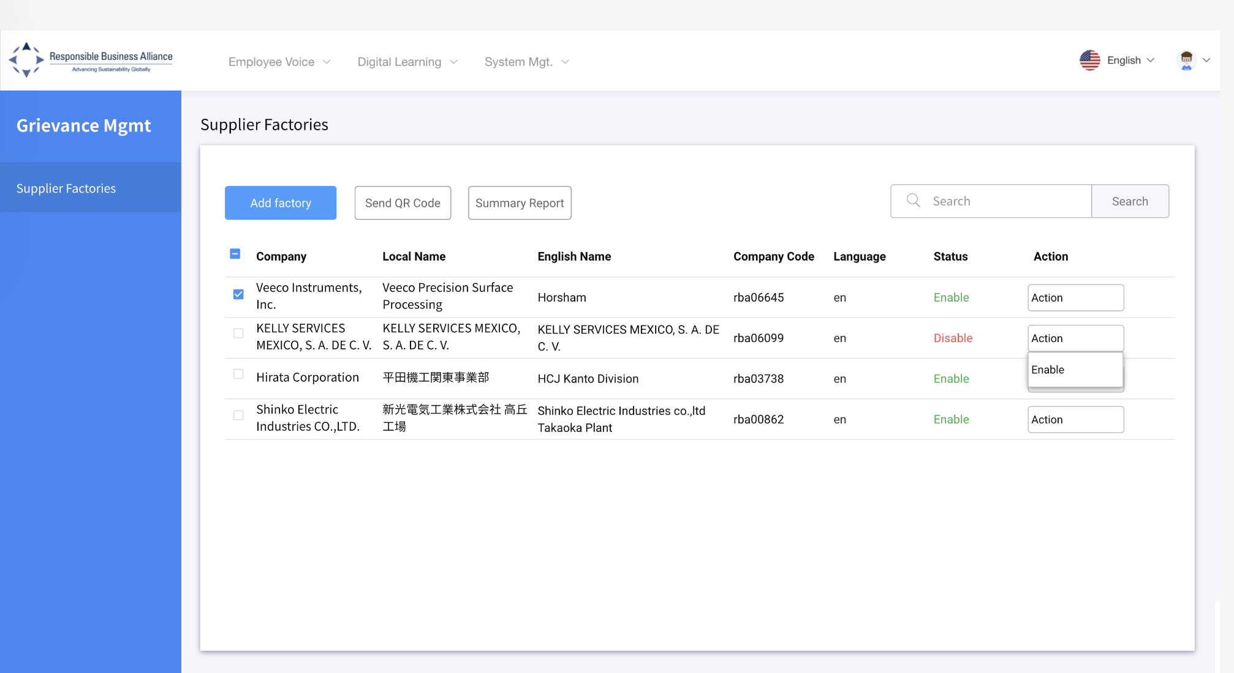
Lists all factories that have launched the grievance tool, and their status ‘enable’ or ‘disable’.
- select “Add Factory” to access a full list factories linked to member RBA ID #

Slide 7
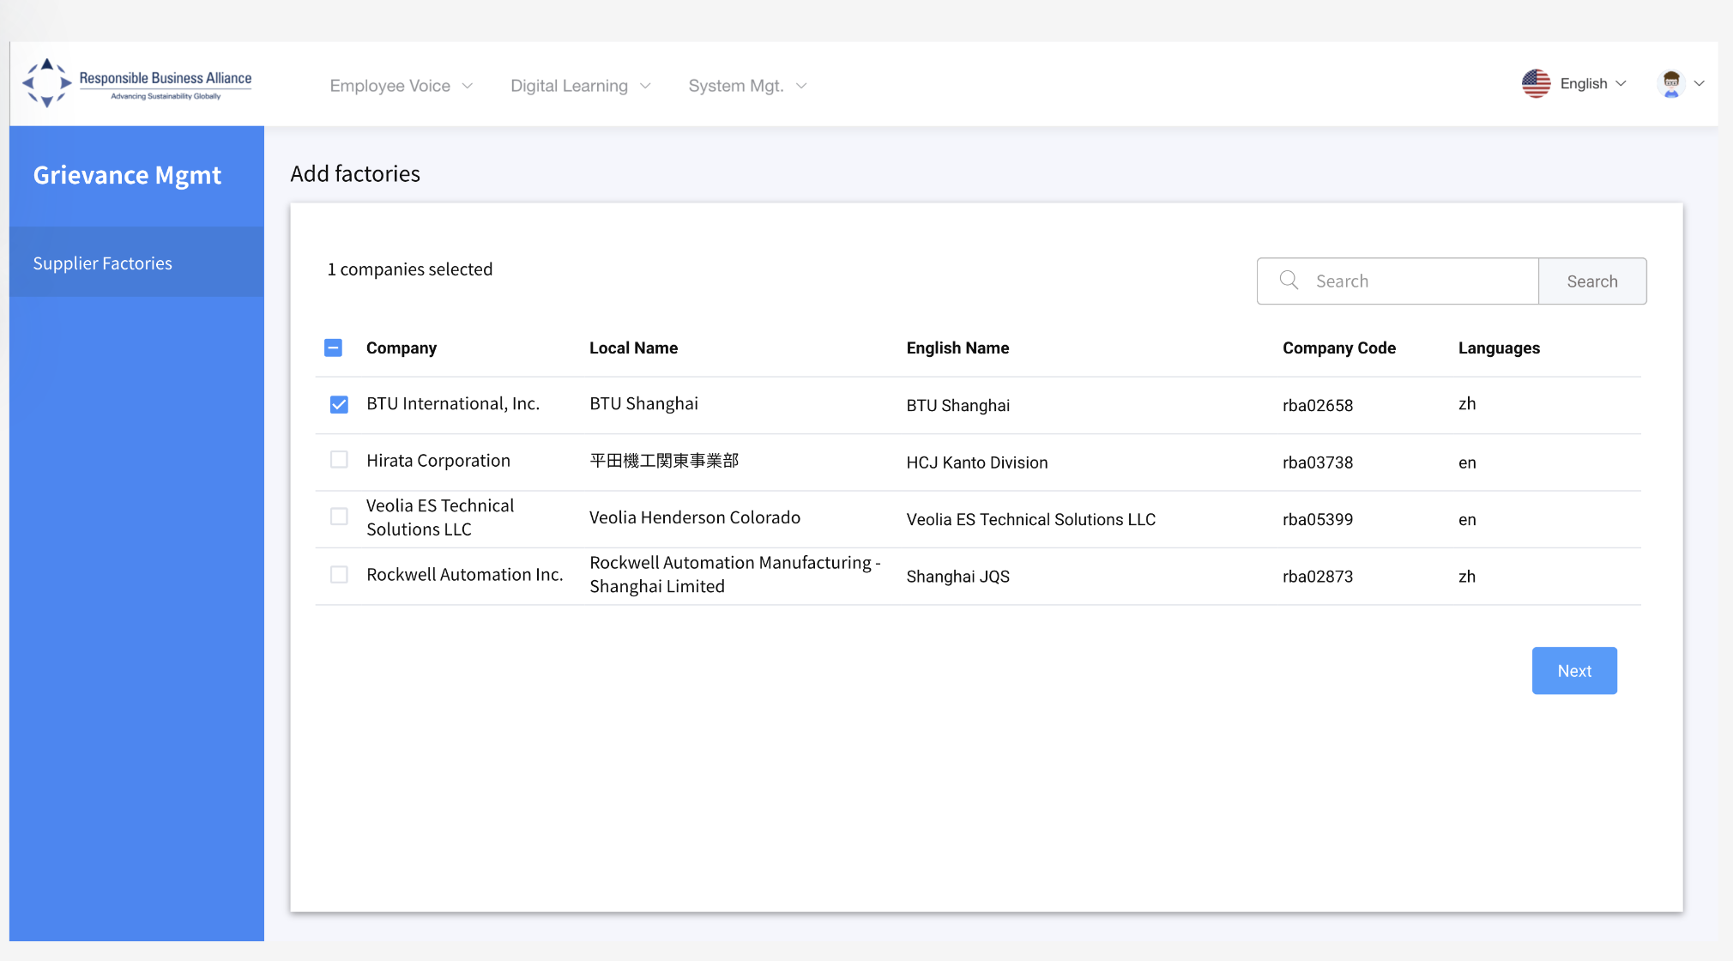
Select the Factory (s) you’d like to launch the grievance tool.
Then select “next”

Slide 8
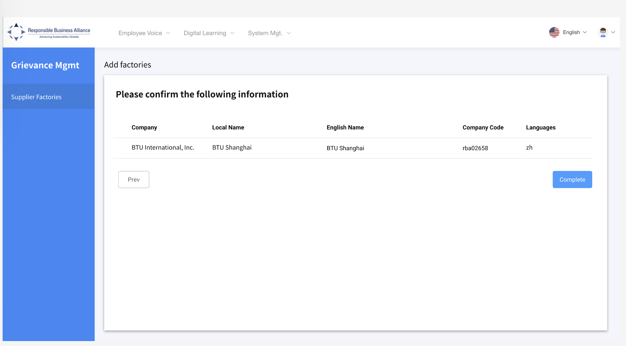
- Review and Confirm information, then select ‘next’.

Slide 9
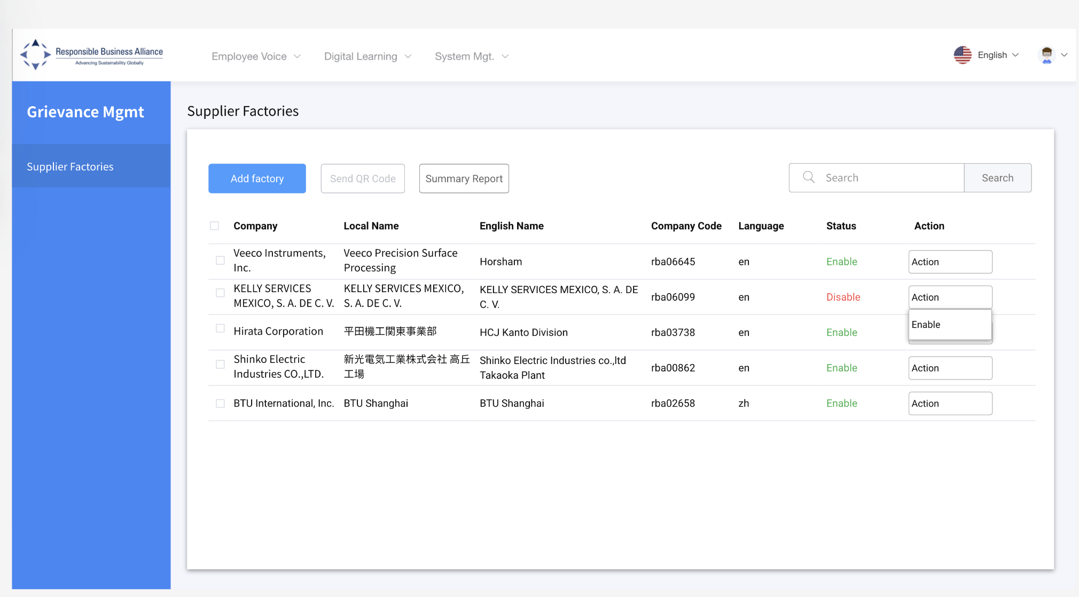
A member will see the factory(s) already deployed. Send QR code tick and select “send QR code”.
- Select “action tab” to disable grievance tool. Note: automatically activates to the app

Slide 10
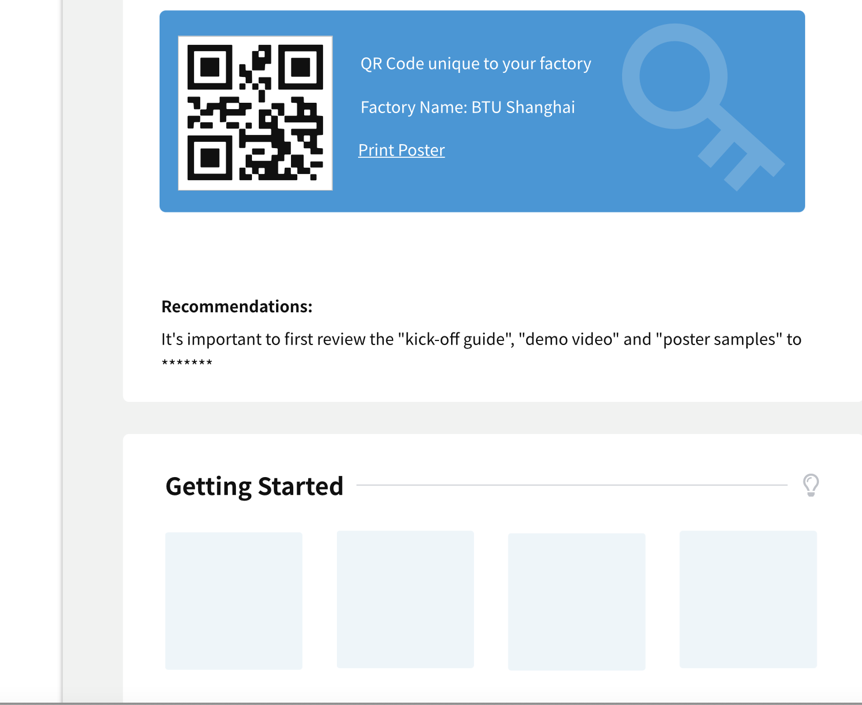
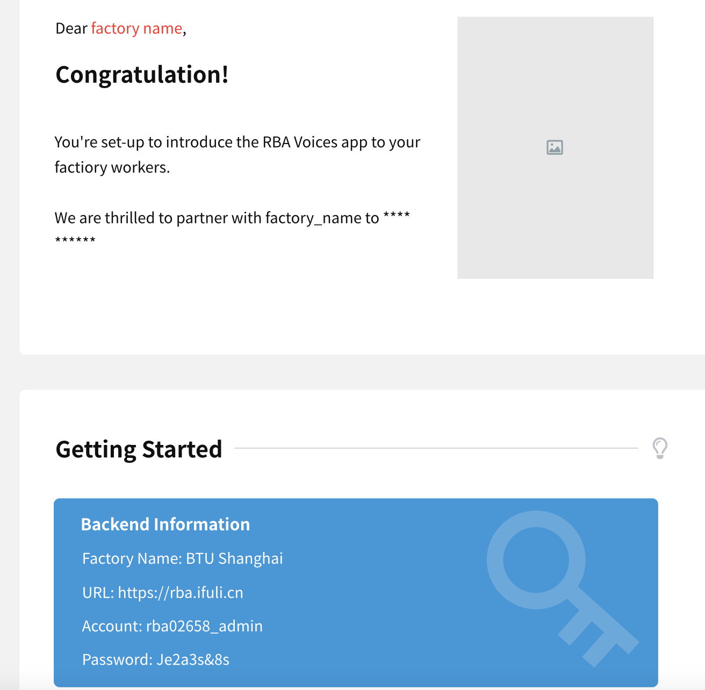
An email will be sent to the FTY contact in RBA Online, includes:
- RBA Voices app QR code (download app)
- FTY backend login credentials
- Grievance tool “How To”

Slide 11
Sharing information (phase II)
Factory approval is complex

Slide 12
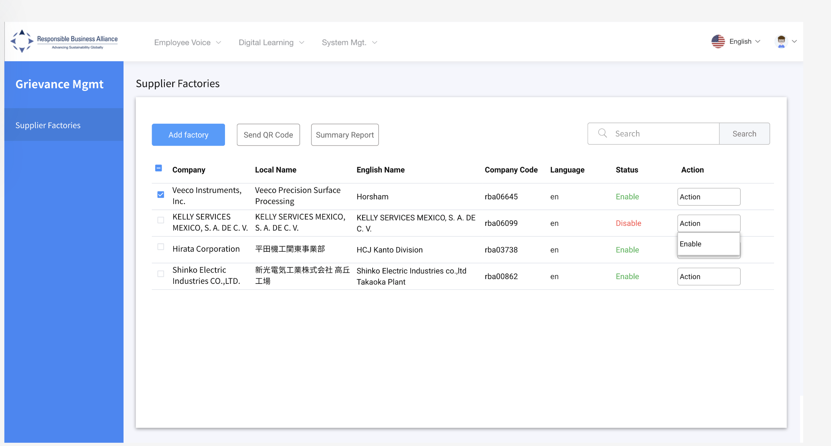
Member Grievance Reports:

Slide 13
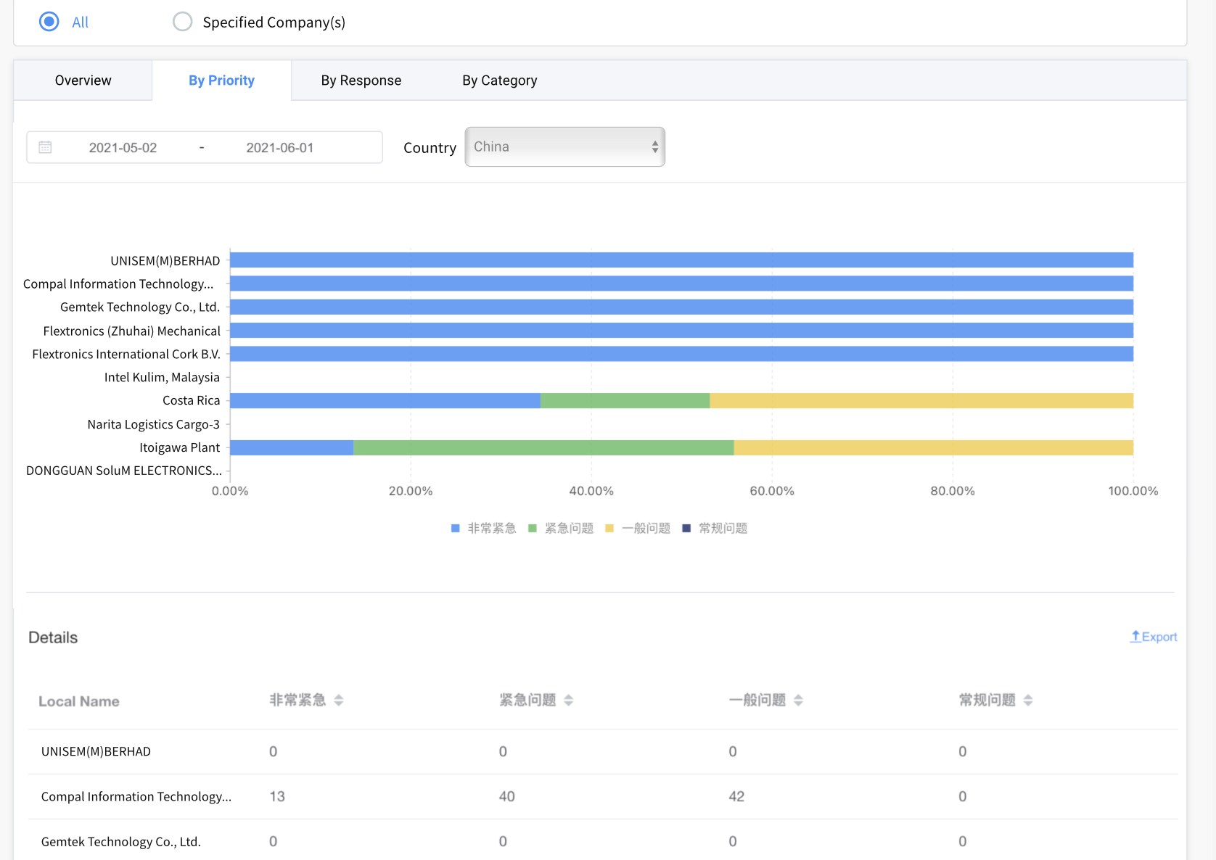
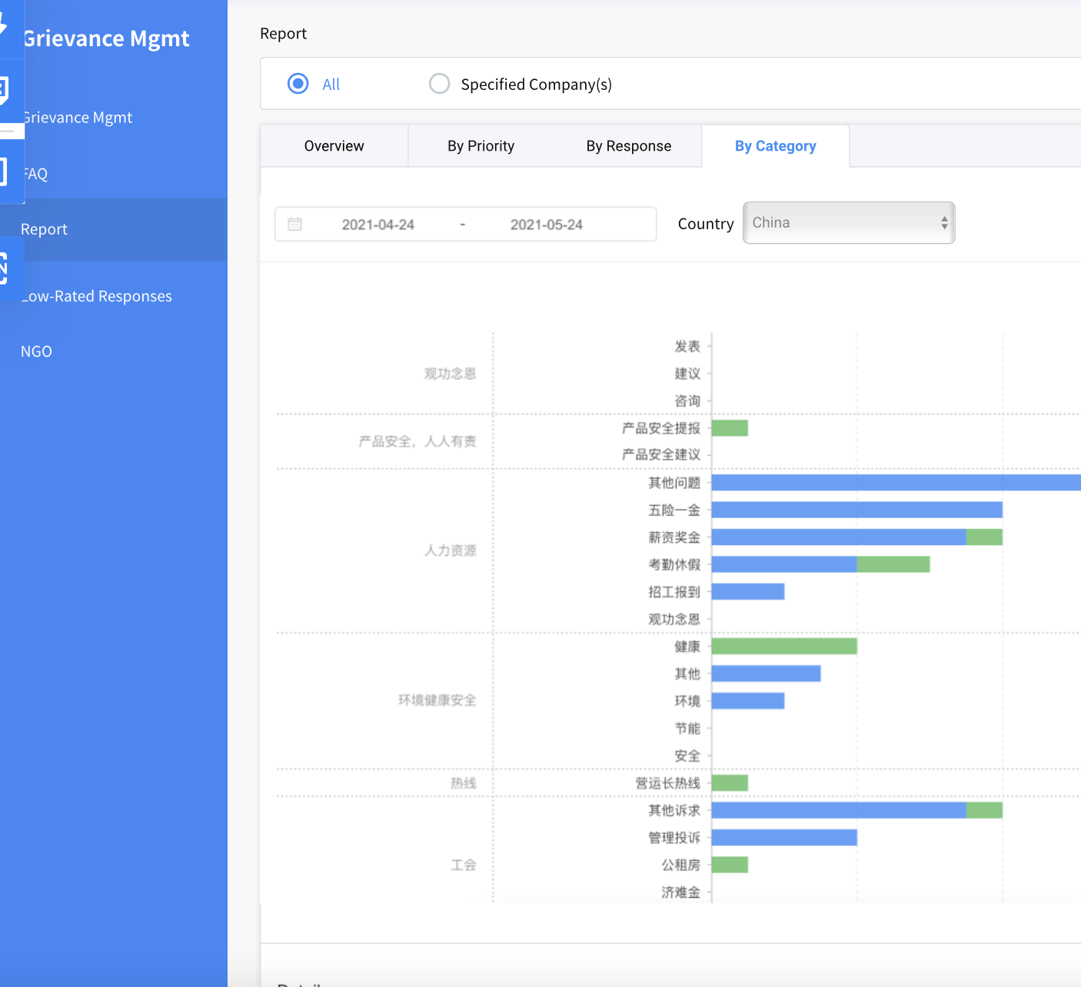
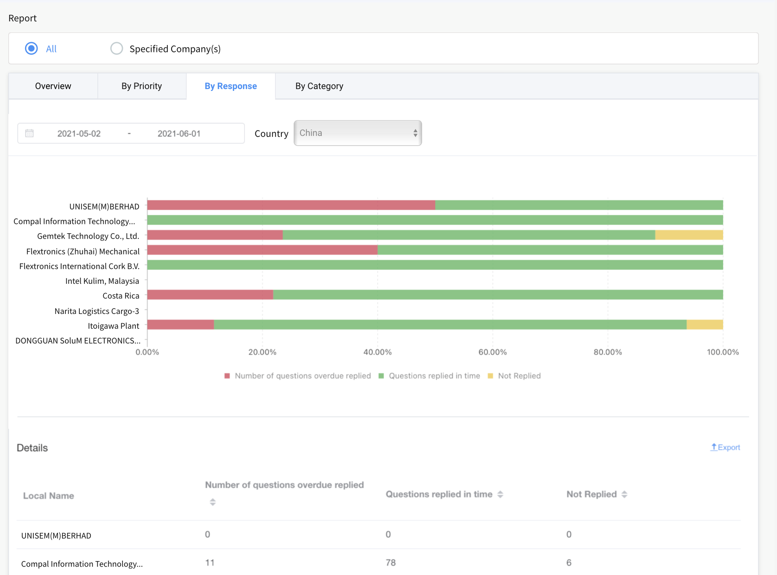
Member Report 1: Grievance by Priority level
Member Report 2: Response time by Factory
Member Report 3: Grievance by Category
Note: No detailed grievances will be included in the member reports.

Slide 14
01.
Factory View

Slide 15
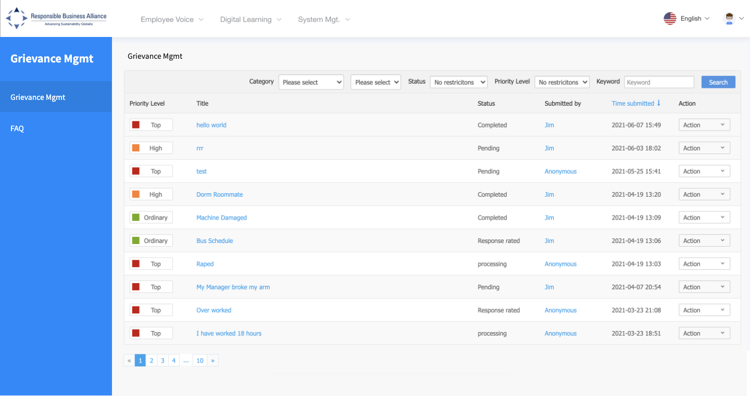
Once a worker submits a grievance, the message will be received in the factory dashboard. The factory will click on the link to view and corresponded with worker.
Note: the login credentials are sent in the email

Slide 16
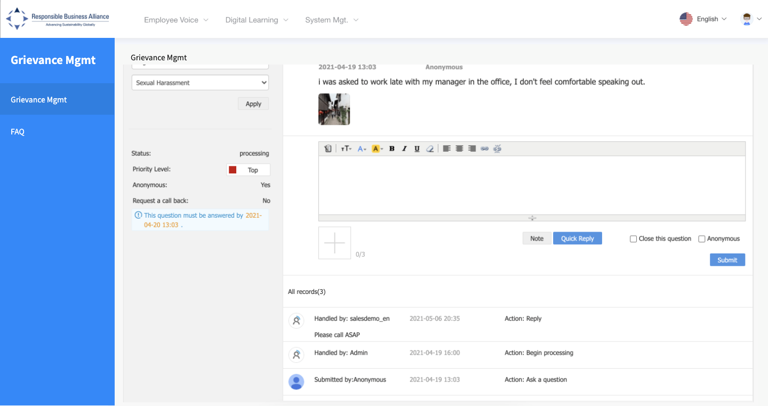
Factory view of an individual grievance dialogue with a worker. Select “close the question” to end the dialogue.

Slide 17
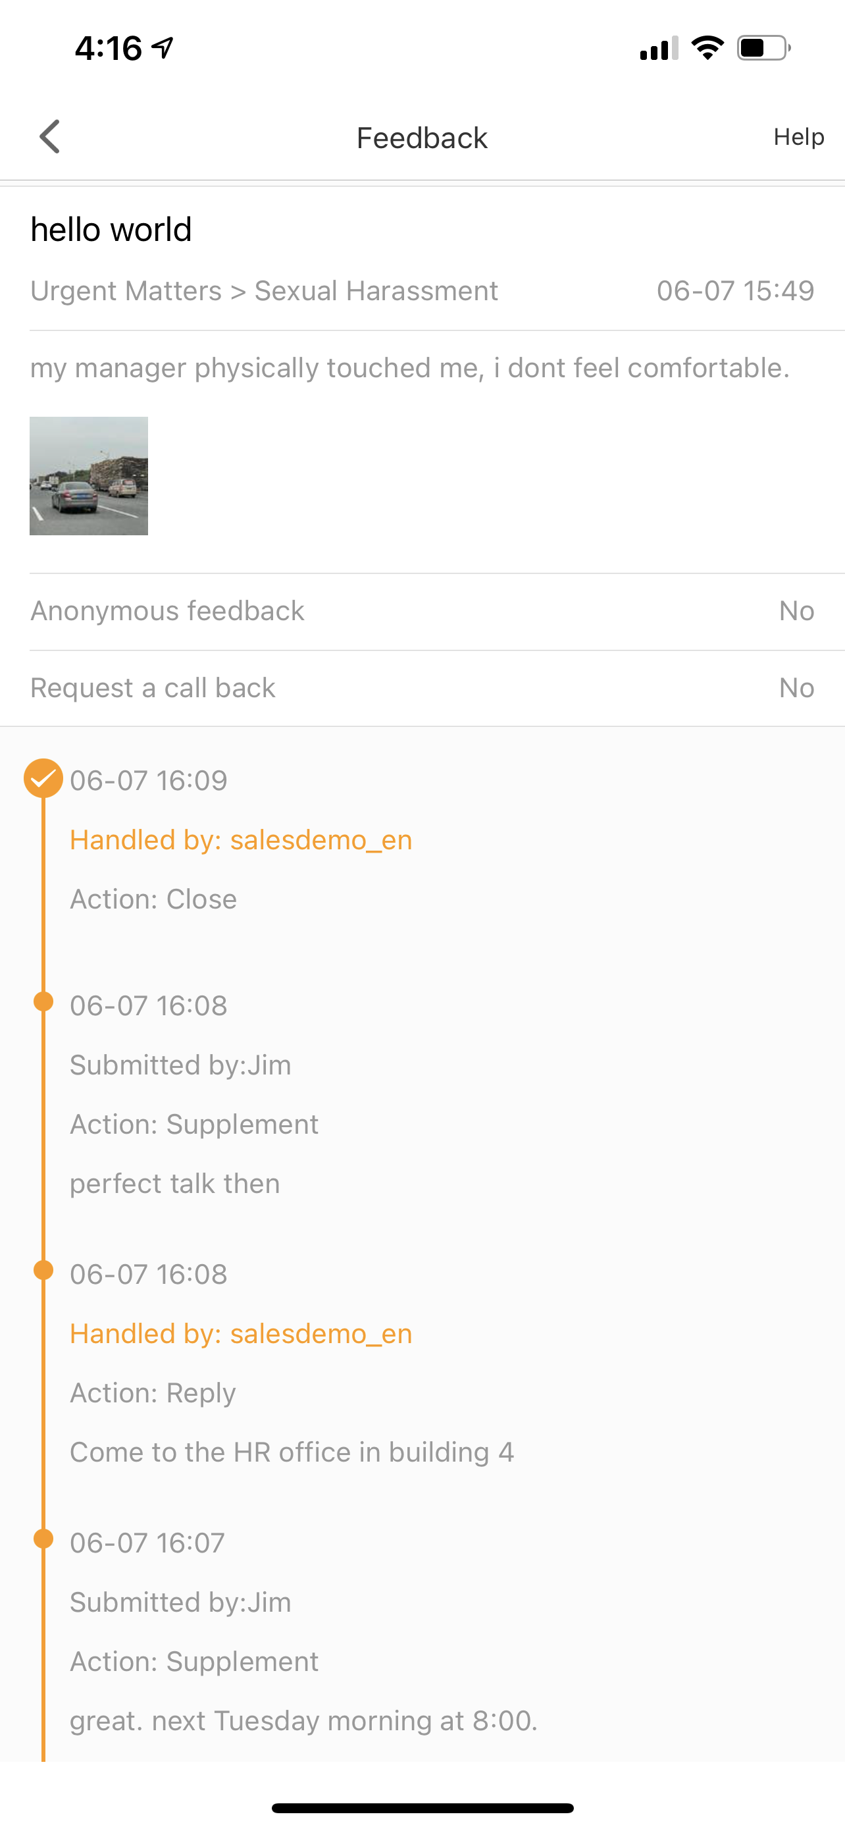
A “worker view” - once a grievance has been submitted, a worker communicates with factory management via the app.

Slide 18
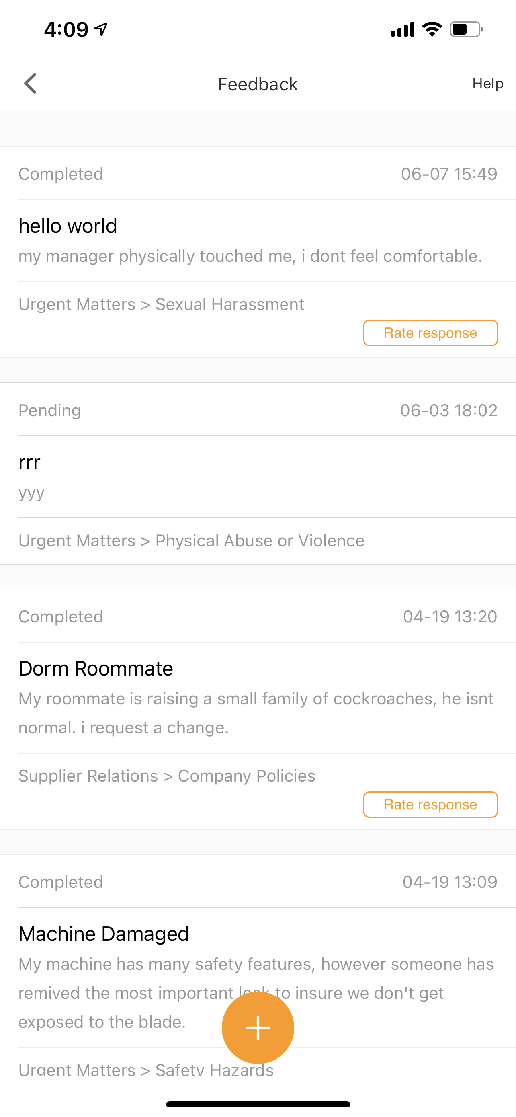
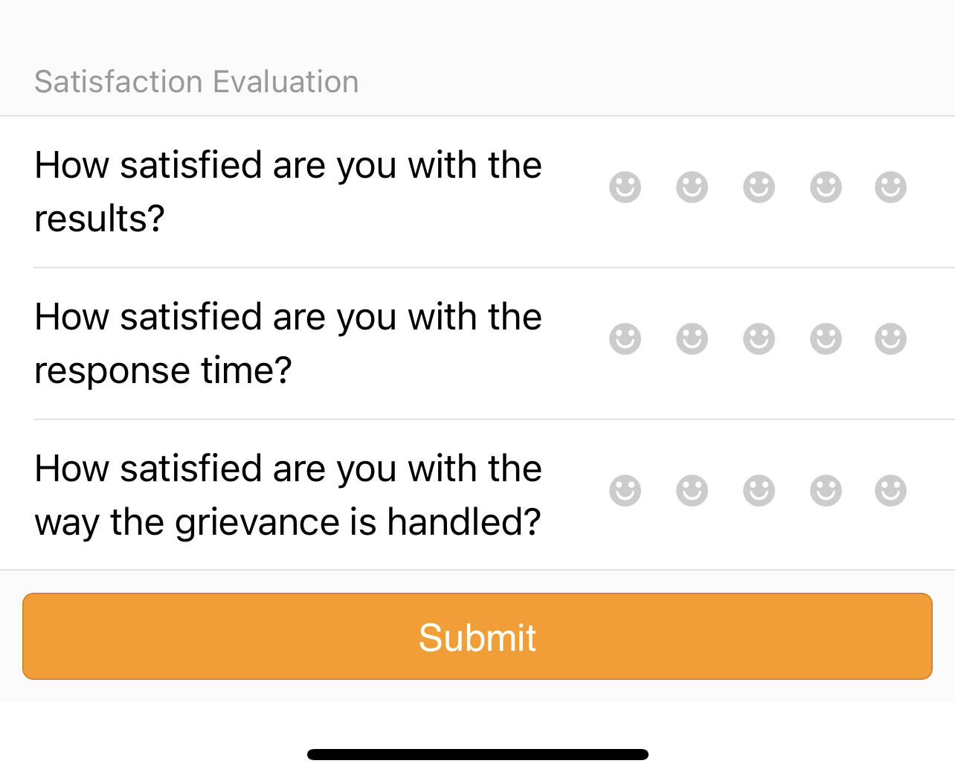
Once the communication is closed by the factory, the worker will have the ‘ability to rate’ the experience. Note: the worker will have 72 hours to rate the response.

Slide 19
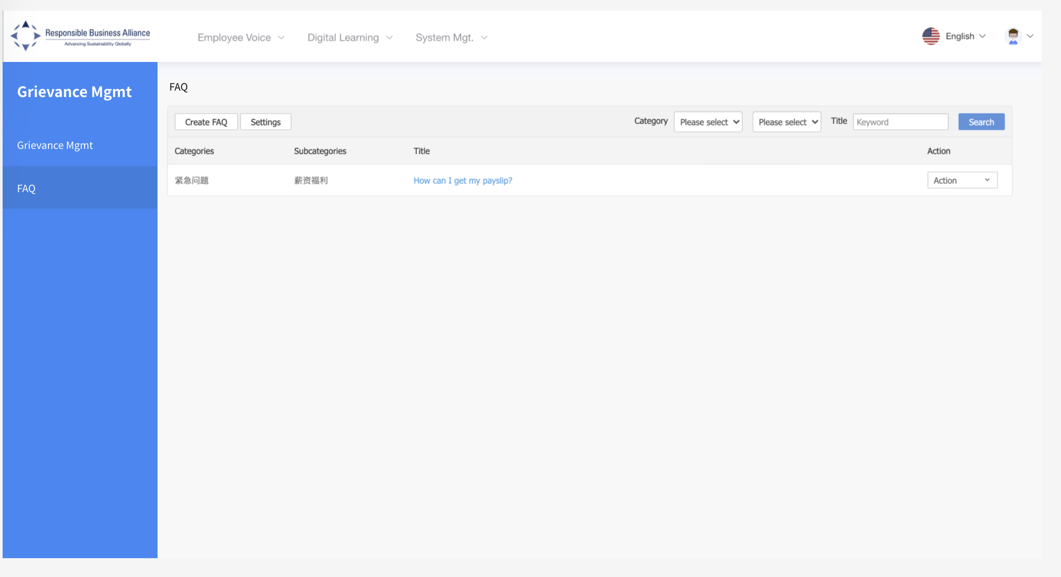
FAQ: Auto response feature to provide workers with quick answers and facts.

Slide 20
01.
RBA/NGO View

Slide 21
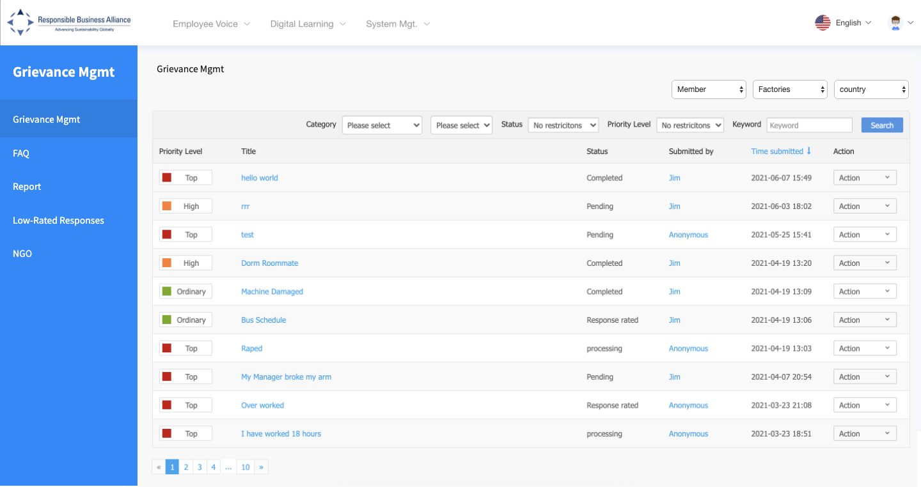
RBA View: When a worker submits a grievance, the message will be received in the RBA dashboard in their backend. The RBA will have the ability to click and view. They will have visibility to all grievances, with the ability to filter the information. RBA will have the same view and functionality as the FTY. RBA will be able to assign FTY’s to NGO based on login.

Slide 22
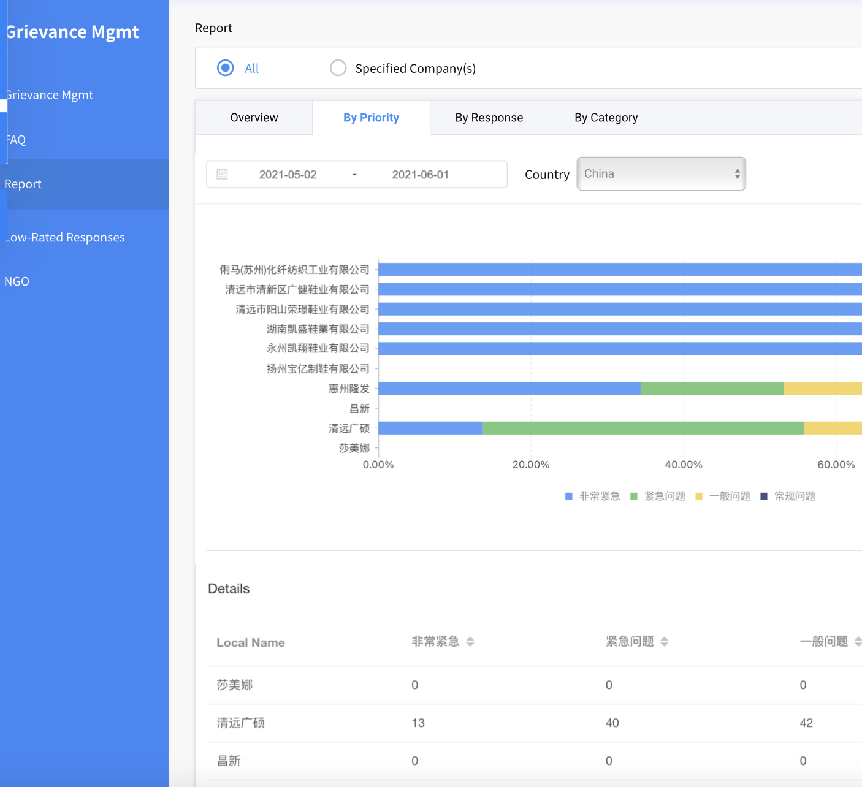
Report 1: Grievance by Priority level
Report 2: Response time by Factory
Report 3: Grievance by Category
Note: Detailed grievance information will be included reports to members.

Slide 23
Assign factory to an NGO in RBA Online, then the backend will only allow them to view those suppliers.

Slide 24
01.
Member Owned (Foxconn HQ)

Slide 25
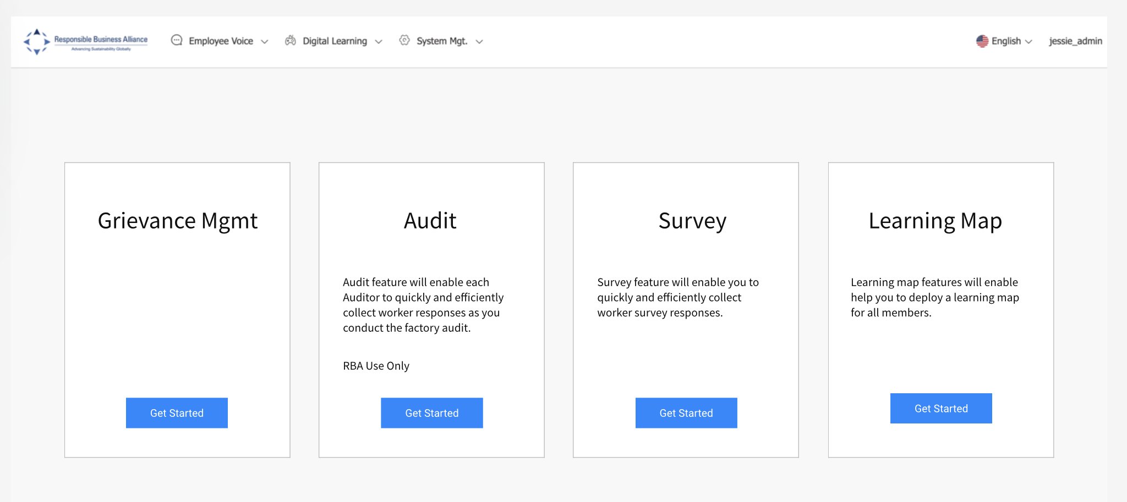
Member login to the RBA backend account to deploy the grievance feature, members FTY’s are integrated from RBA Online. Will add a data share authorization link.

Slide 26
Lists all factories that have launched the grievance tool, and their status ‘enable’ or ‘disable’.
- select “Add Factory” to access a full list factories linked to member RBA ID #

Slide 27
Select the Factory (s) you’d like to launch the grievance tool.
Then select “next”

Slide 28
- Review and Confirm information, then select ‘next’.

Slide 29
A member will see the factory(s) already deployed. Send QR code tick and select “send QR code”.
- Select “action tab” to disable grievance tool. Note: automatically activates to the app

Slide 30
An email will be sent to the FTY contact in RBA Online, includes:
- RBA Voices app QR code (download app)
- FTY backend login credentials
- Grievance tool “How To”

Slide 31
Member Grievance Reports:

Slide 32
RBA View: When a worker submits a grievance, the message will be received in the RBA dashboard in their backend. The RBA will have the ability to click and view. They will have visibility to all grievances, with the ability to filter the information. RBA will have the same view and functionality as the FTY. RBA will be able to assign FTY’s to NGO based on login.

Slide 33
Report 1: Grievance by Priority level
Report 2: Response time by Factory
Report 3: Grievance by Category
Note: Detailed grievance information will be included reports to members.

Slide 34
01.
Member Owned and Suppliers (Dell)

Slide 35
Member login to the RBA backend account to deploy the grievance feature, members FTY’s are integrated from RBA Online. Will add a data share authorization link.

Slide 36
Lists all factories that have launched the grievance tool, and their status ‘enable’ or ‘disable’.
- select “Add Factory” to access a full list factories linked to member RBA ID #
Do they see owned and suppliers?

Slide 37
Select the Factory (s) you’d like to launch the grievance tool.
Then select “next”. – (Identify owned or not)

Slide 38
01.
Frontend App view
(worker view)

Slide 39
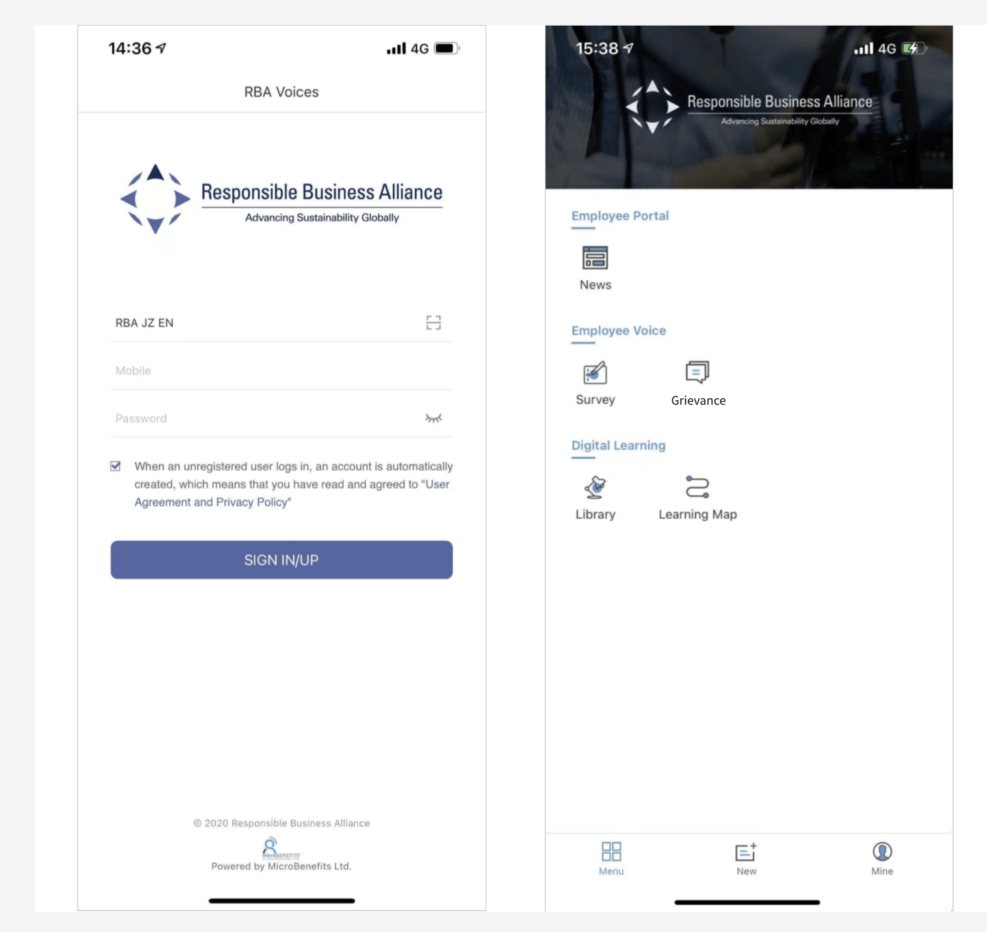
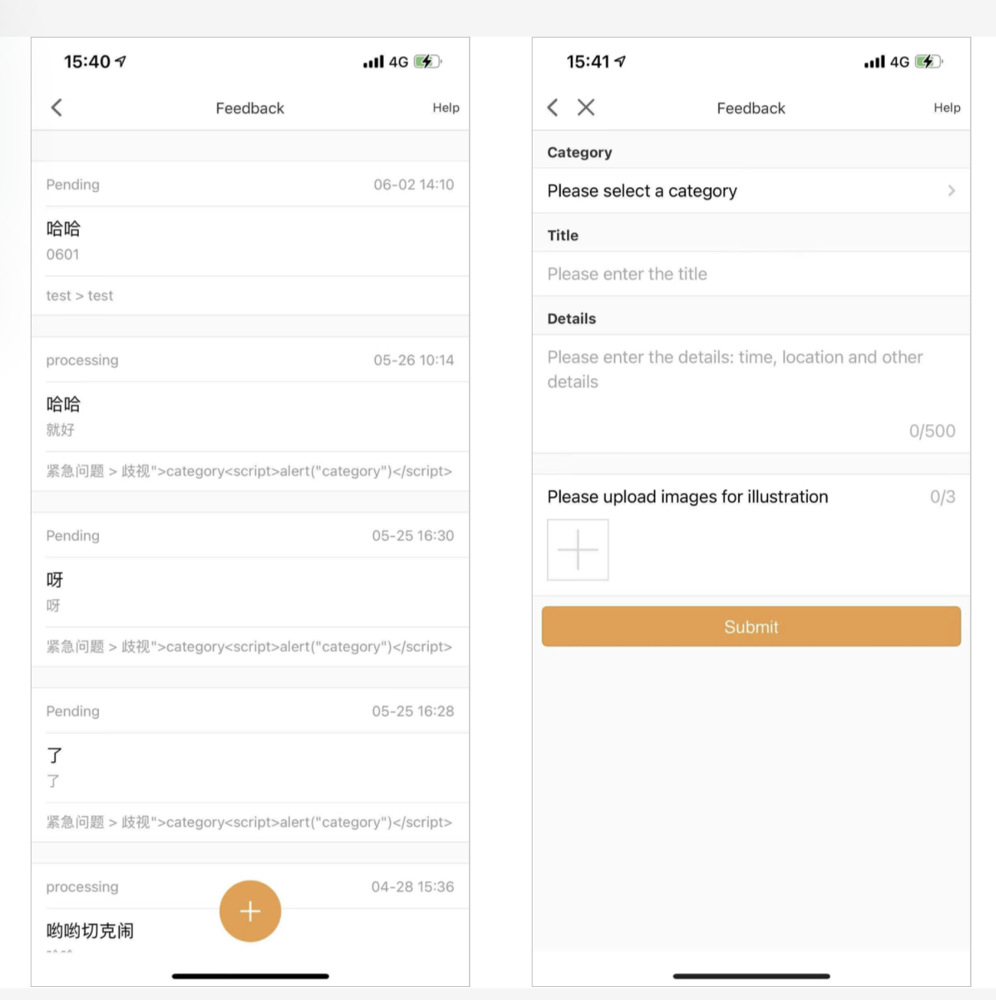
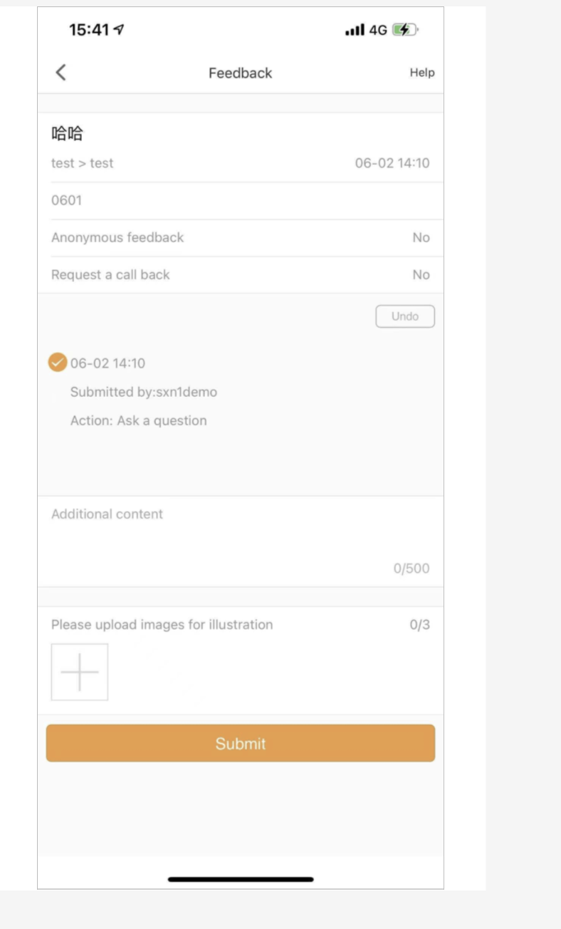
Once the grievance tool is activated by the member, the tool will automatically download to a workers RBA Voices app. The FTY ID will be linked to the QR code. Steps:
1) login to app 2) select “Grievance” icon 3) list of previous submissions, select the”+“ icon 4) complete page questions select ”submit” 5) dialogue with FTY management

