Slide 1
Factory Quick Guide:
How to Deploy Survey QR Code

Slide 2
Quick Kick-off Guide - Factory Actions
Step 1: Factory POC will receive an email from the participating IA POC with
survey QR code poster attached.
Step 2: The Factory POC will print QR Code posters and post throughout factory
Note: Poster distribution hints: Display posters in high traffic areas for workers to easily access the survey; cafeteria, dormitory, entrances, and information boards.
(see pictures below)
Step 3: Factory POC will communicate with line leaders and other factory management to encourage workers to participate in the survey
Step 4: Worker will scan QR to access survey. Survey will take ~ 5 minutes

Slide 3
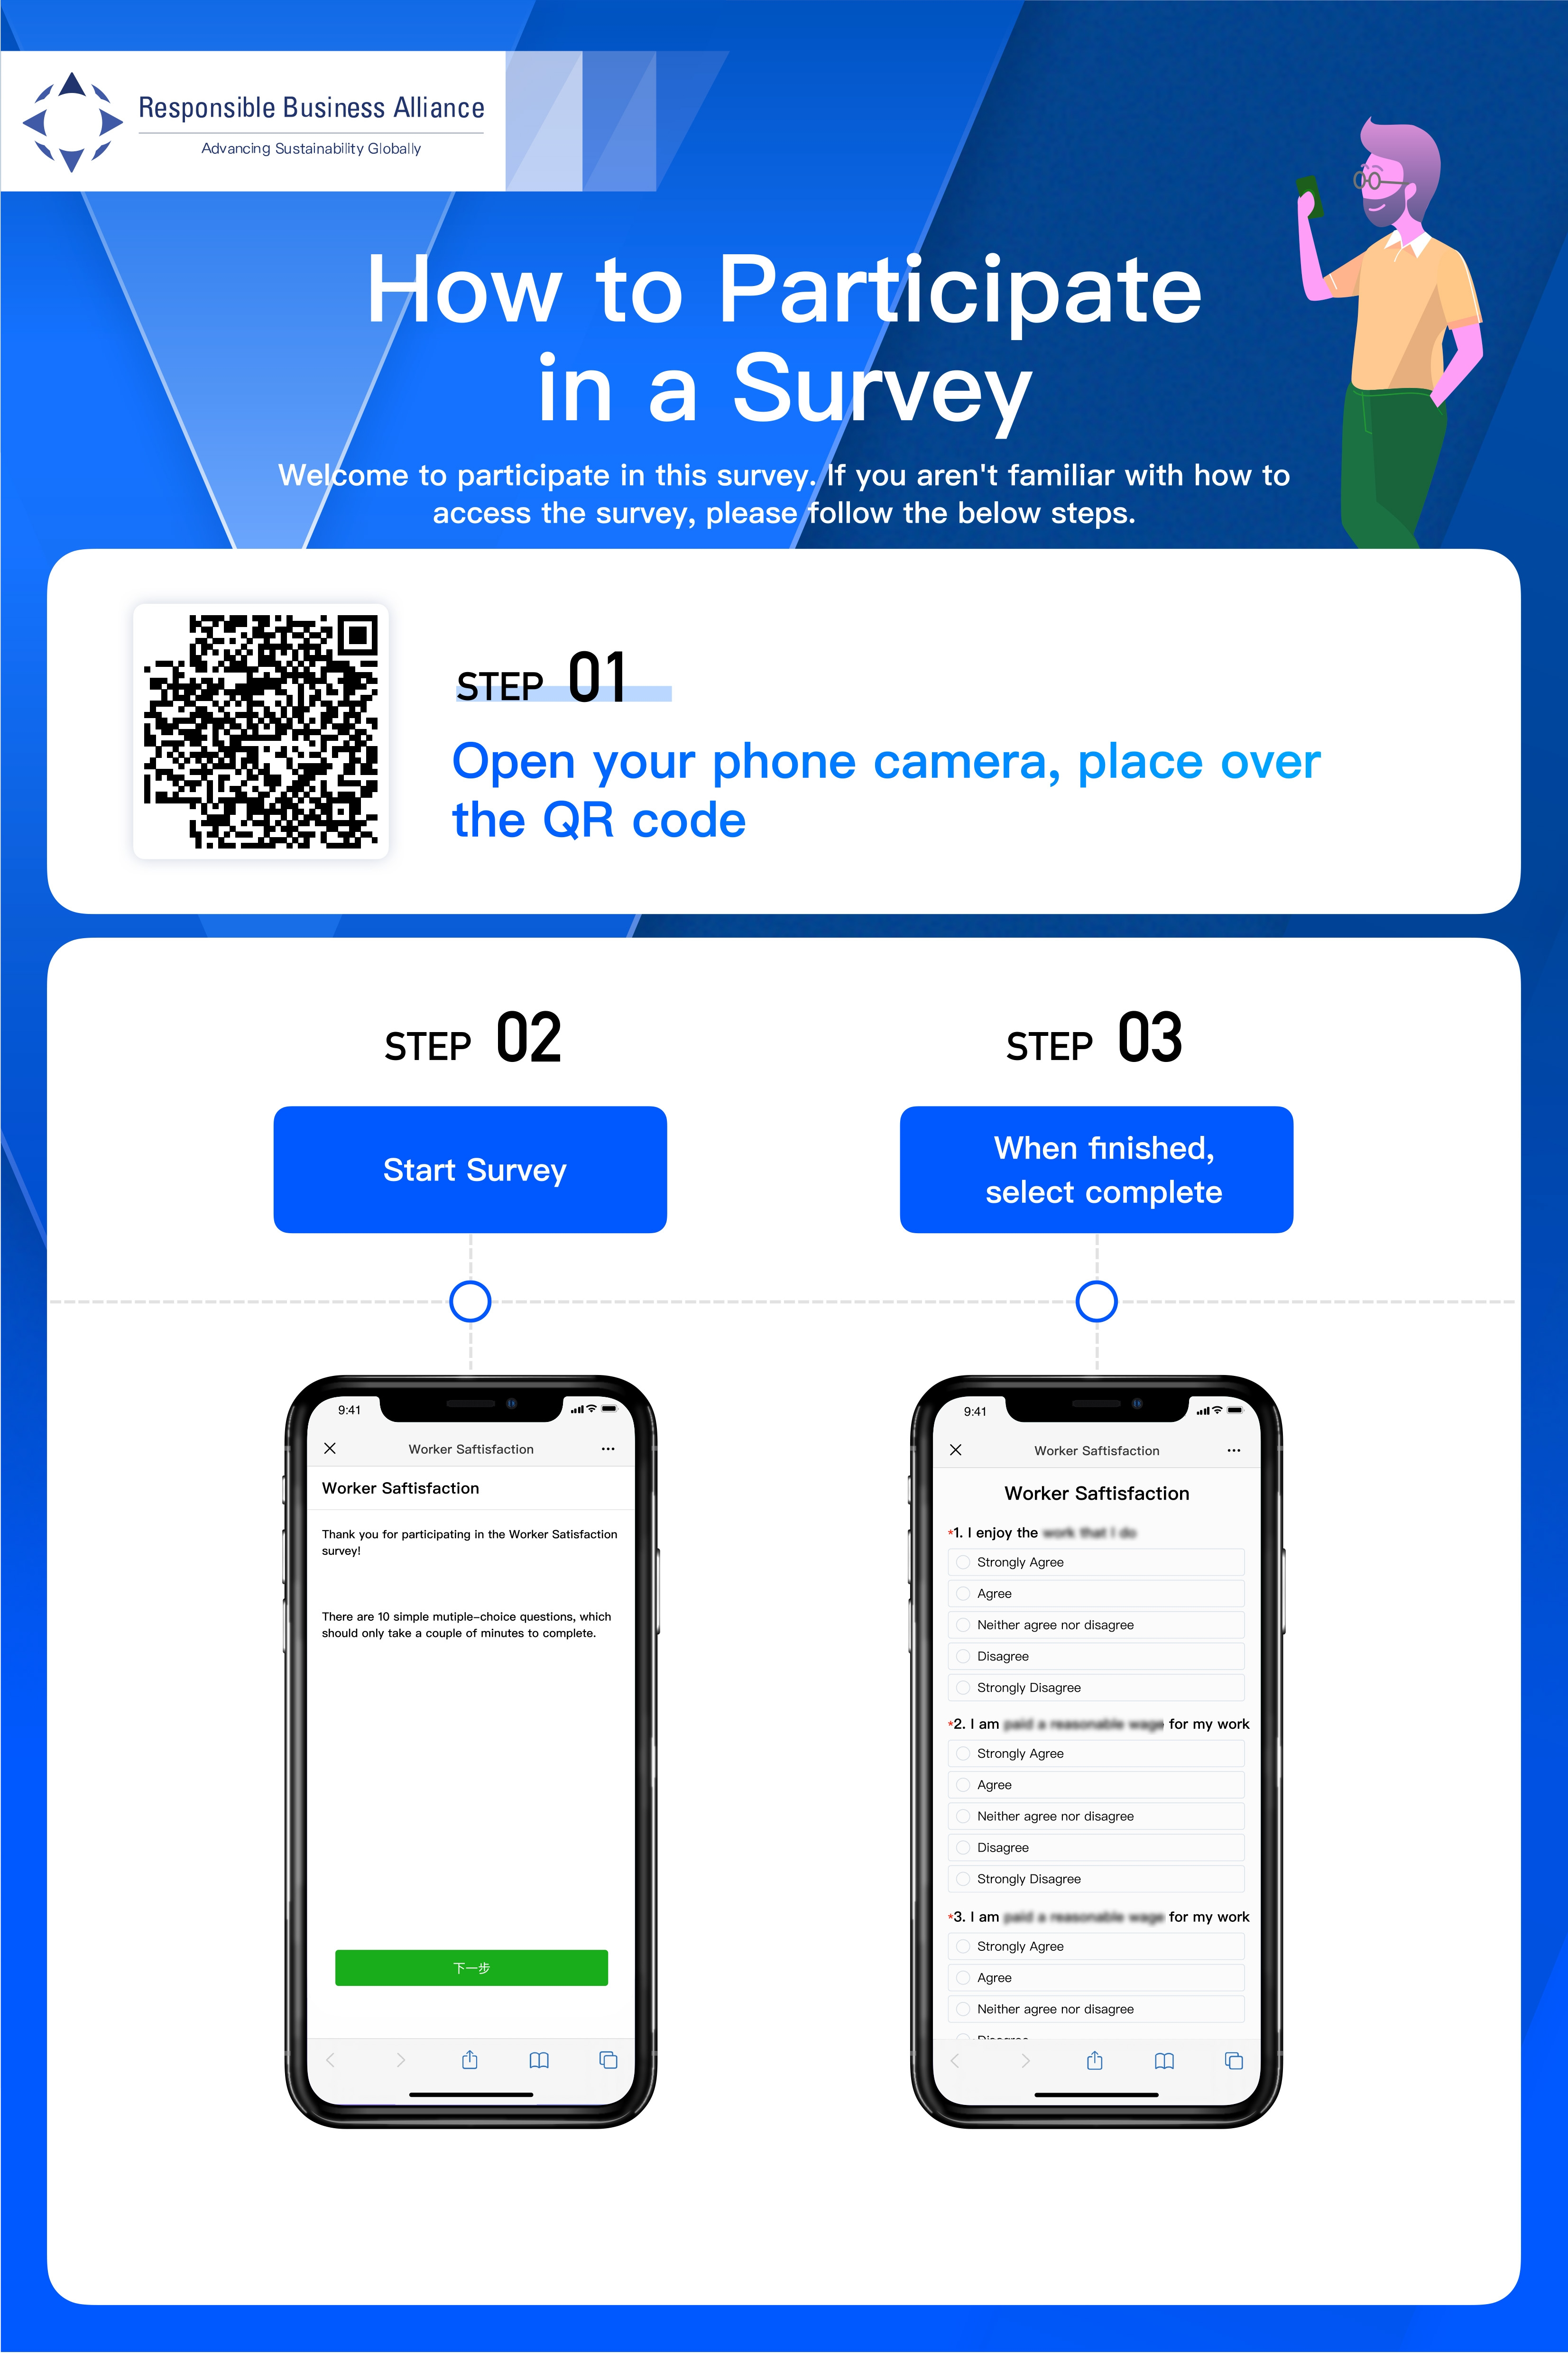
Sample: QR Code Poster
Note: Poster distribution hints: Display posters in the correct native language in high traffic areas, that is easy for workers to access the survey; cafeteria, dormitory, entrances, and information boards.
(see pictures below)

Slide 4
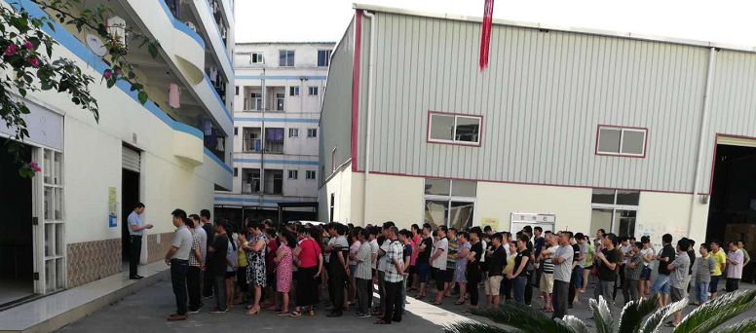

‘Promote’ to Line Leaders:
Communicate with the team leader（Important）
Important reminder to include in the email communication ：
Identify values and goals to be achieved with survey
Clear the operation method and answer questions on the spot
Value
Proposition
Introduce Survey
MicroBenefits
www.microbenefits.com

Slide 5
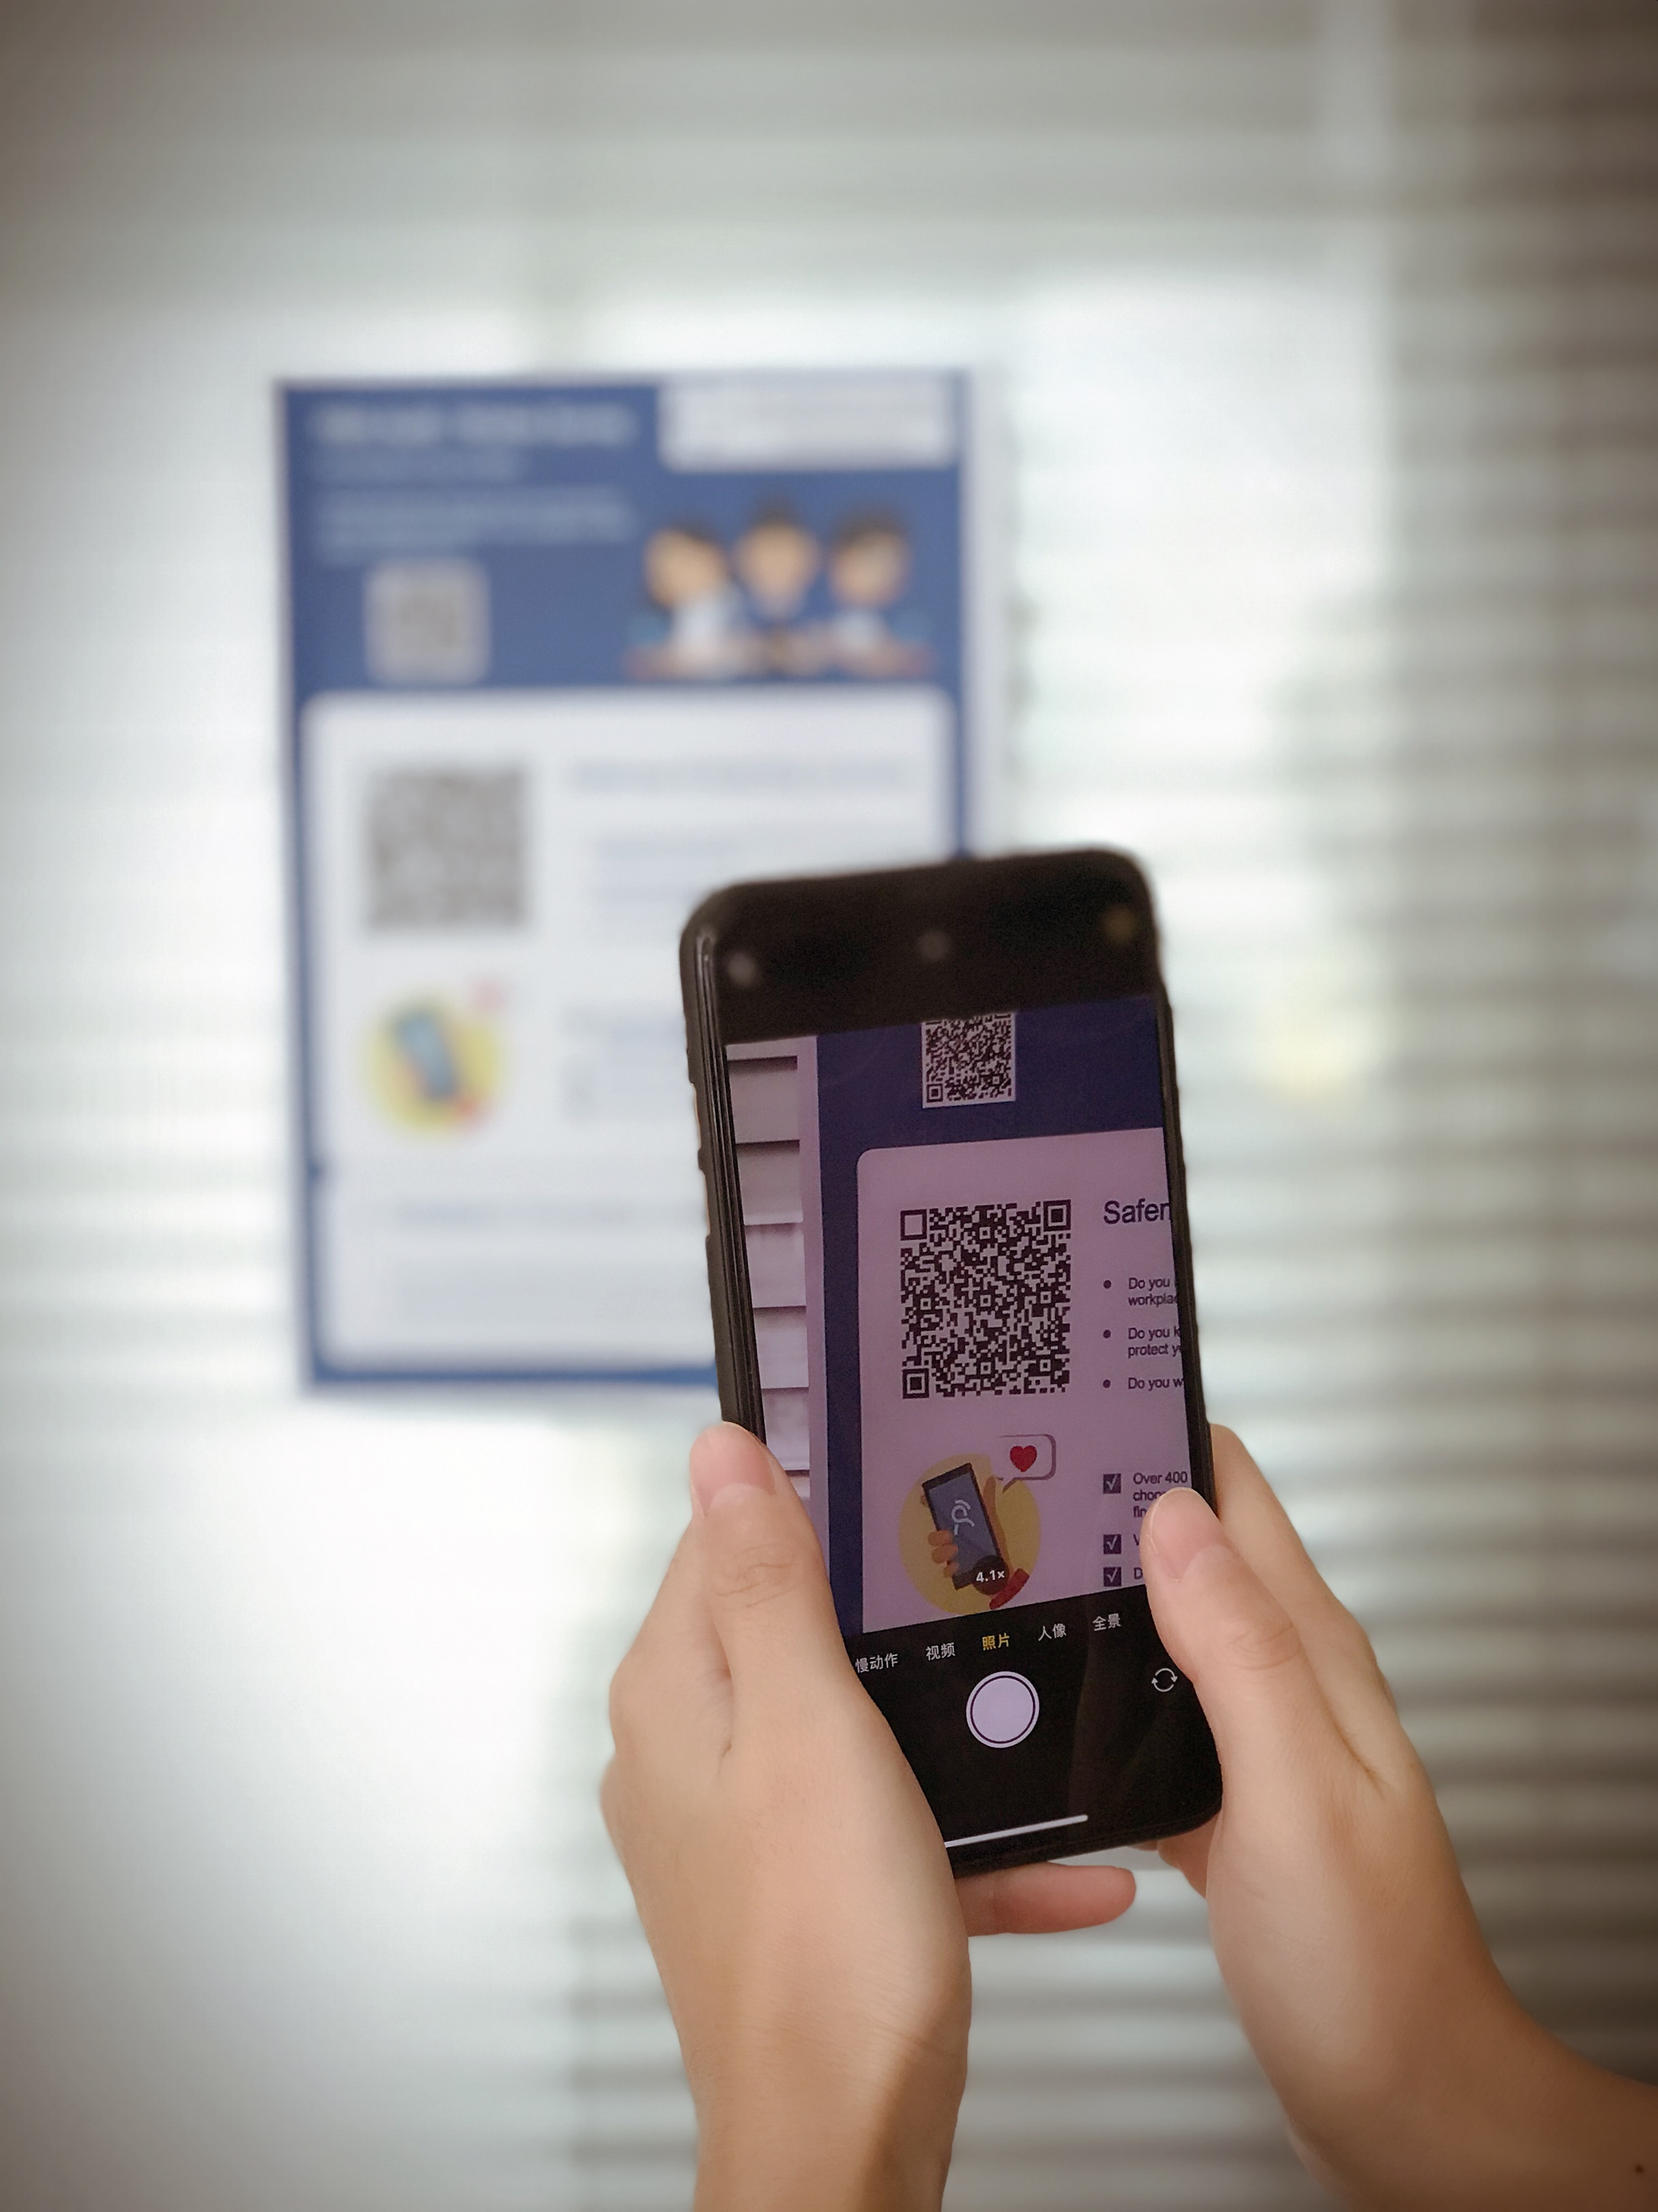
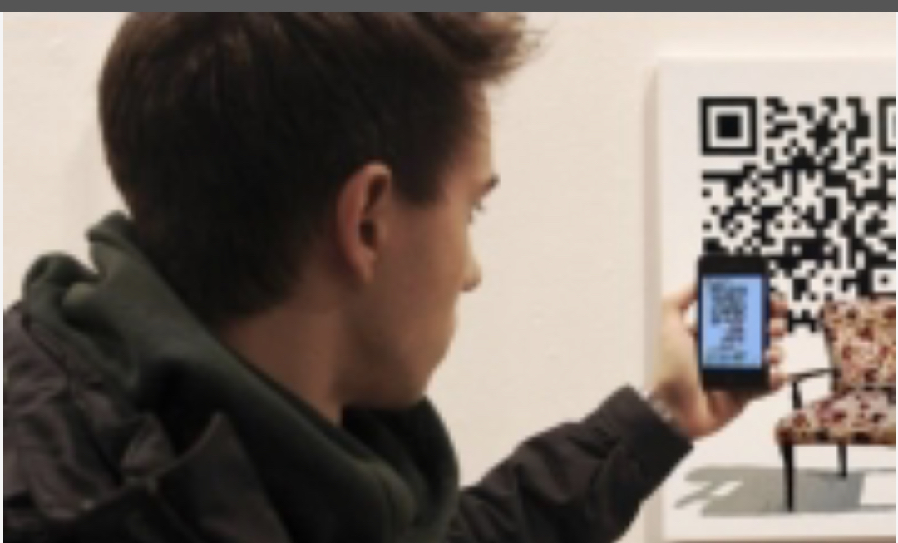
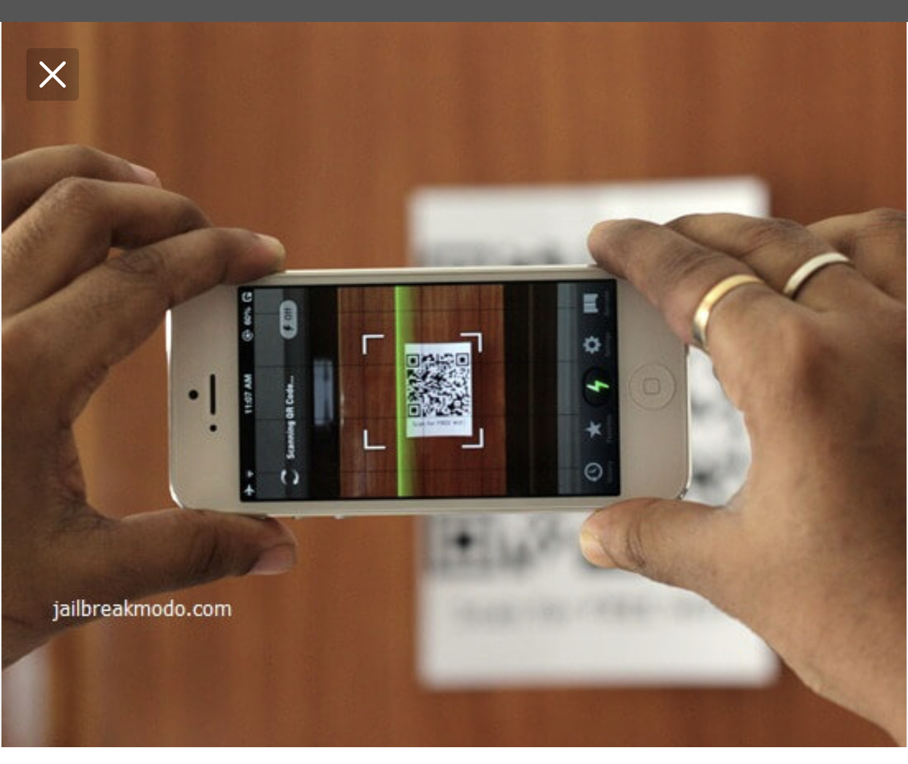
Access Survey: Open Camera, hold over QR code and select link.
- survey language will default to phone settings

Slide 6
Best Practices for a Successful Survey
Announce the survey to management one week before launch
  Should use the pyramid structure ”top to bottom” to announce news to management
  Guide them how to take the survey and assign task “encourage workers in your line to take survey” for them
Announce the survey to workers the day of the survey in multiple ways:
  1) Pre-or-Post shift meetings
  2) Posters in high-traffic areas such as bathrooms, canteens, etc.
  3) E-mail or other worker news channels
Provide free wi-fi to workers for the duration of the survey
Set-up survey point of contact in case workers have more question to ask
Remind workers to take the survey the last two days it is open.
If a site achieves 20% participation or above, offer a reward like a piece of fruit at lunch or extra rice for taking the survey.
Post the results after the survey is complete
Source: Microbenefits Operations 2021

