Slide 1
Member Quick Guide:
How to Deploy RBA Voices app

Slide 2
Member: Quick Guide (App deployment)
Quick Steps :
Step 1: Receive email with login credentials, click “Get Started” in body of email
Step 2: Login Page - enter ‘username’ and ‘password’
Step 3: Under ‘System Mgt.’ select “My Factories”
Step 4: View factories associated with RBA Member ID
Step 5: Select ‘Send QR Code’ in drop down box
Step 6: Email with QR Code is automatically sent to Factory contact

Slide 3
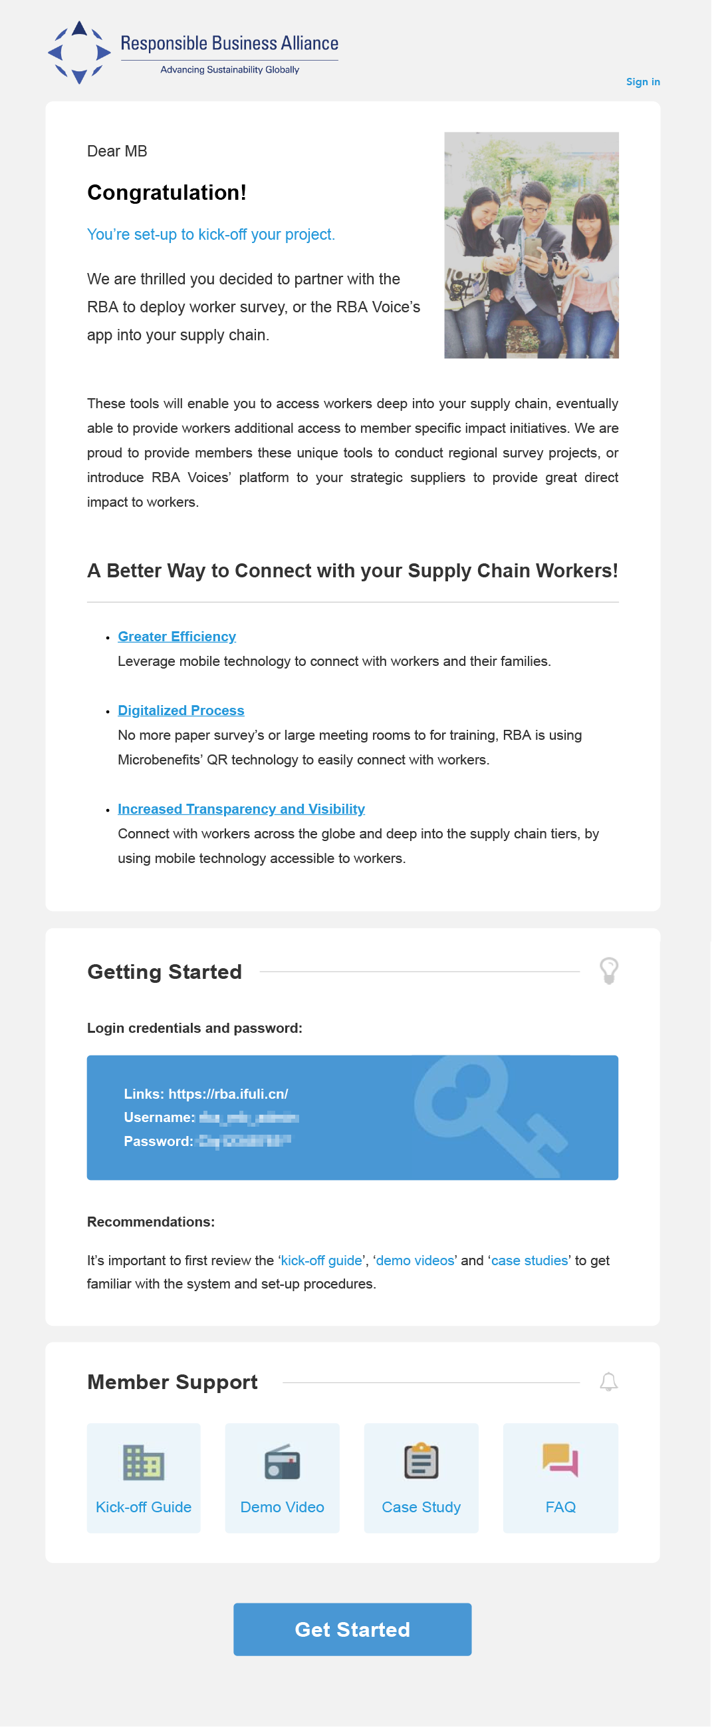
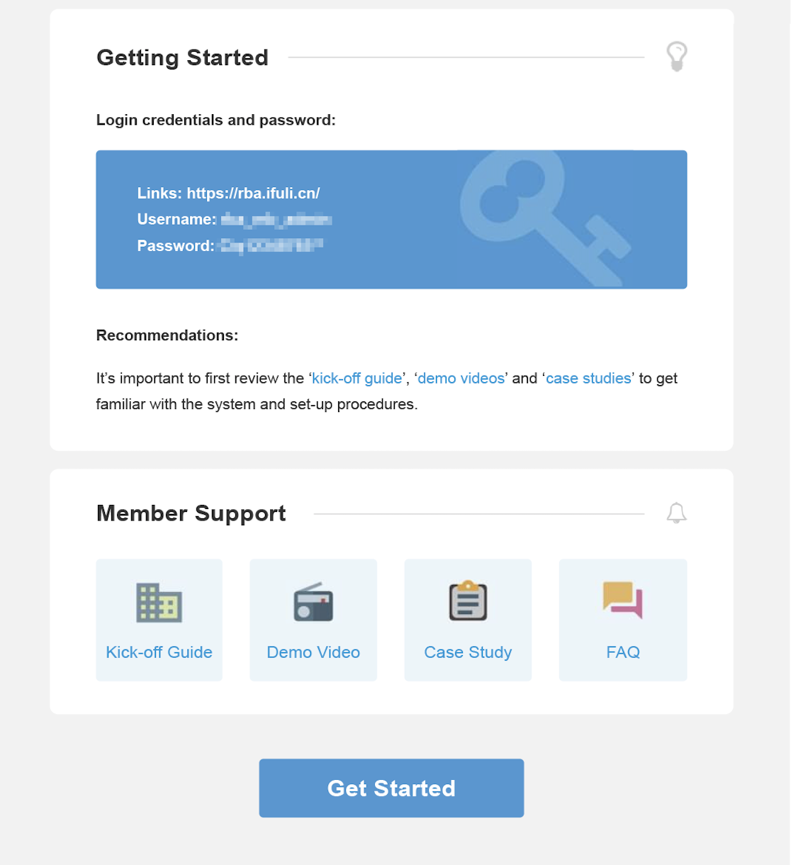
Step 1: Login Credentials and “Get Started”

Slide 4
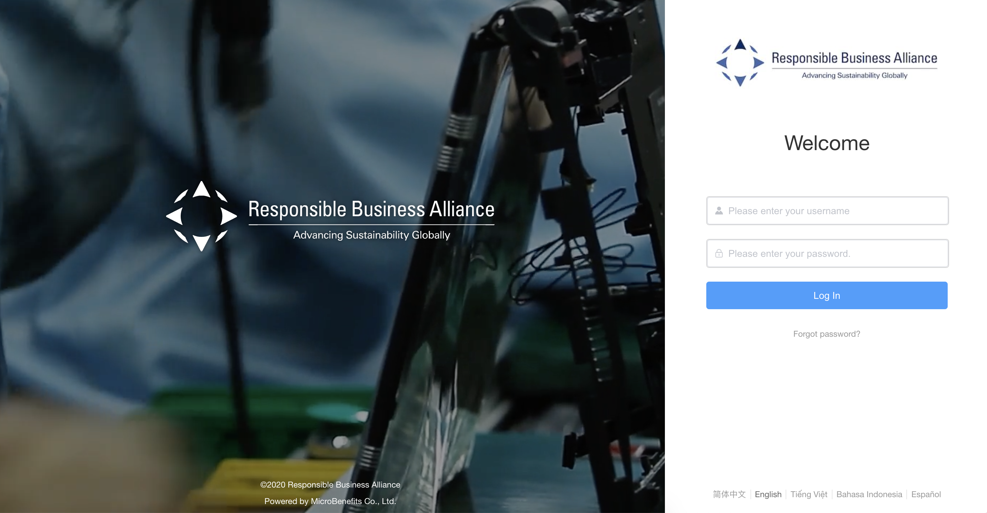
Step 2: Login Page
Step 1: Go to https://rba.ifuli.cn/login/index.html#/
Go to https://rba.ifuli.cn/login/index.html#/

Slide 5
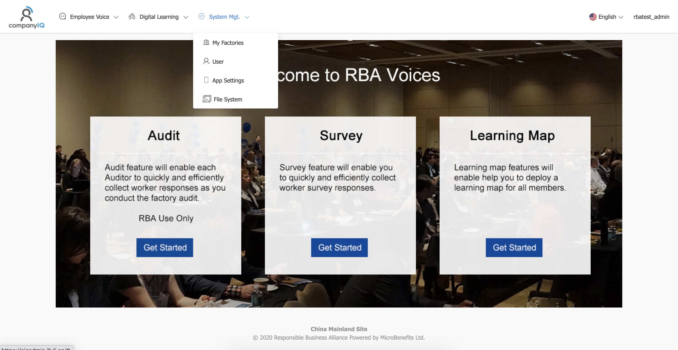
Step 3: Under ‘System Mgt.’ select “My Factories”

Slide 6
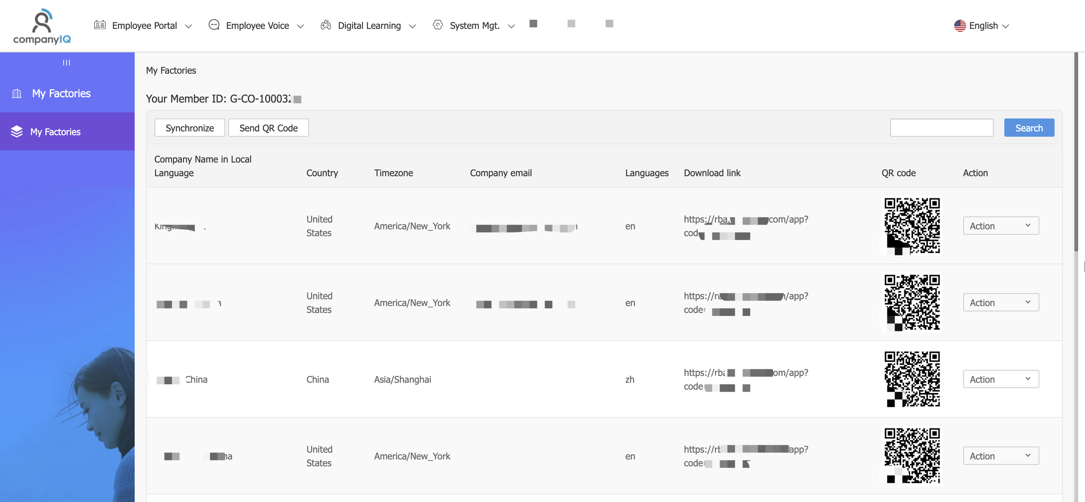
Step 4: View Factories Associated to Member ID

Slide 7
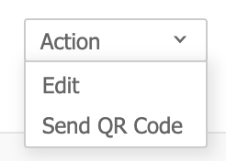
Step 5: Select ‘Send QR Code’ in Drop Down Box

Slide 8
Factory: How to Deploy RBA Voices app

Slide 9
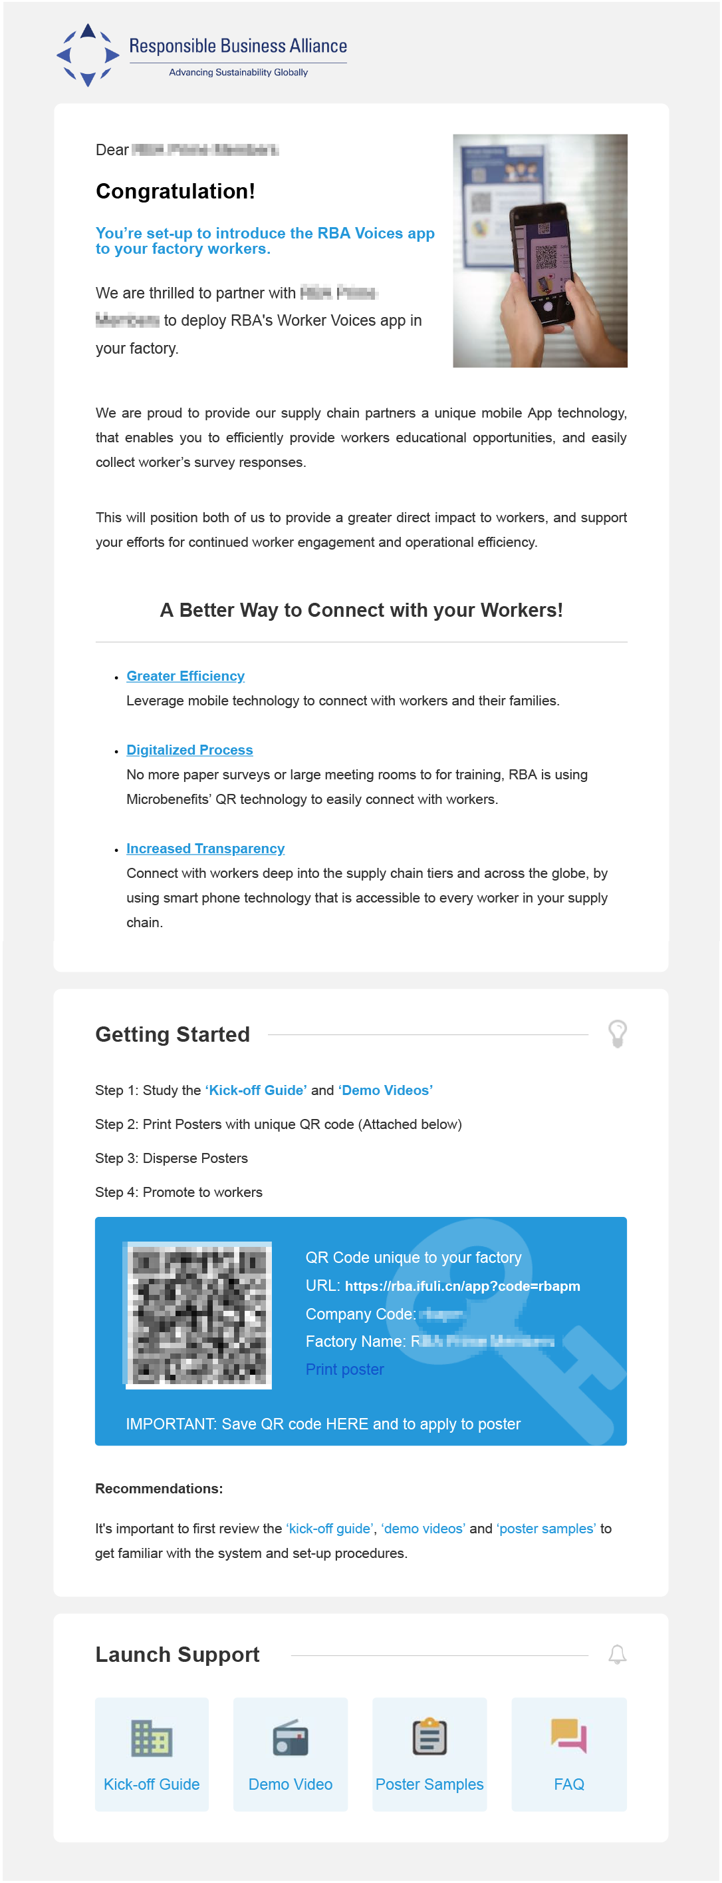
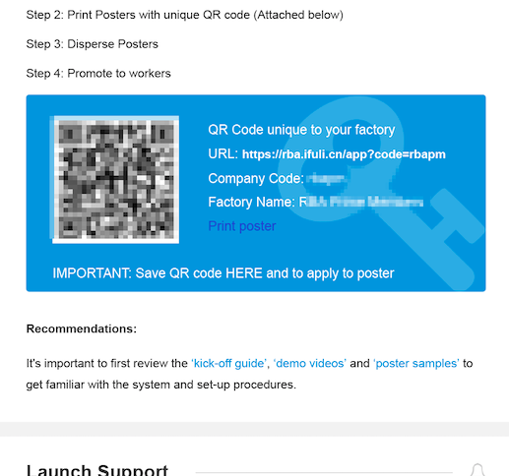
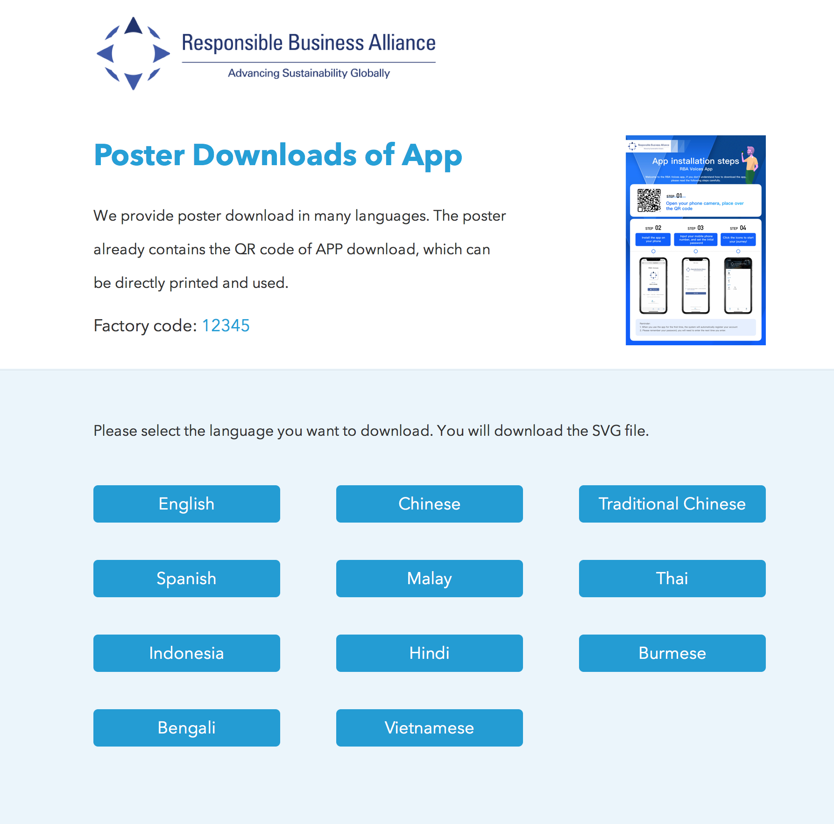
Factory Email: Actions

Slide 10
Quick Kick-off Guide (Factory App deployment)
Quick Steps :
Step 1: Receive email with QR code, click “Print Poster” in body of email
Step 2: QR Code Poster will be “saved to computer”
Step 3: Print Poster (Note: print size A3)
Step 4: Distribute Poster around factory for workers to access app

Slide 11
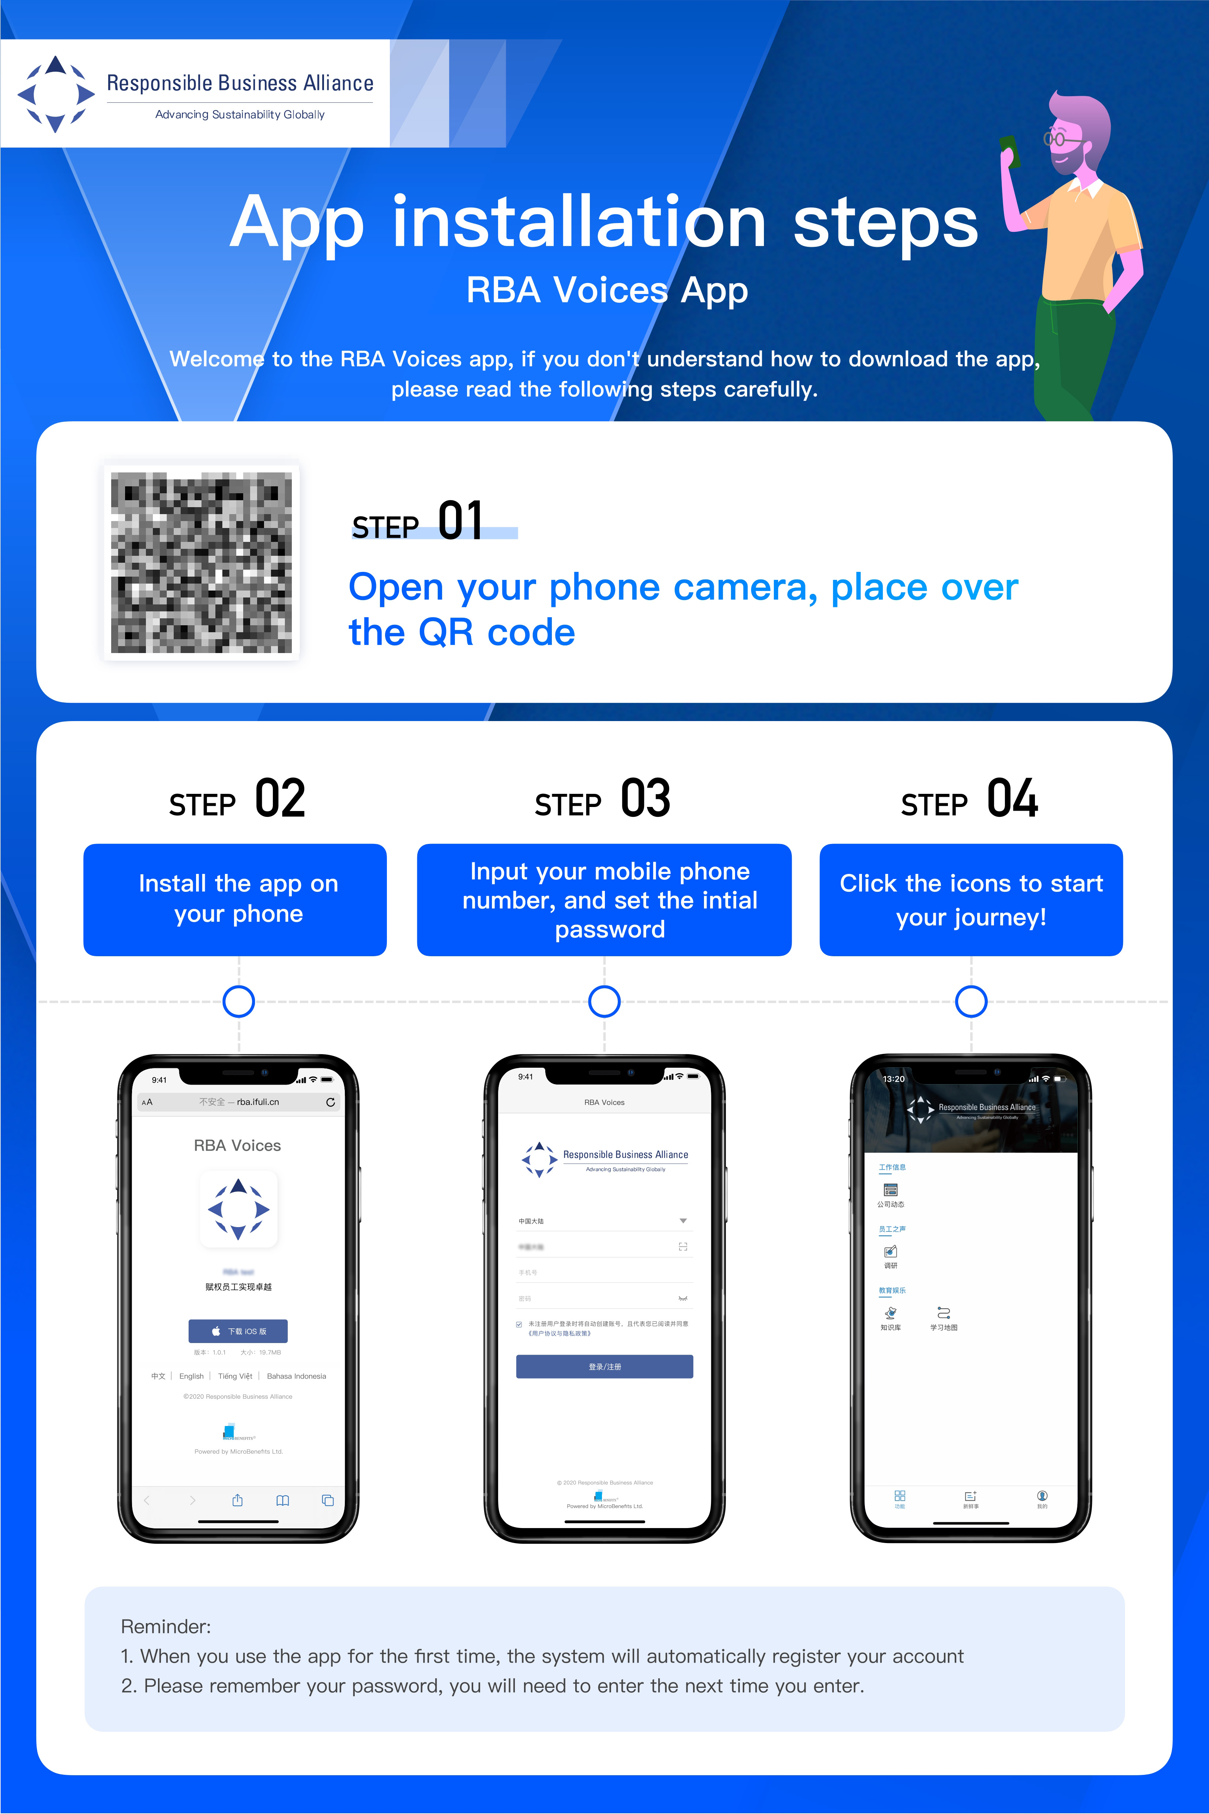
QR Code Poster Sample

Slide 12
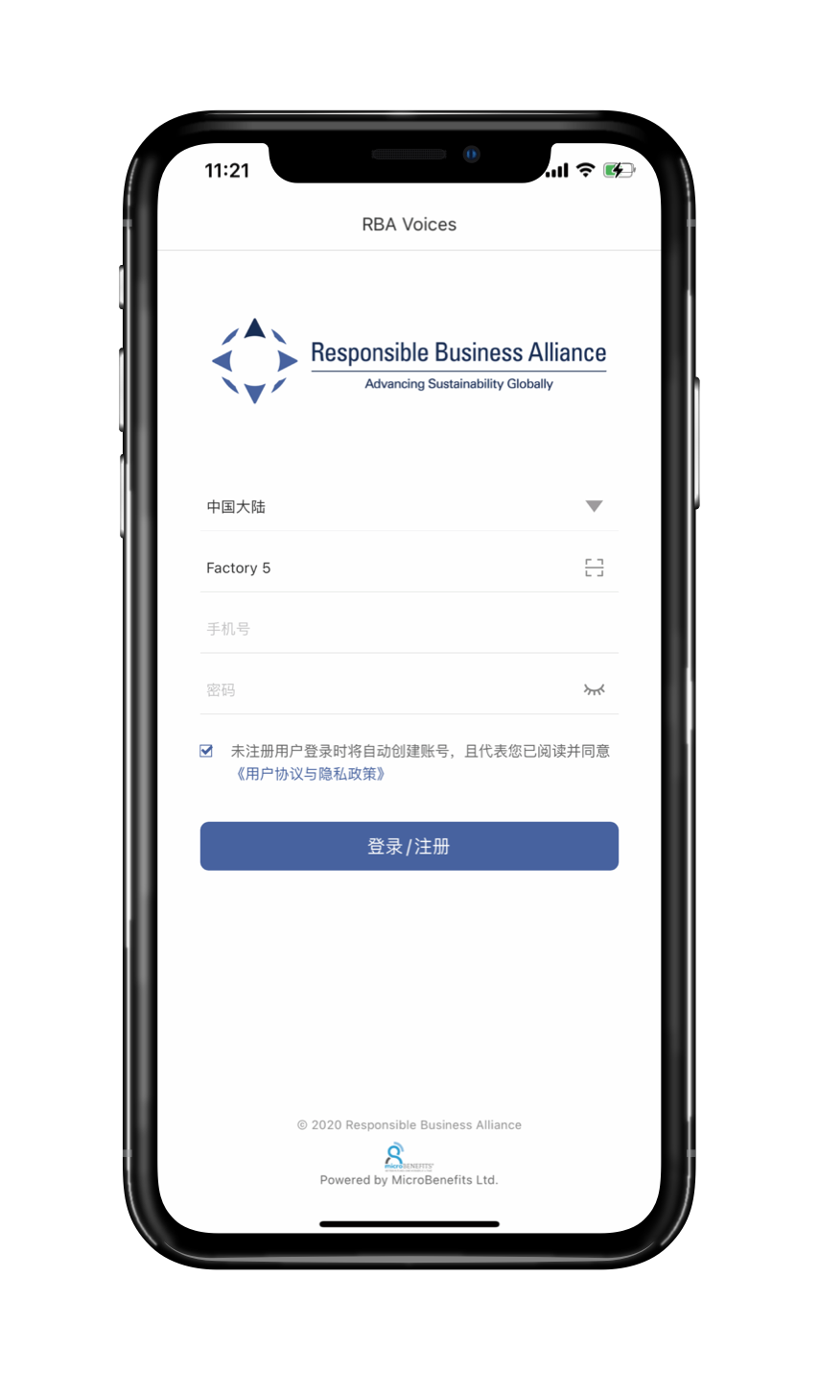
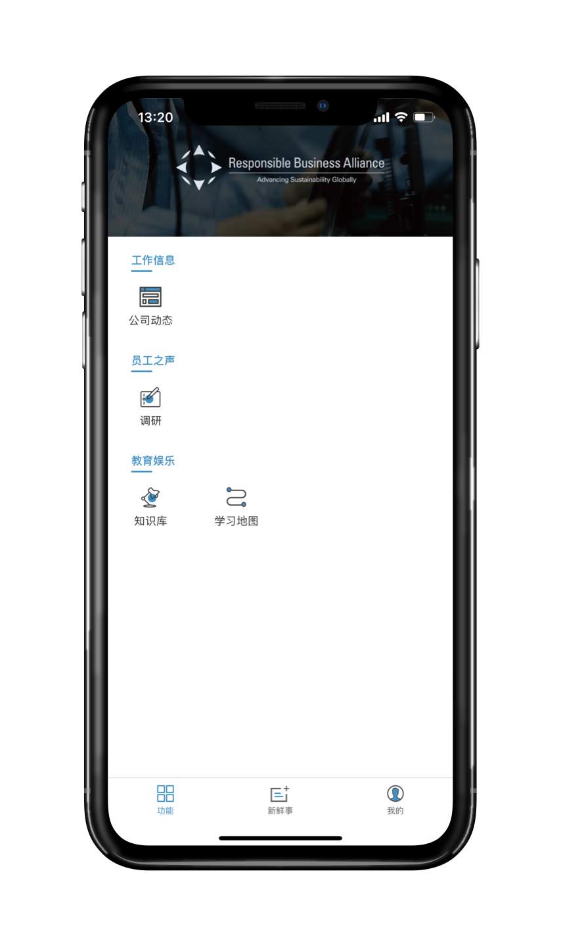
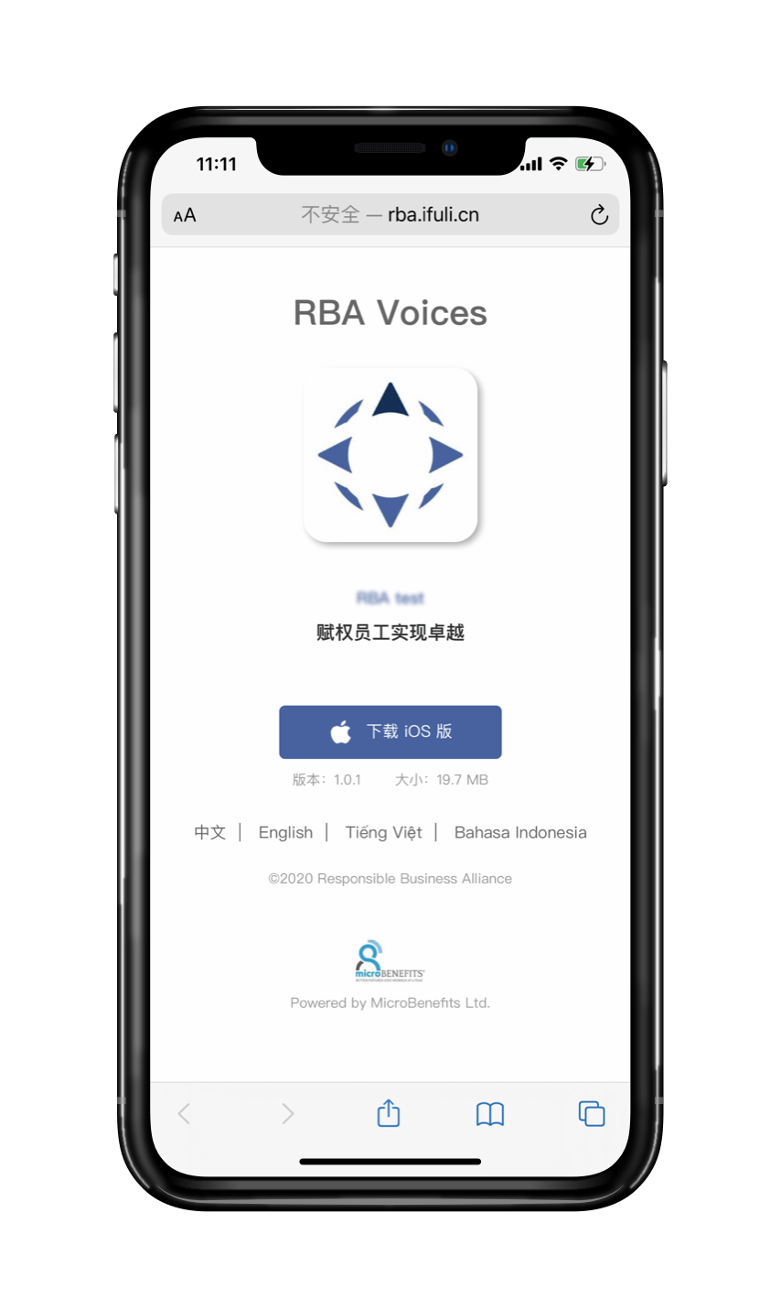
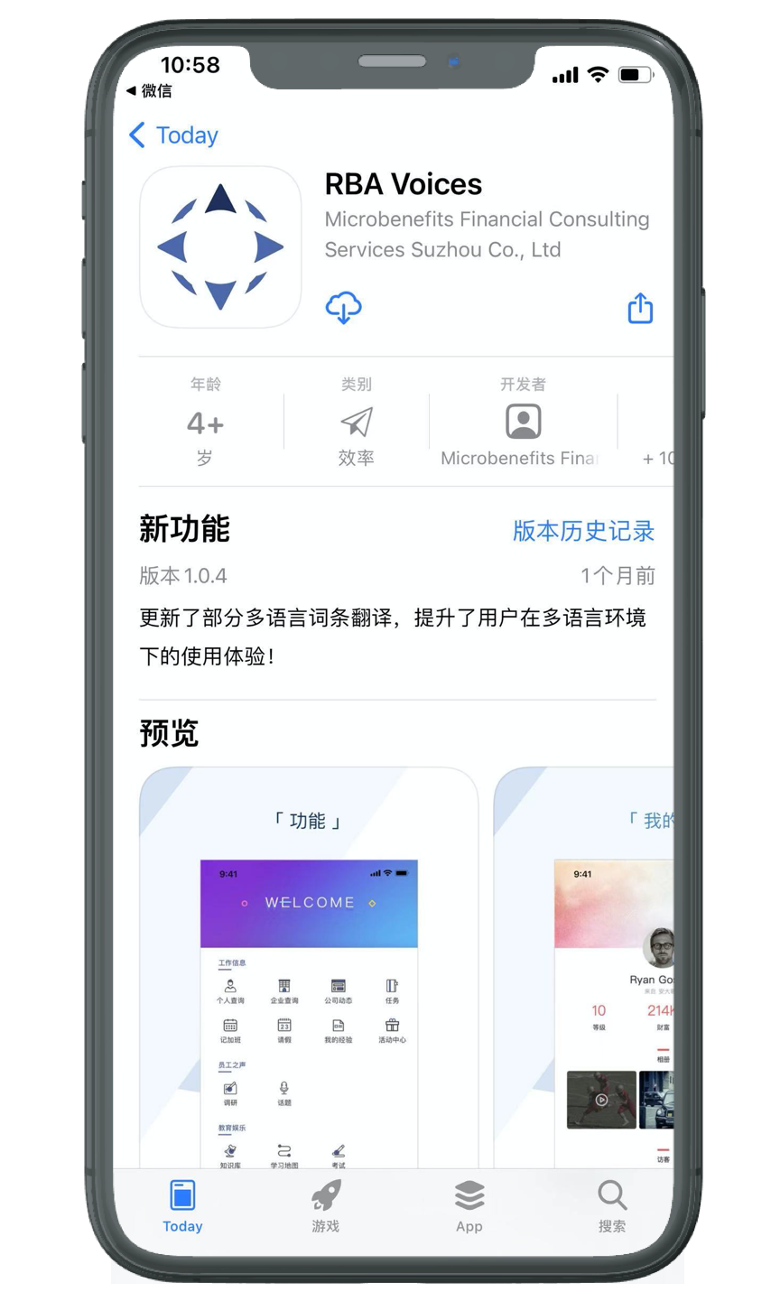
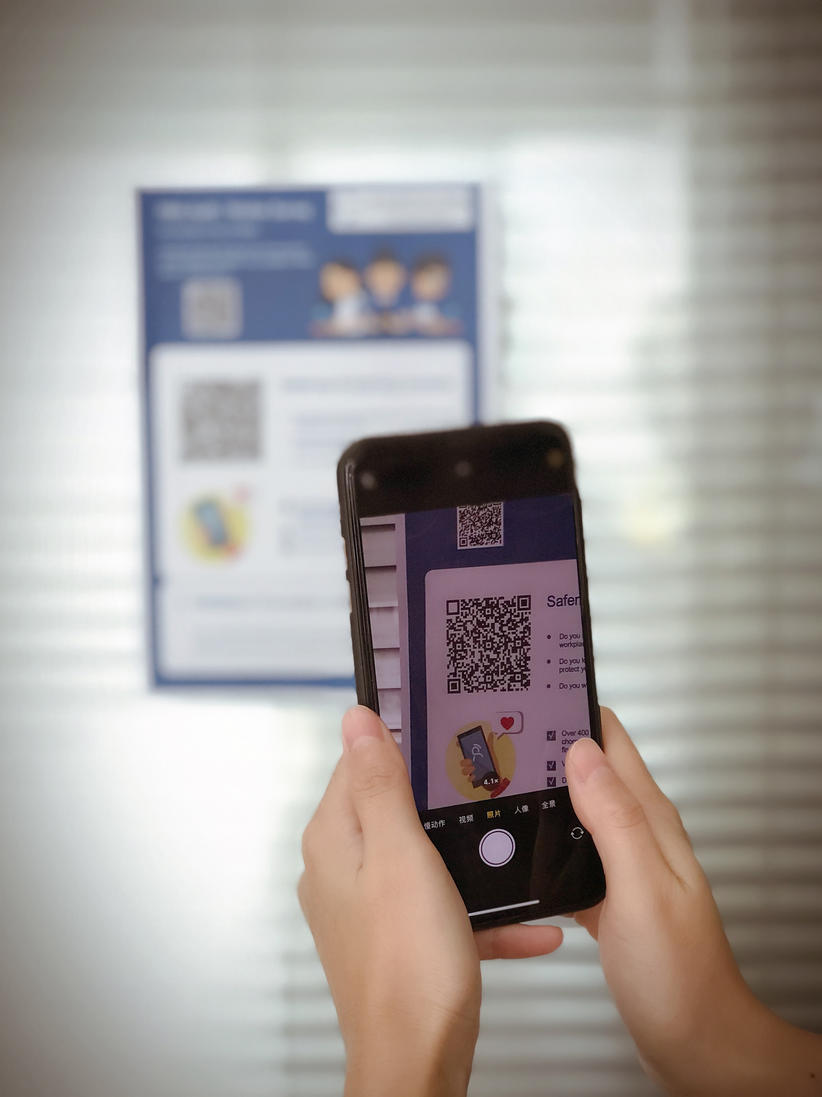
Factory: How to download RBA Voices app

Slide 13
Customer Support:
If you have any comments or questions:
voicessupport@responsiblebusiness.org
Thank you!

