Slide 1
Factory Quick Guide:
How to Deploy RBA Voices app

Slide 2
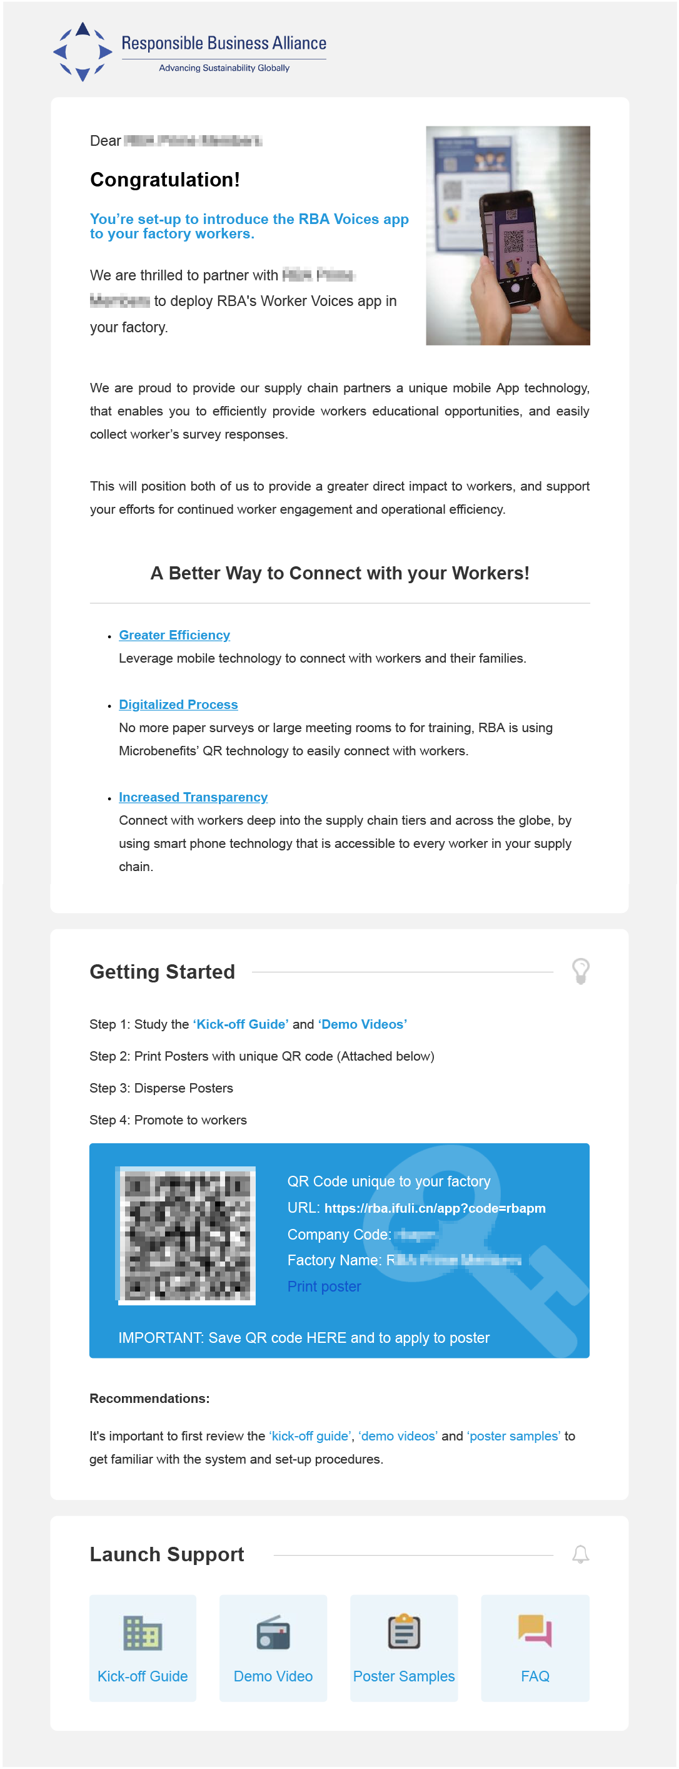
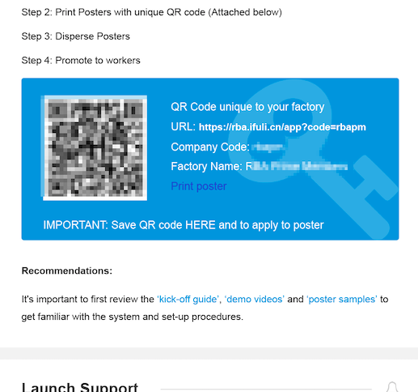
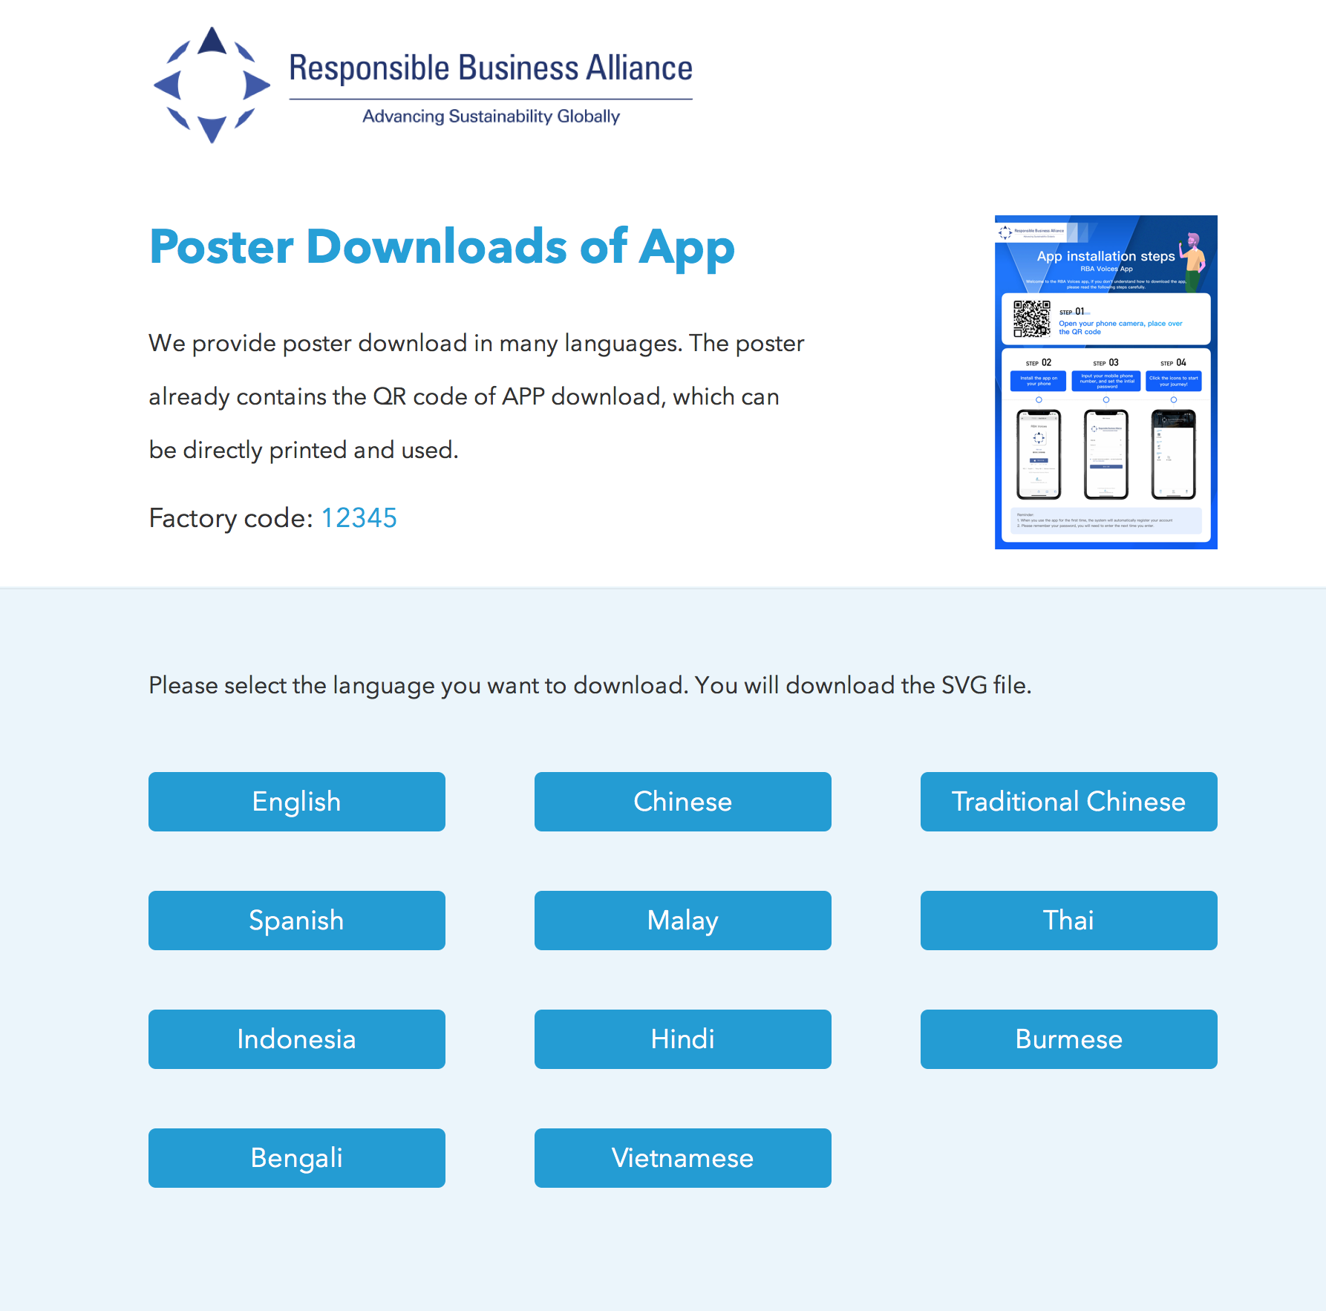
Factory Email: Actions

Slide 3
Quick Kick-off Guide (Factory App deployment)
Quick Steps :
Step 1: Receive email with QR code, click “Print Poster” in body of email
Step 2: QR Code Poster will be saved to your computer
Step 3: Print Poster (Note: print size A3)
Step 4: Distribute Poster for workers to access app

Slide 4
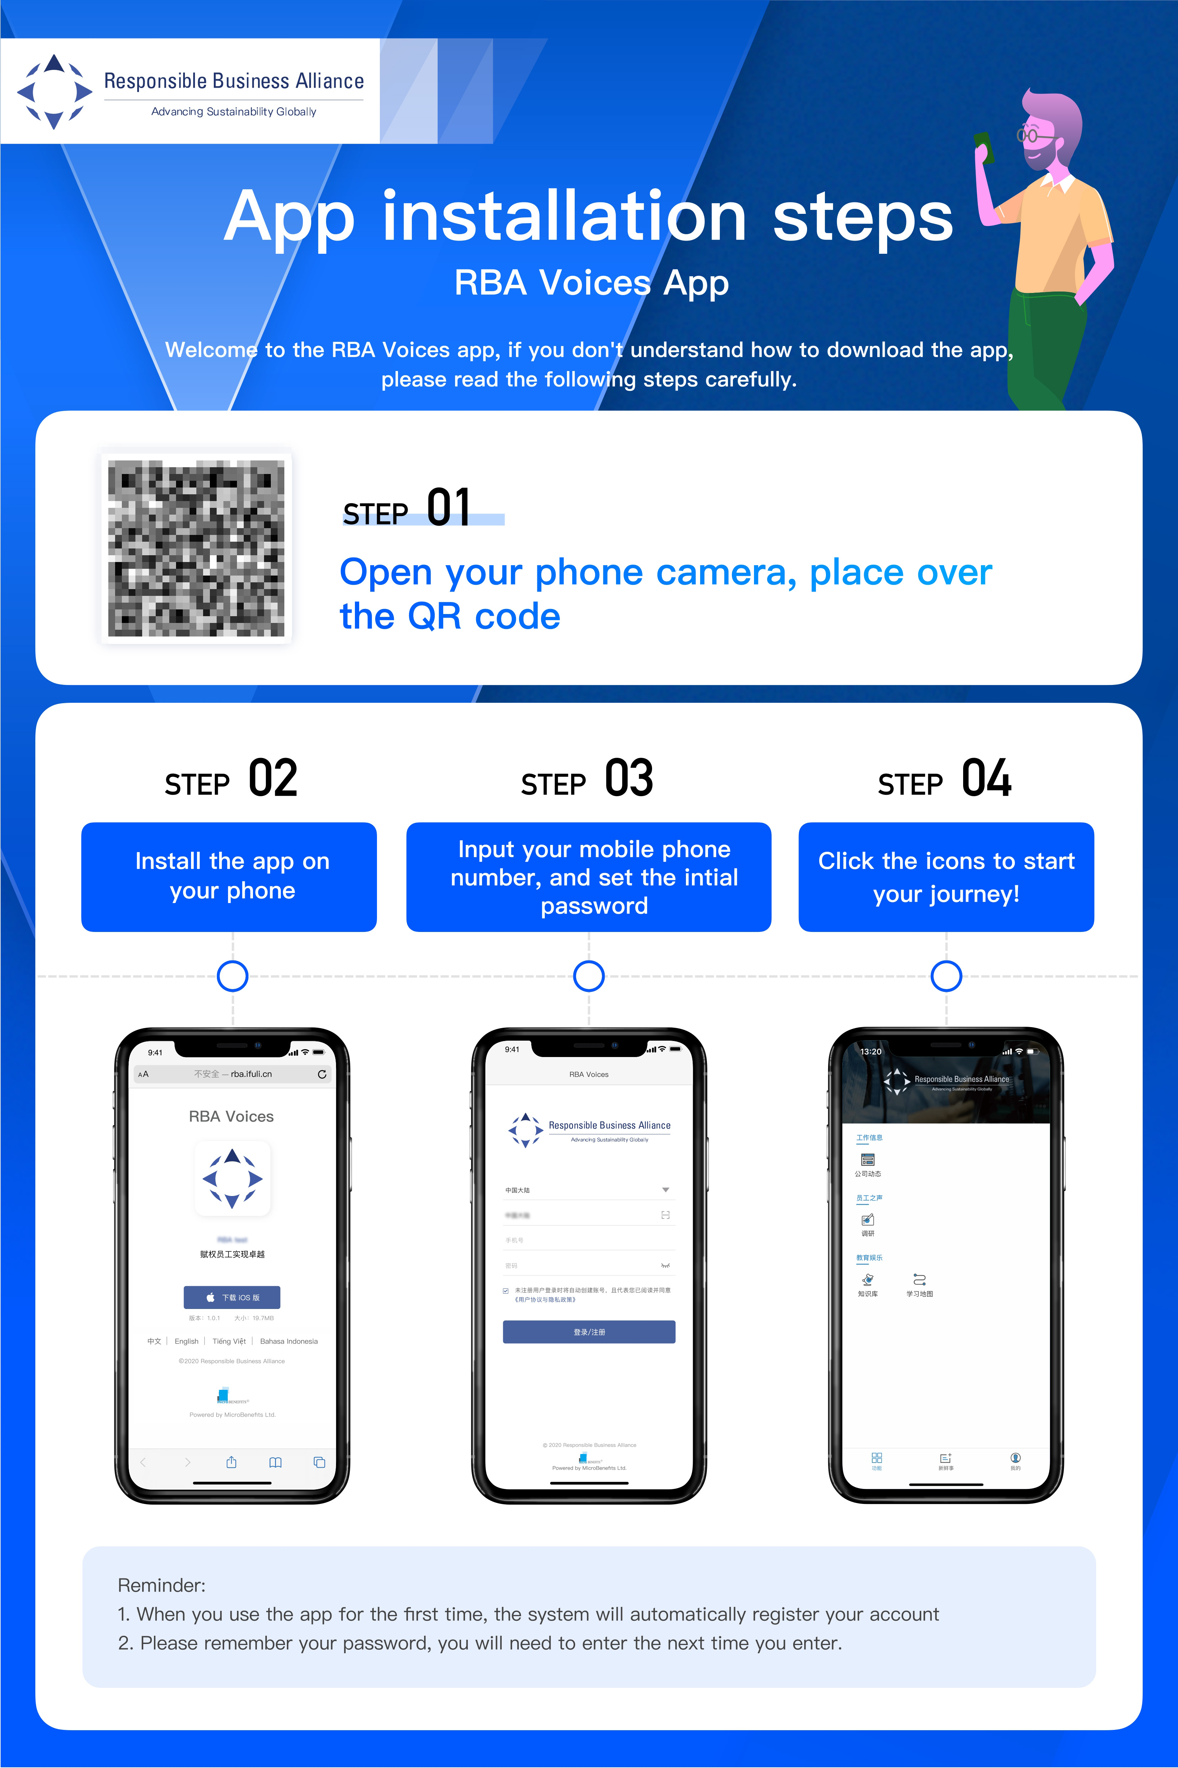
QR Code Poster Sample

Slide 5
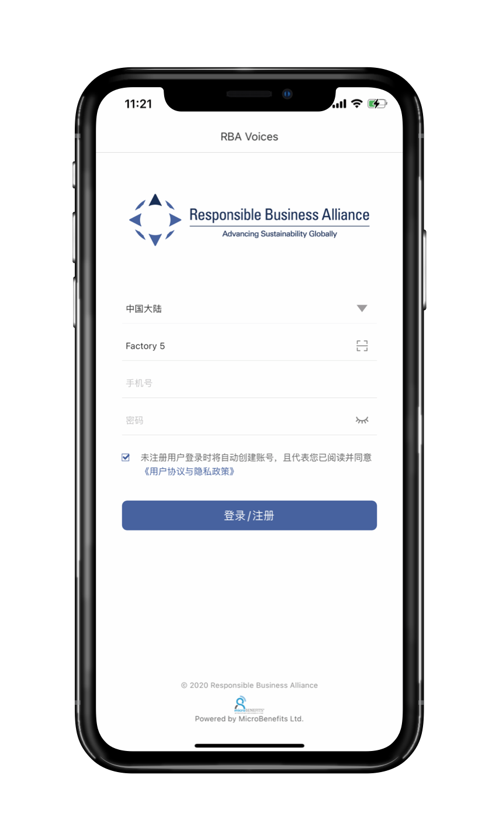
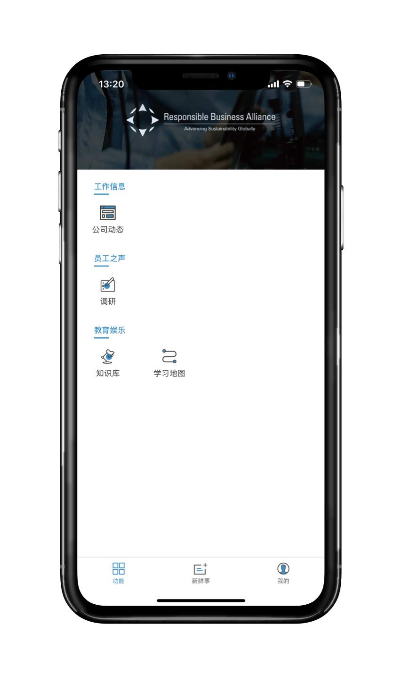
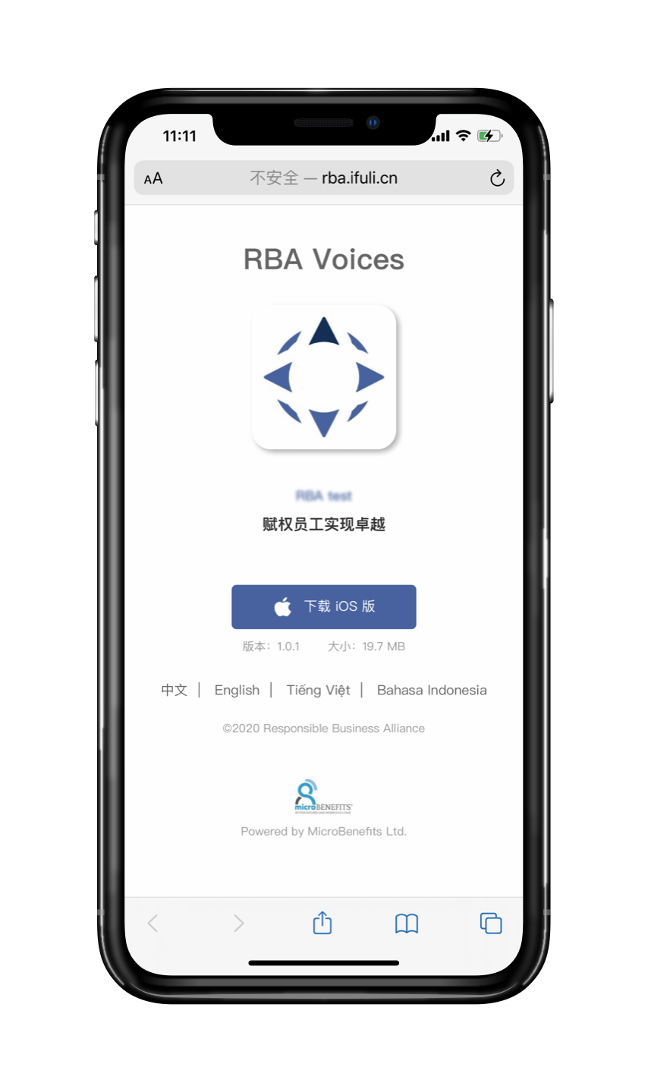
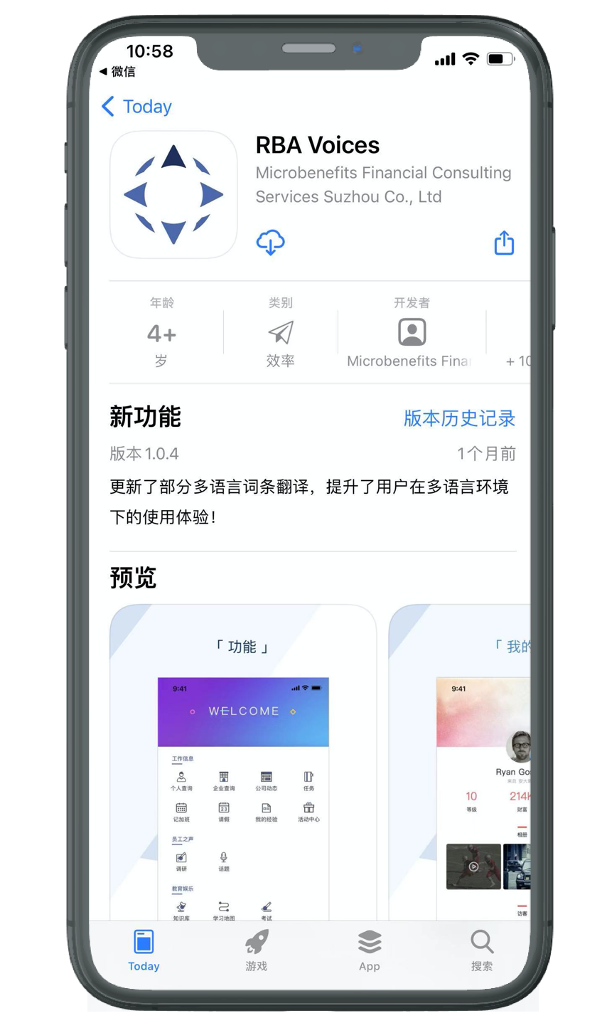
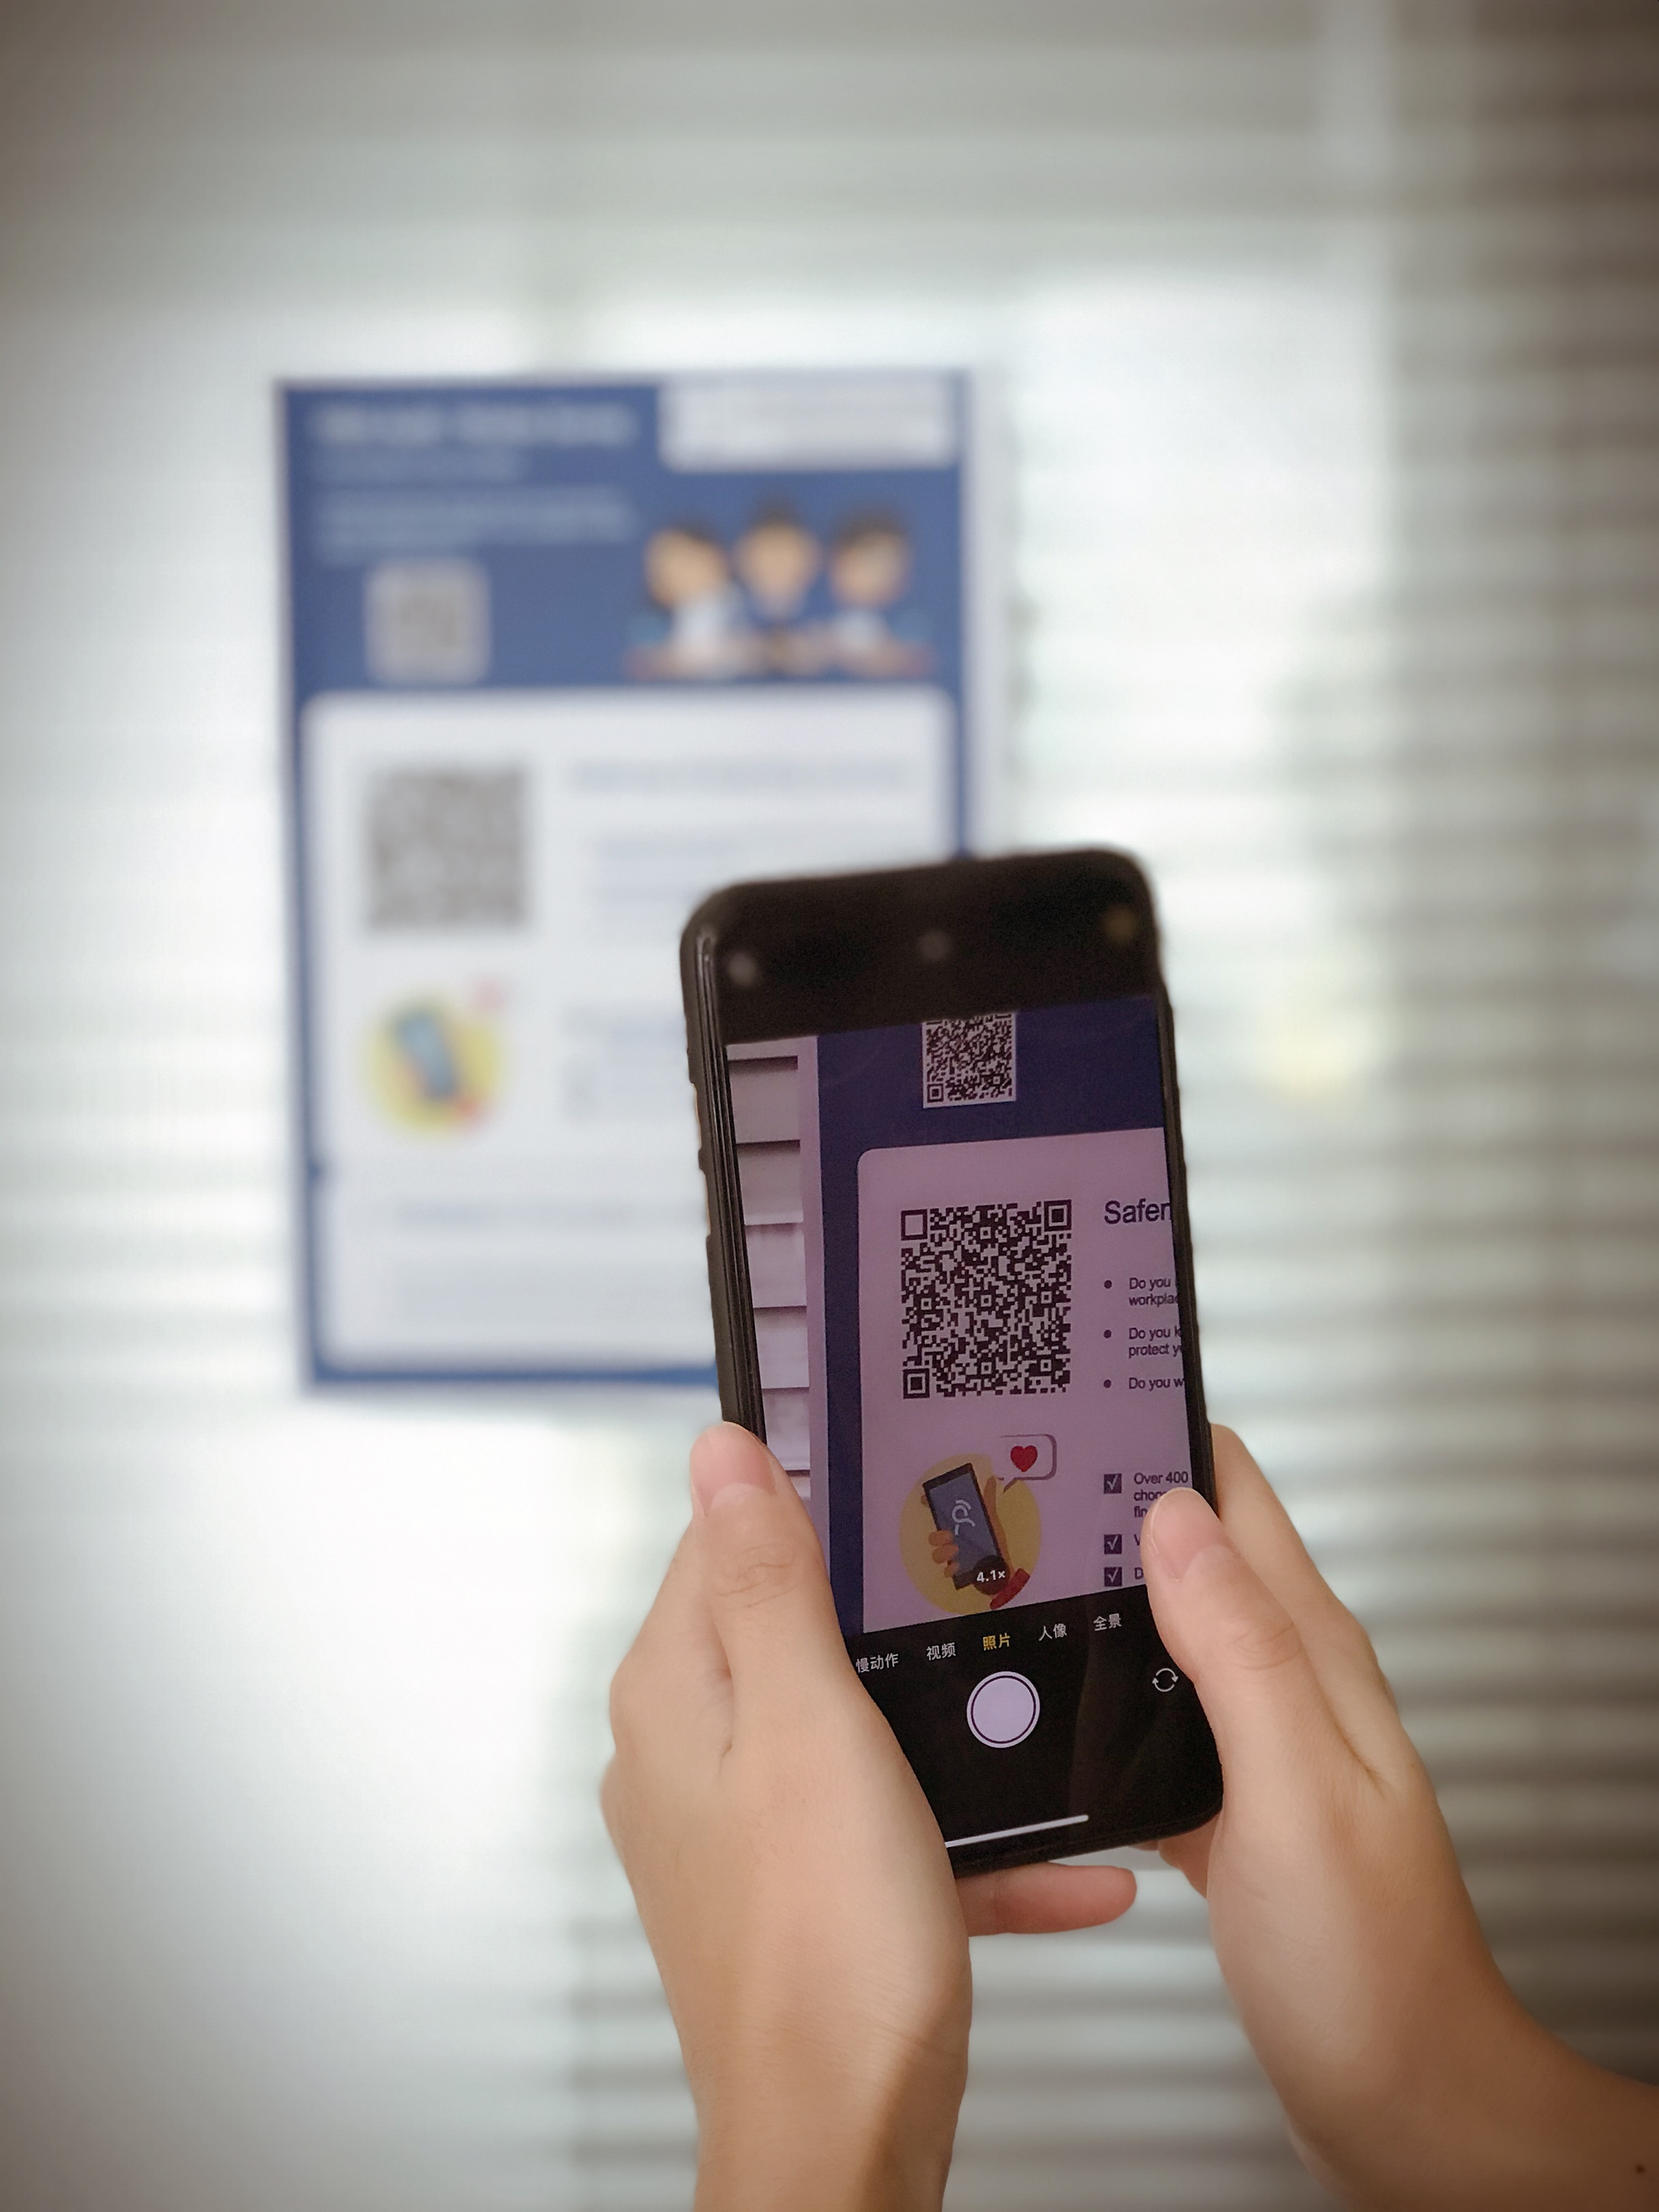
Factory: How to download RBA Voices app

Slide 6
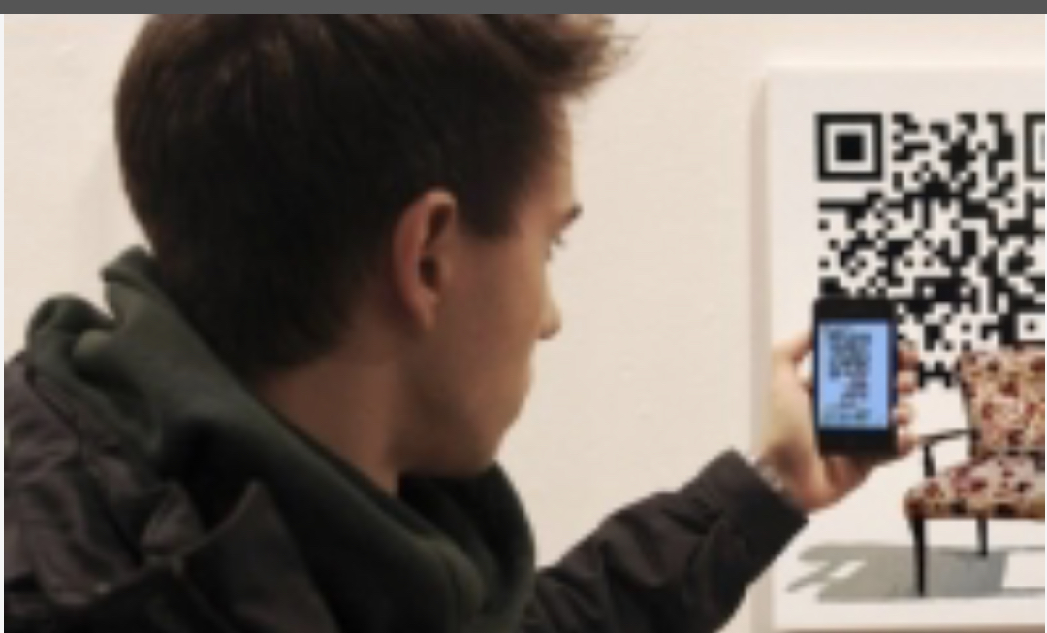
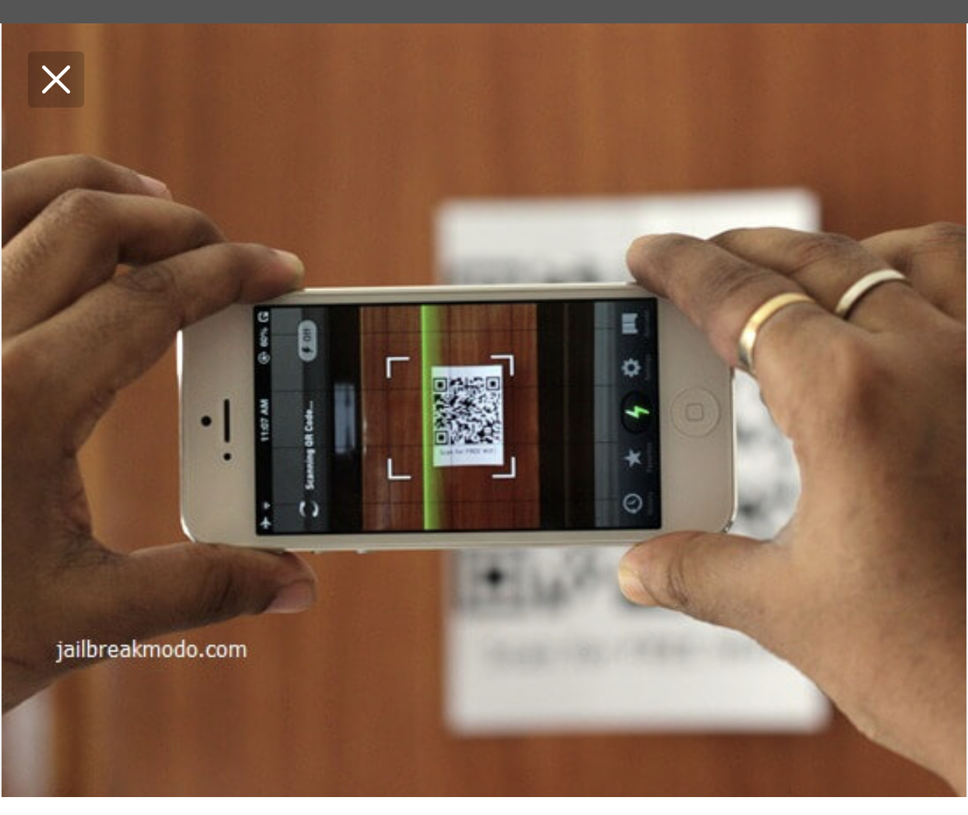
Suggestions: Open Camera, hold over QR code

Slide 7
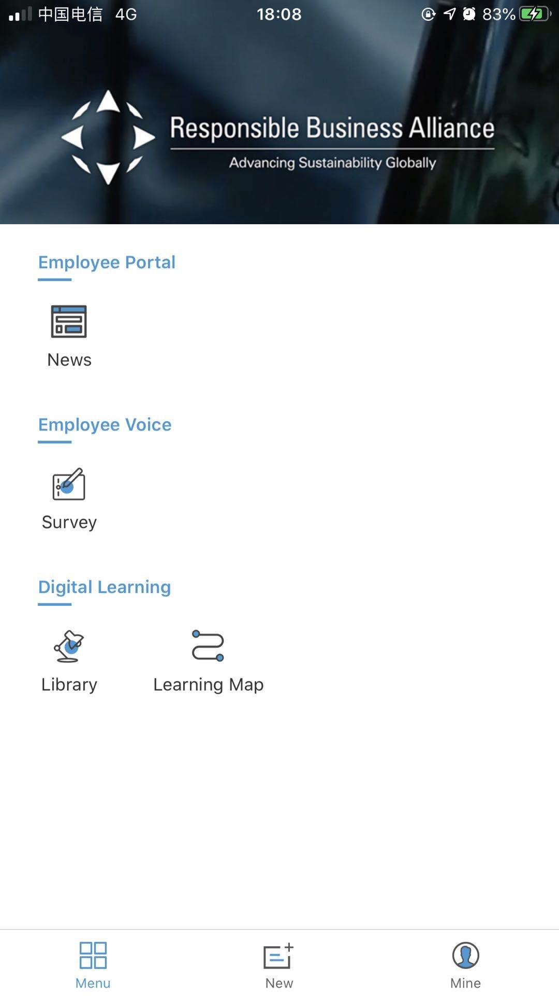
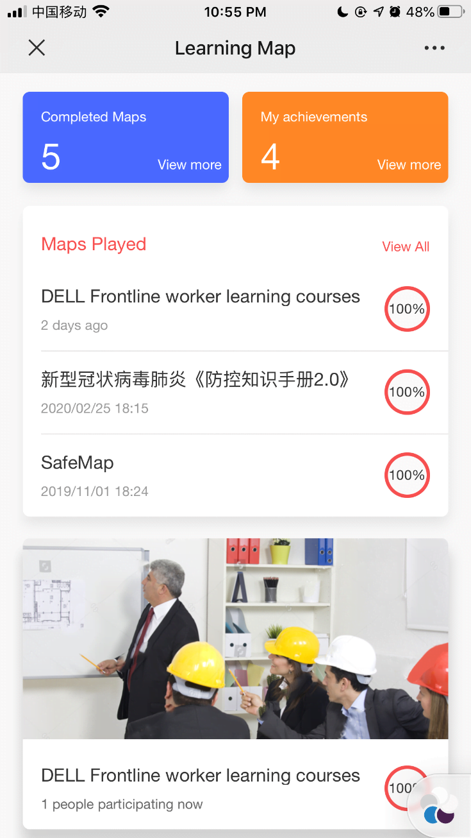
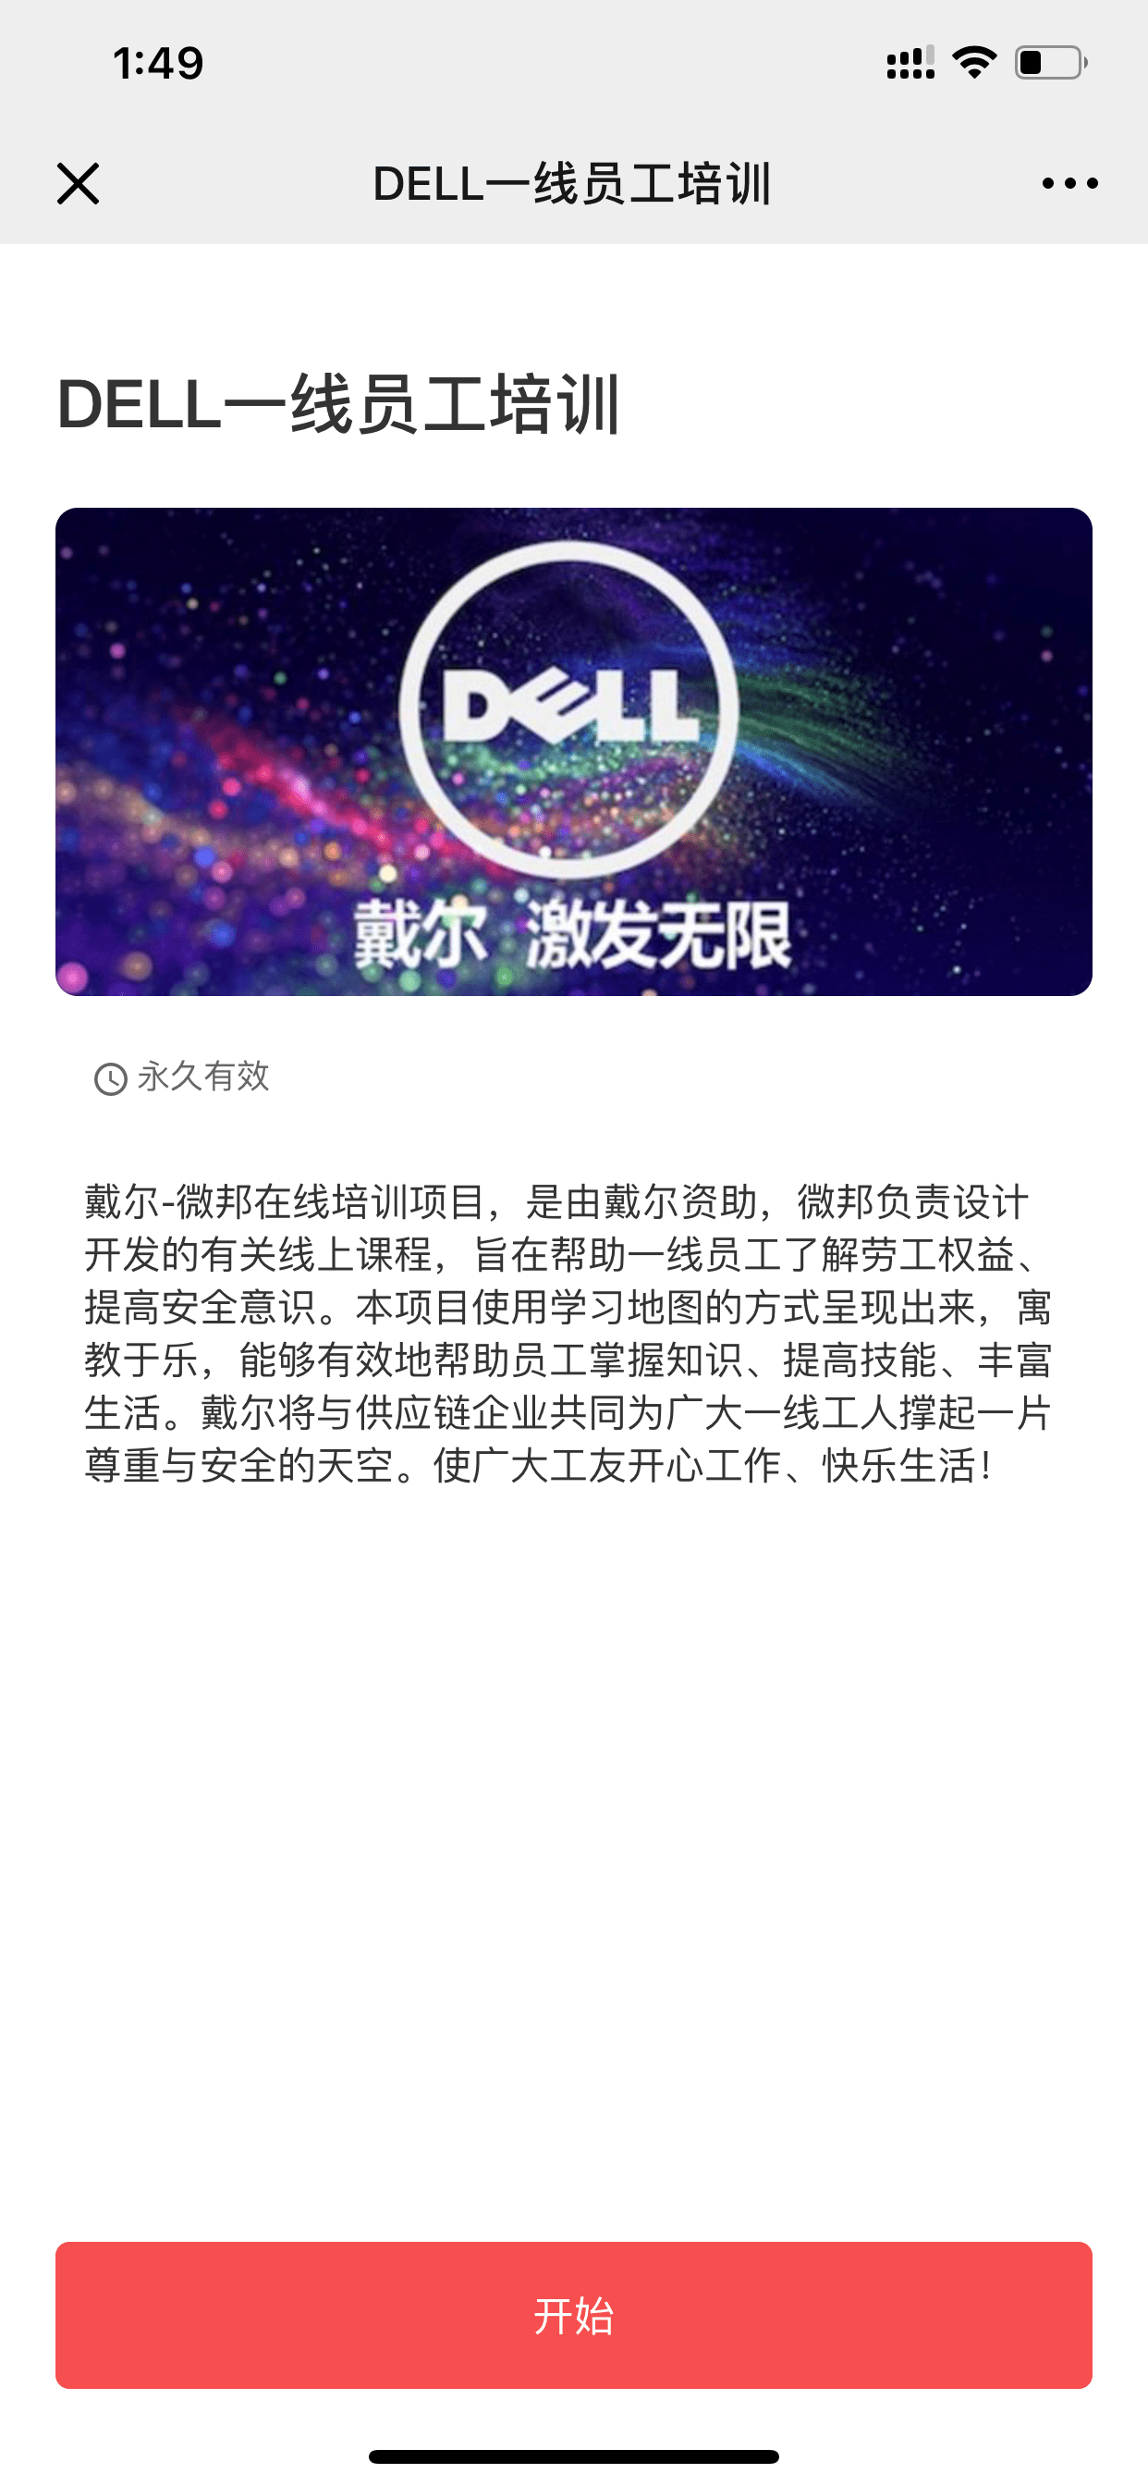

Suggestions: App Navigation
Individual Course learning
Start learning by clicking in each level icon
Click on the target map

Slide 8
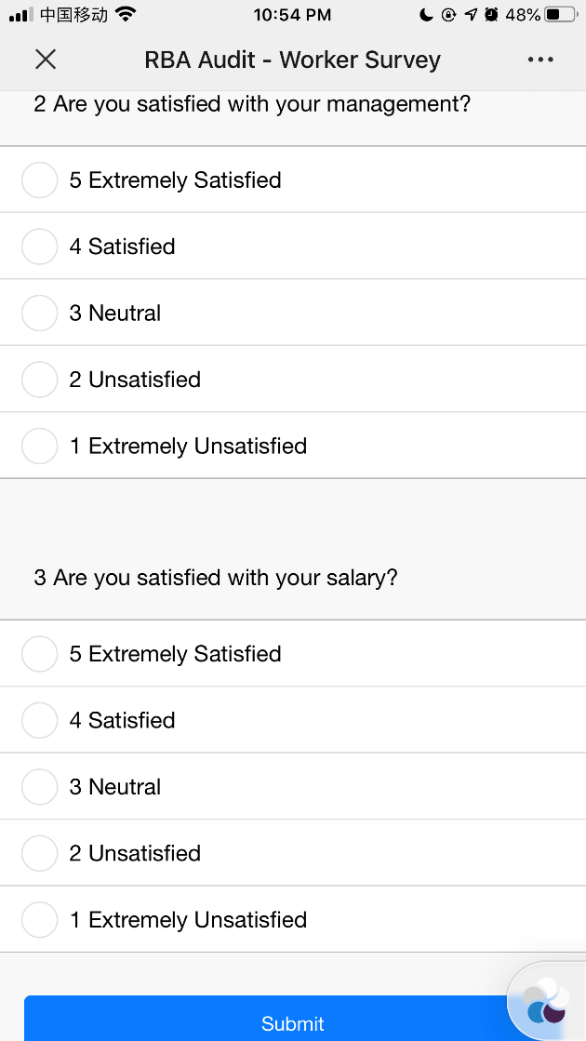
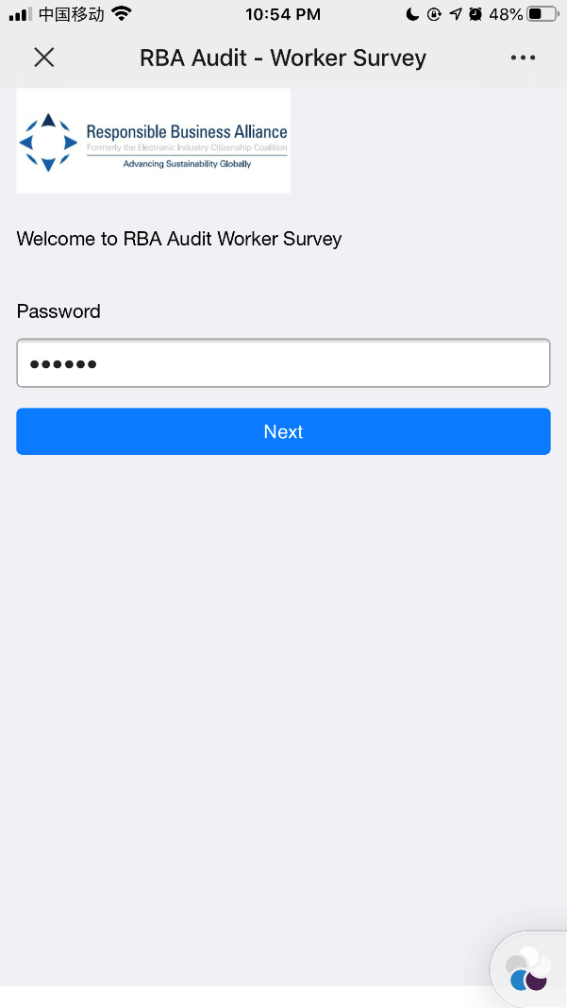
Suggestions: App Navigation
Front page Survey
Start survey by clicking in each level icon

Slide 9
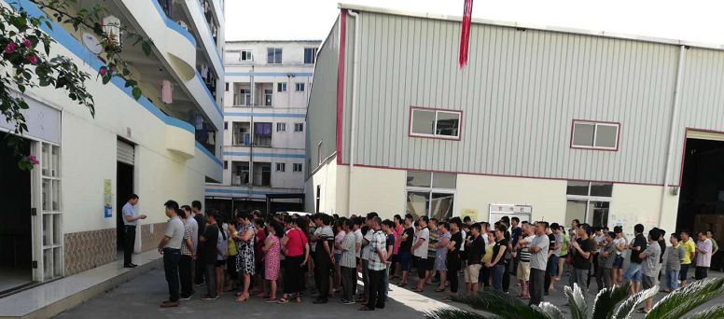

‘Promote’ to Line Leaders
Communicate with the team leader（Important）
Important reminder：
Identify values and goals to be achieved
Clear the operation method and answer questions on the spot
Value
How to Login
How to Learn
Introduce Survey
MicroBenefits
www.microbenefits.com

