Slide 1






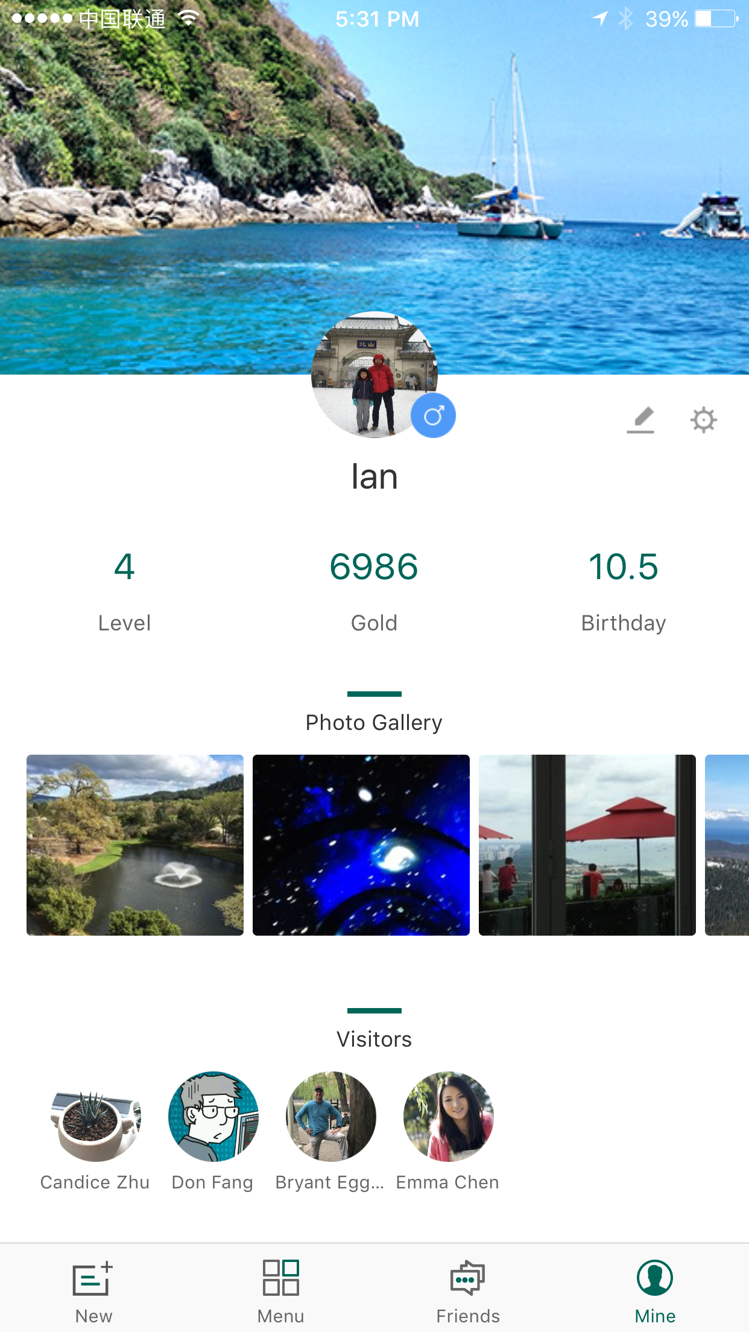
The Full RBA Voices App can increase worker engagement, reduces costs for suppliers, and give brands visibility into their supply chain
Greater Engagement
Increase frontline employee engagement through CIQ’s customized ’Friend Finder’ feature, ‘Grievance’ and ’Employee Voice' channels
Improved Productivity
Data docking processes enable reduced time spent on manual HR tasks. And, supported by our data tool, identifies potential engagement issues and opportunities
Increased Savings
Enjoy monthly savings of over $80K through decreased turnover rate¹ and savings of over $70K through office automation²
Enables Effective Capacity Building
Integrate CIQ’s 300+ gamified courses with pre-existing training materials, or use your own materials and templates to standardize and measure employee learning
Value-Added Services
Professional services, focus groups, automated reports, data analytics, and surveys, increase efficiencies and build employee communities
1.
2.
At an electronics factory with a workforce of ~4,000 employees Across five factories with a total workforce of ~40,000 employees
1

Slide 2
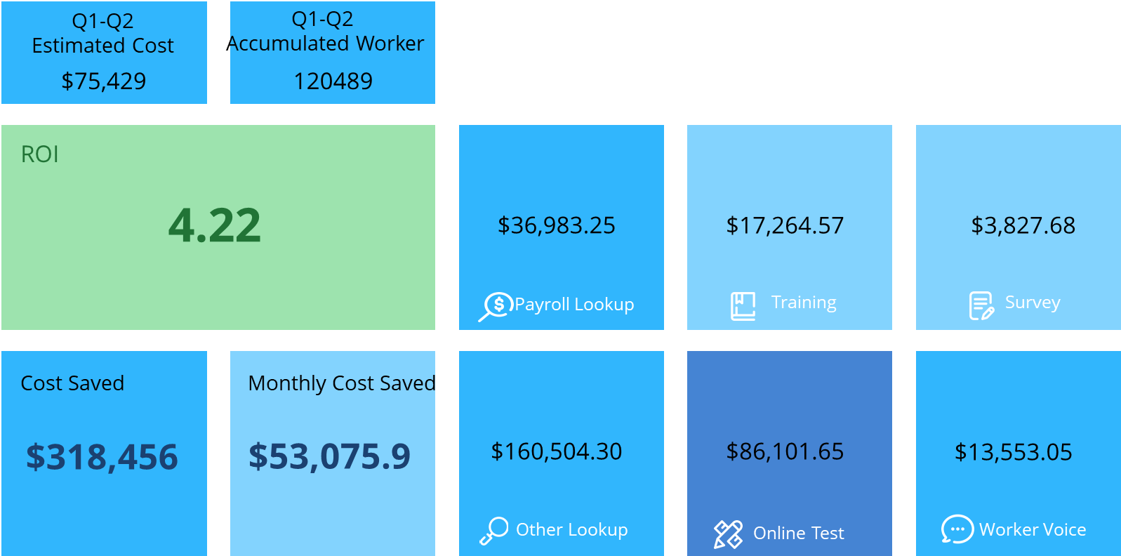
Customers Love Our Platform –
Generates a 4.2x ROI through better engagement and lower turnover
Cost-effective
Cost-efficient tools for conducting worker training
Cost-efficient tools to upgrade worker-management communication
Substantive cost-saving on various HR functions (e.g. pay slips)
Source: ROI case study from client Jabil QBR Report (2018)
2

Slide 3
Worker Learning Project - a large global manufacturer
* Data updated till May 31, 2020
76
100,520+
22153+
Participated factories
Completed all courses among
125,037 workers
Provided training hours
23,907
Completed annual survey among
12,522 targeted workers
963
Learning and impact stories collected from workers who joined learning
191 % Completion rate
768
Reward prizes distributed to motivate workers and improve their benefits

Slide 4
Dell Case Study

Slide 5





Employee Engagement Survey Project
Coverage of 47 factories across 5 regions
Multi-region coverage and support
Same questionnaire to ensure data consistency
Implemented via QR code questionnaire
RESPONSE BY REGION
5 Regions
 | Baseline |  | Endline
Total | 10078 | （% of Total) | 9279 | （% of Total)
China | 5450 | 51% | 4780 | 52%
Vietnam | 2115 | 20% | 1752 | 19%
India | 1632 | 15% | 1205 | 13%
Guatemala | 886 | 8% | 887 | 10%
Bangladesh | 695 | 6% | 655 | 7%
47
Factories
11,279 Responses
Note: Employee Engagement Program is a part RSAP program

Slide 6
Ethical Recruitment Survey
Objectives
Understand current recruitment practices in Chinese factories
Identify challenges and risks in the recruitment/job-seeking process
Use survey data to inform the development of training materials on responsible recruitment
China
Goal | Workers | Factories
Respondents Diversity | Age, education, working experience, geographic origin etc. | Size, location, industry, years in business etc.
X 5,000 X 100
Notes:
Understand the current recruitment practices in Chinese factories as well as challenges and risks;
Use survey data to inform the development of training materials on responsible recruitment for Chinese factories, which will be accessible for free to all ETI members.

Slide 7
Ethical Recruitment Survey
2 survey questionnaires
1 month deployment
5000+ workers from all over China
200+ Recruitment/HR managers
20+ manufacturing sub-industries
*Others including pharmaceutical, leather, plastic molding, art crafts, printing, ceramics, wooden furniture, accessories, chemical, baby products etc.

Slide 8

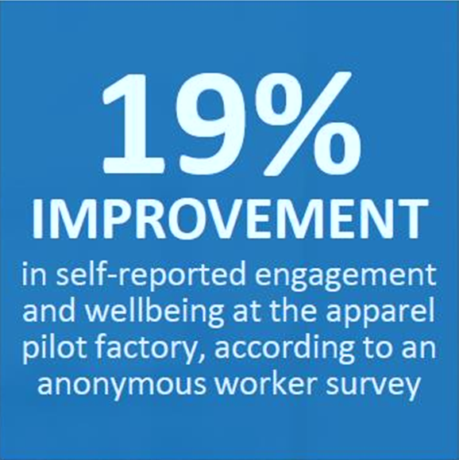
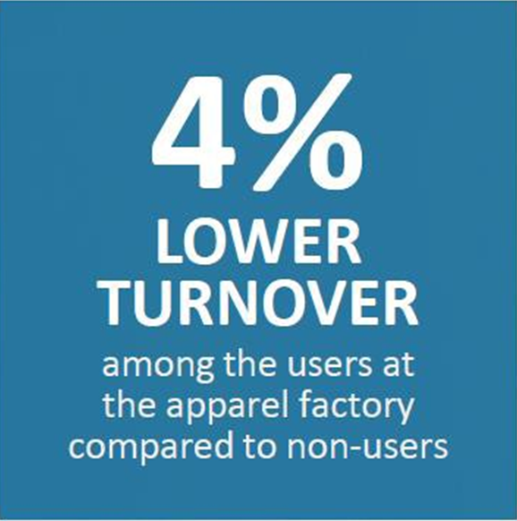
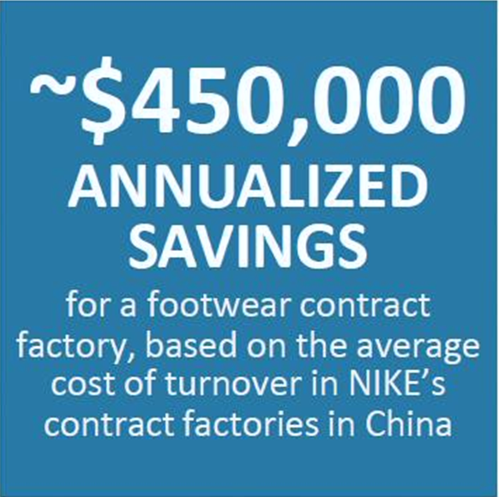
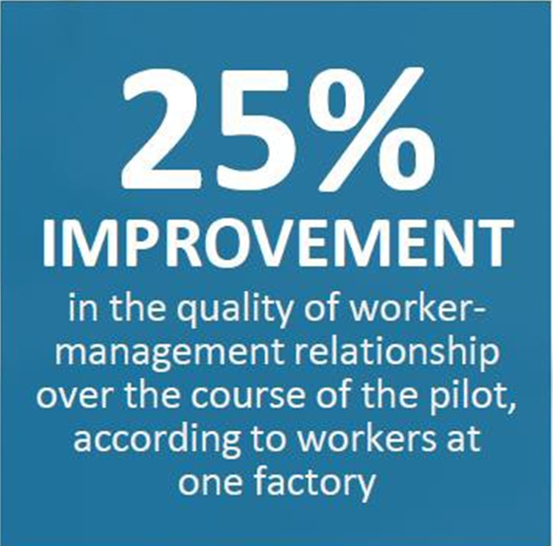
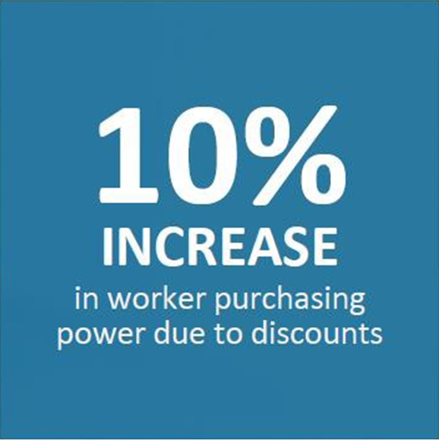

Case Study: Consumer brand realized $450,000 in annualized savings and 19% better employee well-being
Suppliers in China
NEW VENTURE PILOT SNAPSHOT RESULTS
Source: Nike, Inc. Sustainable Business Report 2014/2015
8

